Slide 1
Strategic Purchasing & Contracts Huron Assessment & Jaggaer Initiative
Administrative Leadership Group Meeting
John Luipold, VP Real Estate & Strategic Initiatives
December 17, 2020
Notes:
Title slide option 1

Slide 2
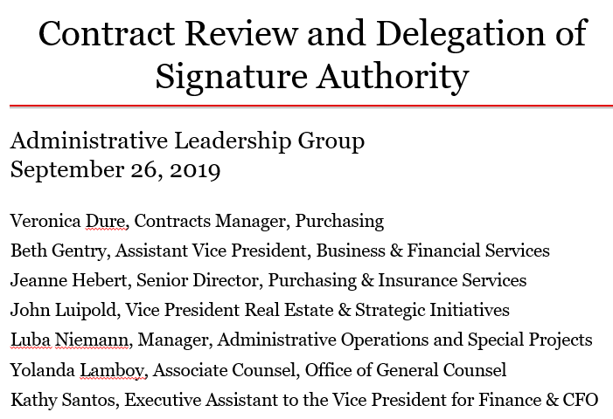
ALG 9.26.19
Notes:
Secondary; open circle bullets

Slide 3
Discussion Topics
What is Strategic Purchasing & Contracts?
Huron Assessment & Recommendations
Jaggaer Initiative
Notes:
Secondary; open circle bullets

Slide 4
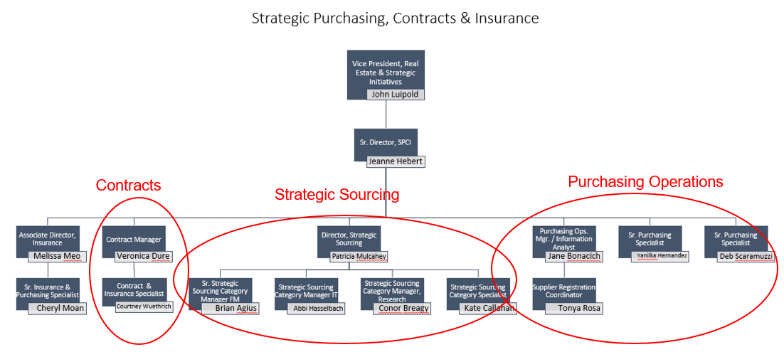
SPCI Organization
Notes:
Secondary; open circle bullets

Slide 5
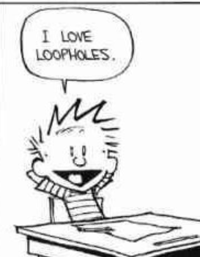
Purchasing Policies & Procedures
Except for COVID-19 supplies, departments make independent purchasing decisions subject to purchasing procedures, policies and department budgets.
A Purchase Order is required for the purchase of goods or services in excess of $3,000 (during Covid-19 this has been reduced to $1,000).
All purchases up to $25,000 require at least one written quote.
All purchases over $25,000 require at least at least 3 competitive quotes or - when 3 quotes can’t be obtained - a sole source justification.
Departments have access to the Brown University Purchasing Card (PCard), an authorized buying method for low-cost purchases of non-restricted commodities from non-restricted suppliers.
Notes:
Secondary; open circle bullets

Slide 6
Purchasing vs. Strategic Sourcing
Purchasing is the process of acquiring goods and services, typically in a non-strategic manner (e.g –unmanaged Pcard spending, one off transactions).
Strategic Sourcing is
an organized, collaborative, data-driven approach to making informed purchasing decisions that result in improved services and process efficiencies.
a structured process of analyzing and leveraging overall spend to negotiate competitive contracts and implement the most optimal solutions
aligning spending with a smaller number of preferred, qualified suppliers.
focused on the total cost of ownership, which is not necessarily the lowest purchase price.
a continuous process of information gathering, monitoring, and planning, as well as collaboration and relationship-management.
Notes:
Secondary; open circle bullets

Slide 7
Examples of Strategic Sourcing @ Brown
Negotiated Dining Services partnership agreement with Bon Appetit. Dining MSP contract renewal negotiation in August 2020 resulted in total additional savings of over $2M (over 6-yr term: $602K negotiated cost avoidance + Signing Bonus Revenue $1.5M)
Using Strategic Sourcing Category Managers, over $615K in savings and cost avoidance in one years' time via consolidation of significant spending within Facilities Management and Research & Scientific categories, through establishment of standardized competitively bid contracts
In support of EH&S, negotiated master service agreement w/vendor for hazardous waste disposal, achieving a 16% avg. discount on line item services.
Notes:
Secondary; open circle bullets

Slide 8
Example of a typical purchase process (pre-covid)
Under $3,000 purchase
Department uses Pcard to purchase allowable goods (from any supplier they choose); or
Department orders from a supplier, which invoices department
Good is received by Department
Department submits invoice to A/P for payment through Workday
Notes:
Secondary; open circle bullets

Slide 9
Example of a typical purchase process
Over $3,000 purchase
Department obtains quote(s) from supplier(s) to purchase good or service, or
Department may engage Strategic Sourcing team for support.
Simple order: Quote & Purchase Order creates contract
Complex order: contract (Professional Service Agreement or other form of contract) is negotiated & executed.
Purchasing Operations distributes Purchase Order to supplier
Good or service is received from supplier
Department submits invoice to A/P through Workday
Notes:
Secondary; open circle bullets

Slide 10
Challenges
Current purchasing policies are focused on de-centralized spending.
Purchasing decisions by departments are sometimes made without consideration of holistic University spending.
Over-reliance on sole sourcing for goods/services > $25,000.
Supplier choice often negates ability to bundle and leverage spend.
SPCI office is often involved after the purchase has been committed.
Pcard spending is often not managed and review is post-fact.
Contracts are often renewed without revisiting terms.
Departments often don’t use Brown’s preferred vendors (simple examples – water, coffee, office supplies).
Notes:
Secondary; open circle bullets

Slide 11
Huron Assessment Overview
Assessment on Strategic Purchasing & Contracts initiated with Huron Consulting Group (Jan. 2020)
Goals – Identify areas of operational improvement & assess savings & cost avoidance opportunities
Focus on 6 key areas
Organization
Process
Strategic Sourcing Initiatives
Policy
Technology
Travel
Notes:
Secondary; open circle bullets

Slide 12
Huron Assessment Key Findings
Strong vision within SPCI for what is possible.
Feedback has been positive around the addition of strategic sourcing managers for FM, IT, Research & Scientific
Strategic Sourcing efforts have yielded measurable benefits.
Campus groups do not always see the value of following policies, which are viewed more as a suggestion than a rule.
Campus perception of “constantly changing” policies leads to confusion and frustration.
Notes:
Secondary; open circle bullets

Slide 13
Huron Assessment Overview
SPCI lacks a 21st century technology Workday-integrated eProcurement marketplace & contract solution.
Key stakeholders such as BioMed, SoE, and others have concerns about inefficient, time consuming workflow processes within SPCI.
Contract process can be opaque, confusing and inefficient
No single contract database exists that offers visibility into the contract review process and status.
Volume of contracts is excessive for staffing and existing technology.
Notes:
Secondary; open circle bullets

Slide 14
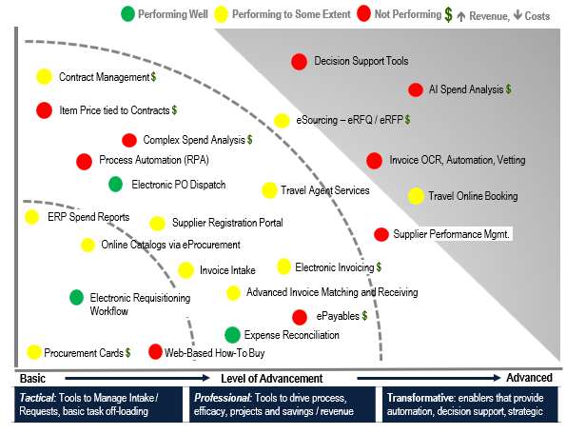
Existing Technology Capabilities
Q&A

Slide 15
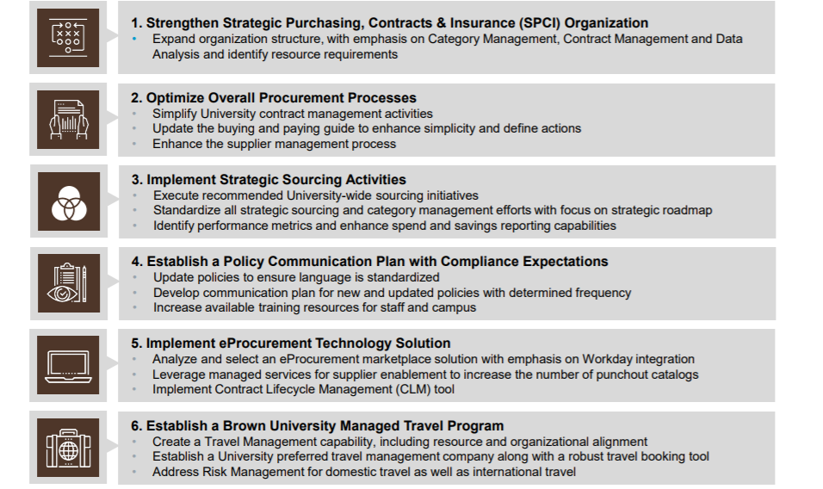
Huron Recommendations

Slide 16
Jaggaer Initiative
Huron’s recommendations establish a strategic framework for the University to optimize procurement & contracting. Over time, if successfully implemented and policies enforced, Huron projects potential annual savings and cost avoidance of $2.8M to $5.3M (based upon pre-COVID-19 expenditures).
Critical to the success of Huron’s recommended strategic framework is the implementation of Jaggaer’s enterprise software, which offers transformative solutions for eProcurement, contract life cycle management, research materials management, process flow, and data analysis.
The Jaggaer system is broadly used by more than 600 institutions around the country including: MIT, Harvard, Princeton, Yale, UPenn, NYU, Stanford, UChicago, Notre Dame, Johns Hopkins, Emory, Rice, and USC, over 70% of the top 25 research universities and 80% of the Carnegie higher research schools in the United States.

Slide 17
Jaggaer Initiative
Two Modules
Contract Life Cycle Management
Streamlined, transparent, and efficient contract management process.
End users engage more easily with the contract management team.
Centrally process & track all contracts for goods, services, and IT.
Coordinate & approve policies.
eProcurement
Focuses spend to suppliers with Brown Strategic Sourcing agreements to achieve long term savings.
Establishes an eMarketplace buying method with pre-negotiated pricing.
Reduces reliance on unmanaged P-Card transactions.
Simplified experience to shop for goods to an expanded user group.

Slide 18
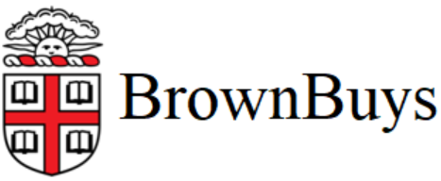
Jaggaer Initiative
Contract Life Cycle Management
SPCI
CIS
Workday
OGC
EVP F&A
Risk Management, Audit & Compliance
eProcurement
SPCI
CIS
Workday
EVP F&A
Controller’s Office

Slide 19
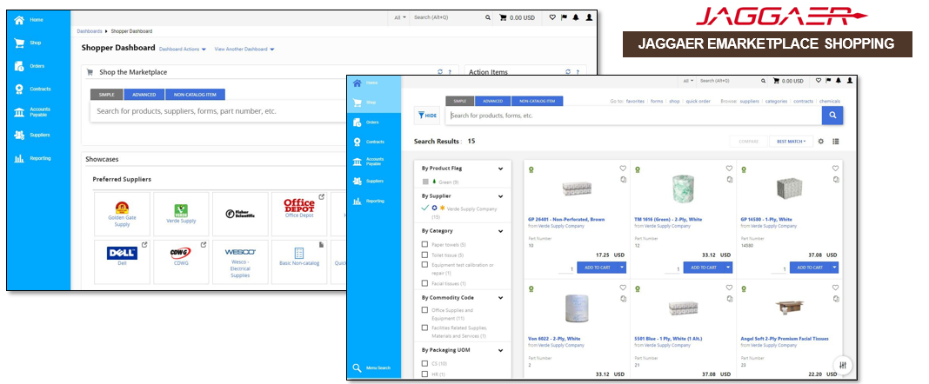
Jaggaer Initiative
E-Procurement: ~20 punchouts planned

Slide 20
Jaggaer & the Comprehensive Policy Review Project
What is the Comprehensive Policy Review Project?
A multi-year project, initiated by the President, to update and improve all University policies.
The goal is to ensure policies are easy to find, read and understand for all members of the community.
Jaggaer will be used to coordinate and approve University policies
It is a powerful document management system that will improve policy workflow for everyone.
Streamlines coordinating policies with stakeholders and senior leaders.
Optimizes version control and tracking of policy development.
Jaggaer will not be used for viewing approved University policies
All policies completed during the Comprehensive Policy Review Project will be displayed on a new fully searchable University Policy Website currently being developed.

Slide 21
Project Timeline

Slide 22
Critical Factors for Success
Actions we will take:
Focus groups with key stakeholders (ongoing)
University-wide training program (in development)
Updated policies for purchasing and contracts
Communication plan
Updated website

Slide 23
Critical Factors for Success
Support from Admin & Academic Units:
Focus group feedback
Participation in training
One or two individuals from each dept will be asked to be trained in the contract management system
Policy familiarity & compliance

Slide 24
Other Initiatives
Supplier Diversity Goals (DIAP Phase 2)
Increase utilization of MBE and WBE
Increase spending with MBE and WBE

Slide 25
Questions
People asking questions, lost in confusion, well I tell them there's no problem, only solutions.
John Lennon, Watching the Wheels

