Slide 1
BIDS Validation
How to BIDS-validate your data
Brown University Clinical Neuroimaging Research Core
Version Date 02/7/2023

Slide 2
What is the BIDS Validator?
The validator is a set of containerized Python scripts that checks whether your data is fully compliant with BIDS formatting guidelines.
See BIDS presentations 1&2 for more information
Prior to running you need to put your data in BIDS format (through heudiconv or manually) and the bids-validator will check that it was done correctly
Terminal output tells you if/where there are BIDS formatting errors

Slide 3
Why validate?
Confirm that your lab procedures are aligned with current best practices
Some analysis pipelines will not run if your data is not fully compliant (e.g. fMRIPrep, MRIQC)
Other programs continue to be developed using BIDS
Allows you to spot issues easily
Files located in the wrong folder
Files named incorrectly

Slide 4
How to run your data through the BIDS validator Singularity container on CCV

Slide 5
How to run bids-validator on CCV
Log into CCV, copy the highlighted grey script into a text file, name it bids_validator.sh
To run enter into your command line: bash bidsvalidator.sh
Defines variables
bids_directory changes based on where your data is located
Runs the singularity
Stays the same regardless of where your directory is located
#!/bin/bash
version=v1.10.0
bids_directory=/gpfs/data/<PI’s username>/<path/to/rawdata>
simg=/gpfs/data/bnc/simgs/bids/validator-${version}.sif
singularity exec -B ${bids_directory} ${simg} bids-validator ${bids_directory}
1
2

Slide 6
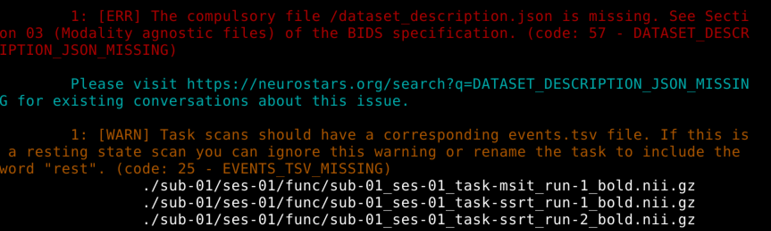
Errors
After running the validator if there is anything wrong with your BIDS format you will get an error message like the one below
Errors have to be corrected and the validator needs to be run again in order for the data to work with programs that require BIDS formatting
Warnings do not have to be fixed, but should be addressed at some point

Slide 7
How to BIDS-validate your data locally with docker

Slide 8
How to run bids-validator on docker
After installing docker, open a terminal window and type the code below:
In addition to the errors / warnings (see slide above), you will also receive a summary output:
docker run -ti --rm -v /path/to/data:/data:ro bids/validator /data
/path/to/data needs to be the path to your BIDS directory (‘rawdata’ directory)

Slide 9
Helpful Links
https://github.com/bids-standard/bids-validator
https://neuroimaging-core-docs.readthedocs.io/en/latest/pages/bids-validator.html#creating-a-bidsignore

