Slide 1
Diffusion Preprocessing
Brown University Clinical Neuroimaging Research Core
Version Date: 4/13/2023

Slide 2
What is Diffusion Weighted Imaging (DWI)?
Measures the motion of water molecules within a voxel of tissue
How water diffuses through brain tissue
Water moves differently through different types of brain matter
Term encompases multiple diffusion imaging techniques
Diffusion Tensor Imaging (DTI)
How water moves through white matter tracts
Notes:
https://radiopaedia.org/articles/diffusion-weighted-imaging-2?lang=us
https://www.ncbi.nlm.nih.gov/pmc/articles/PMC5039674/
https://www.mayfieldclinic.com/pe-fmri_dti.htm#:~:text=Diffusion%20Tensor%20Imaging%20(DTI)%20is,must%20be%20protected%20during%20surgery.

Slide 3
What impacts diffusion image quality?
Diffusion images are sensitive to non-zero off-resonance fields caused by the susceptibility distortions of the subjects head, eddy currents from switching of diffusion weighting gradients, and subject motion.
Susceptibility induced distortions
The FSL tool topup is used to estimate the susceptibility induced distortions
Eddy currents and movement
The FSL tool eddy is used to correct eddy currents and movement

Slide 4
Important Terms
b0 Image
A non-diffusion weighted image taken at the beginning of a dwi scan
Can also use SE Fieldmap images as b0 image
Total Read Out Time
Found in the acq_param file (and .json file)
The time between echoes in K space
Phase Encoding Direction
Data is collected in one direction (A→P) and to correct for distortion a second image is taken in the opposite direction (P→A)
A→P - Anterior to posterior
P→A - Posterior to anterior
Bval File
Has a number per volume which shows how large of a diffusion gradient was applied
Bvec File
Has triplet of numbers per volume showing what directions the gradients are in

Slide 5
TOPUP / EDDY Overview
TOPUP - estimates susceptibility induced distortions
Input:
File of images with different phase-encoding parameters
Merged AP/PA B0 images, EPI fieldmaps
Acquisition parameters file - describes how the B0/fieldmap volumes were acquired
First three columns specify phase encoding direction, last column is total readout time
Configuration file
Text file containing parameters that are specific for topup. FSL provides these files
Output:
File containing spline coefficients encoding the field (_fieldcoef.nii)
Movement parameters text file (_movpar.txt)
File estimating the field in Hz
EDDY - corrects for eddy current-induced distortions and subject movement
Input:
Diffusion image(s), bval & bvec files
If collected in multiple phase-encoding directions, merge files
Brain mask (created from 1st volume of topup output)
Topup output root filename
Additional files: acquisition parameters, index file
Describes how diffusion data was collected
Output:
Eddy-corrected image (.nii)

Slide 6
Steps in Pre-Processing
Create two b0 images in opposing phase-encoding directions (AP, PA).
These can be b0 images separately scanned, or extracted images from the first volume of the diffusion or SE fieldmap sequence using fslroi.
Combine the two b0 images together to create a two-volume, AP_PA_b0 image using fslmerge.
Create acquisition parameters text file that indicates the phase encoding direction and total readout time of the b0 images.
fsl topup
Output: corrected image and quality metrics for each diffusion sequence
Create files/variables needed for eddy:
Index, brain mask, merged diffusion files (if applicable), bvals and bvecs, etc.
fsl eddy & fsl eddyquad
Note: These steps may differ depending on your study’s diffusion acquisition

Slide 7
Data Organization
Data should be organized following BIDS convention:
/gpfs/data/<PIname>/<project>/sourcedata
/rawdata
/derivatives
/code
Create a folder within derivatives for the diffusion pre-processing: </gpfs/data/<PIname>/<project>/derivatives/dwiprepro>
If you need further guidance on BIDS, please refer to the BIDS website or to additional BIDS tutorials.
Raw unconverted data (e.g., DICOMs, E-Prime event logs). For archival purposes, not tested for BIDS compliance.
Minimally processed data e.g., converted files (.nii, .csv, etc.) and metadata files (.json sidecars) stored according to BIDS, tested for compliance.
Output from processing and analysis pipelines (e.g., preprocessing, fmri_univariate, eeg_model1). Not tested for compliance.
Code repository. All elements needed for independent replication from raw data. Where scripts are stored.

Slide 8
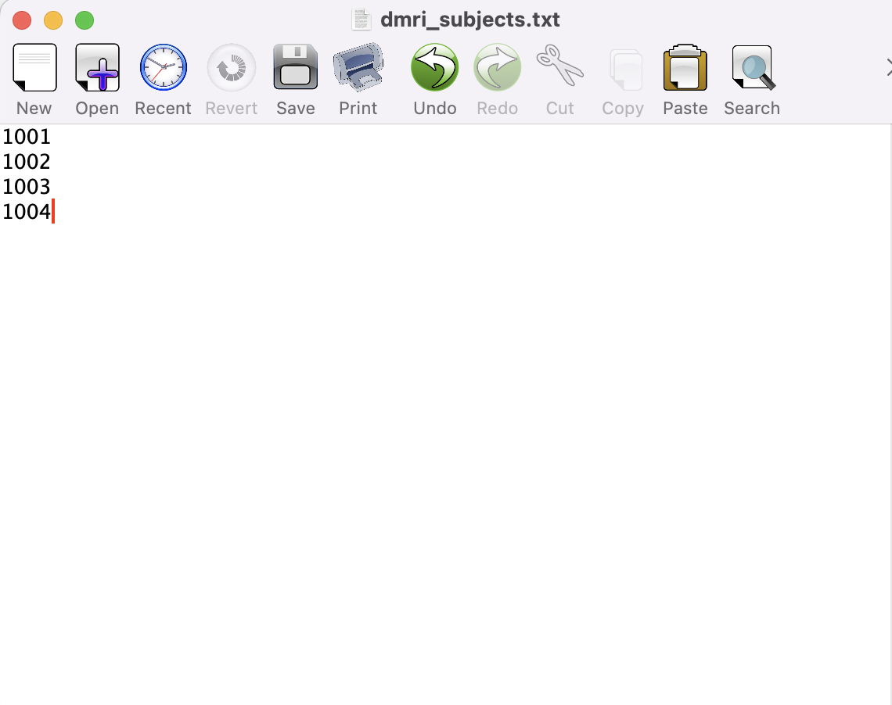
Subject Text File
Create a text file with subject IDs for the SLURM array to loop through.
Store the text file in your /code directory
The ID in the text file should be whatever follows sub-<ID> in the subject’s files.

Slide 9
Requesting Resources – SBATCH
This script is run using sbatch configuration. The first step is to request the appropriate SLURM resources to run the script.
Be sure to update the email address so you get updates about your script.
Note: This is an approximation of time.
If you have a large amount of diffusion runs, you may need to request more time.
#!/bin/bash
#SBATCH -N 1
#SBATCH -n 2
#SBATCH -p gpu --gres=gpu:1
#SBATCH --mem=40G
#SBATCH --time 10:00:00
#SBATCH -J dwi_prepro
#SBATCH --output /gpfs/scratch/%u/dwi_prepro-log%A_%a.txt
#SBATCH --mail-type=ALL
#SBATCH --mail-user=your_email_address@brown.edu
#SBATCH --array=1

Slide 10
Configure Modules
The next step is to configure FSL version 6.0.5.2 in your batch script environment.
###### CONFIGURE MODULES #######
module load fsl/6.0.5.2
module load cuda/10.3 cudnn/8.2.0
# This script is built on FSL and is adapted from the HCP-A processing scripts and assumes BIDS organization.
# It can be run on dwi collected on a sphere and requires a merged file of b0 images for eddy correction.
# This preprocessing approach is not appropriate for grid dwi acquisitions.

Slide 11
Manual User Input
### - IMPORTANT MANUAL USER INPUT - ###
# The topup function needs an acquisition parameters text file describing your spin echo field maps (e.g. b0_AP and b0_PA).
# Examples can be found at: https://fsl.fmrib.ox.ac.uk/fsl/fslwiki/topup/TopupUsersGuide#A--datain
# The first three numbers in each row describe how image was phase encoded (x-, y-, z-dimensions; 'blip up, blip down')).
# The last number describe the read-out time, in milliseconds.
# Extract this from the TotalReadOutTime field of the b0 .json file.
# You should have one row for each volume in your merged file.
readout_AP=0.0334748
readout_PA=0.0345046
Next, find and enter the TotalReadOutTime from your b0_AP and b0_PA images.
The b0 images will be images with a b-value of 0. Sometimes these will be separate b0 sequences or spin echo fieldmaps (SE fieldmaps).
If you do not have separate b0 images or SE fieldmaps, you can create a b0 image by using the first volume of your diffusion data as the first volume will have a b-value of 0.
(< fslroi diffusionscan_AP_dwi.nii.gz AP_b0.nii.gz 0 1 >)
The TotalReadOutTime can be found in the JSON file of each b0 image.

Slide 12
Define Variables and Paths
Next, you are going to define variables, paths, and create text files.
We will process subjects in a SLURM array, setting the task id to the variable subjects.
Fill in shells with shells collected (e.g. 1000, 2500, b1500) - match the BIDS naming convention of your scans
(e.g. sub-##_ses-##_acq-b1500_dir-ap_dwi.nii.gz).
### - Define variables and paths - ###
ses=01
codedir=/gpfs/data/jbarredo/diffusion/code #path to code directory
rawdir=/gpfs/data/jbarredo/diffusion/rawdata #path to rawdata directory
derivdir=/gpfs/data/jbarredo/diffusion/derivatives #path to derivatives directory
outdir=$derivdir/dwi_prepro #path to dmri directory
subjects="`sed -n ${SLURM_ARRAY_TASK_ID}p dmri_subjects.txt`"
shells=(b1500) #array for shells (1000 2000)

Slide 13
Initiate Subject Loop & Create Relevant Files
This part of the script will first initiate the subject loop and create relevant files needed to run TOPUP.
The red arrows point to where you will need to change the paths/file names in the script to match your study-specific paths/file names.
for s in $subjects #loop through subjects array
do
rawdata=${rawdir}/sub-${s}/ses-${ses}
mkdir ${outdir}/sub-${s}
mkdir ${outdir}/sub-${s}/ses-${ses}
suboutdir=${outdir}/sub-${s}/ses-${ses}
### Prepare files needed for topup ###
### Topup is not shell-dependent so it can be run in the subject loop to speed up processing ###
## PATH TO FIELDMAP/B0 FILES ##
fieldmapfile_AP=${rawdata}/fmap/sub-${s}_ses-${ses}_acq-diffSE_dir-ap_epi.nii.gz
fieldmapfile_PA=${rawdata}/fmap/sub-${s}_ses-${ses}_acq-diffSE_dir-pa_epi.nii.gz
## Create acquisition parameter and other files ##
# Merge fieldmap/b0 files using < fslmerge -t outputfilename fieldmapfile_AP fieldmapfile_PA >
fslmerge -t ${suboutdir}/AP_PA_b0 $fieldmapfile_AP $fieldmapfile_PA
## create acq_params text file for AP_PA_b0 file
## This acq_params file is used during topup
## This file should have a line for each volume in AP_PA_b0 but with respect to phase encoding direction and readout time.
## the acq_params text file is the same for each participant - so we will place it in the outdir
If [ ! -f “${outdir}/acq_params.txt” ]; then
echo “..................................................”
echo “Creating acq_params text file for topup”
echo “.................................................”
touch ${outdir}/acq_params.txt
# number of volumes in fieldmap_AP
ap_vols=$(fslinfo $fieldmapfile_AP | grep -m 1 dim4 | awk '{print $2}')
pa_vols=$(fslinfo $fieldmapfile_PA | grep -m 1 dim4 | awk '{print $2}')
for ((i=0; i<$ap_vols; i++)); do echo 0 1 0 ${readout_AP} >> ${outdir}/acq_params.txt; done
for ((i=0; i<$pa_vols; i++)); do echo 0 -1 0 ${readout_PA} >> ${outdir}/acq_params.txt; done
else
echo “..............................................”
echo “ acq_params text file for topup already exists!”
echo “...............................................”
fi

Slide 14
Run TOPUP
########################### TOPUP #####################################
## Change into subject's directory in output dir ##
cd $suboutdir
# Run topup
# Output is AP_PA_topup_fieldcoef.nii.gz & AP_PA_topup_movpar.txt - files are only for subject/session not for each diffusion shell
# fieldcoef are the inhomogeneity estimations # create additional output for brain mask
echo “..............................................”
echo “Running topup!”
echo “...............................................”
topup --imain=AP_PA_b0.nii.gz --datain=${suboutdir}/acq_params.txt --config=b02b0.cnf --out=sub-${s}_ses-${ses}_AP_PA_topup --fout=sub-${s}_ses-${ses}_AP_PA_topup_HZ --iout=sub-${s}_ses-${ses}_acq-${shell}_topup_image
echo “..............................................”
echo “topup has completed for sub-$s””
echo “...............................................”
# Create a brain mask based on the first image from each topup -iout outup
echo "................................................................"
echo "Creating brain mask for sub-$s"
echo "................................................................"
fslroi sub-${s}_ses-${ses}_topup_image.nii.gz sub-${s}_ses-${ses}_firstvol.nii.gz 0 1
bet sub-${s}_ses-${ses}_firstvol.nii.gz sub-${s}_ses-${ses}_brain.nii.gz -m -f 0.2
Run TOPUP.
TOPUP will create files needed for EDDY.
Additionally, create a brainmask needed for EDDY.

Slide 15
Initiate Shell Loop
This part of the script will first initiate the shell loop and set variables needed for EDDY and EDDYQAUD.
The red arrows point to where you will need to change the paths/file names in the script to match your study-specific paths/file names.
### - Start shell loop - ###
for shell in "${shells[@]}"
do
echo "............................................................"
echo "Defining variables for sub-${s} and ${shell} needed for eddy"
echo "............................................................"
## PATH TO DIFFUSION FILES ##
diff_AP=${rawdata}/dwi/sub-${s}_ses-${ses}_acq-${shell}_dir-ap_dwi.nii.gz
diff_PA=${rawdata}/dwi/sub-${s}_ses-${ses}_acq-${shell}_dir-pa_dwi.nii.gz
# path to a json file - eddy will extract the slice times from the json file. Only one json file is needed so either ap/pa will work #
diff_json=${rawdata}/dwi/sub-${s}_ses-${ses}_acq-${shell}_dir-ap_dwi.json
## Set bvecs and bvals variables ##
bvecs_AP=${rawdata}/dwi/sub-${s}_ses-${ses}_acq-${shell}_dir-ap_dwi.bvec
bvals_AP=${rawdata}/dwi/sub-${s}_ses-${ses}_acq-${shell}_dir-ap_dwi.bval
bvecs_PA=${rawdata}/dwi/sub-${s}_ses-${ses}_acq-${shell}_dir-pa_dwi.bvec
bvals_PA=${rawdata}/dwi/sub-${s}_ses-${ses}_acq-${shell}_dir-pa_dwi.bval

Slide 16
Prepare Files for EDDY
if [ ! -f "${outdir}/${shell}_acq_params.txt" ]; then
echo "..............................................."
echo "Creating ${shell}_acq_params text file for eddy"
echo "..............................................."
## Create acq_params file - only needs to be two lines for eddy ##
touch ${outdir}/${shell}_acq_params.txt
echo 0 1 0 ${readout_AP} > ${outdir}/${shell}_acq_params.txt
echo 0 -1 0 ${readout_PA} >> ${outdir}/${shell}_acq_params.txt
else
echo "............................................"
echo "${shell}_acq_params text file already exists!"
echo "............................................"
fi
if [ ! -f "${outdir}/${shell}_index.txt" ]; then
echo "..............................................."
echo "Creating ${shell}_index text file for eddy"
echo "..............................................."
## Number of volumes in each diffusion scan ##
volumes_AP=$(fslinfo $diff_AP | grep -m 1 dim4 | awk '{print $2}')
volumes_PA=$(fslinfo $diff_PA | grep -m 1 dim4 | awk '{print $2}')
# Write the index file of the diffusion - needs to be a ROW
for i in $(eval echo "{1..$volumes_AP}"); do echo "1" >> ${outdir}/${shell}_column.txt; done
for i in $(eval echo "{1..$volumes_PA}"); do echo "2" >> ${outdir}/${shell}_column.txt; done
echo $(cat ${outdir}/${shell}_column.txt) | sed '/^$/d' > ${outdir}/${shell}_index.txt
else
echo "............................................"
echo "${shell}_index text file already exists!"
echo "............................................"
fi
echo "................................................................"
echo "Merging AP and PA diffusion, bvec, and bvals for sub-${s} ${shell}"
echo "................................................................"
# Merge AP and PA diffusion files #
fslmerge -t ${suboutdir}/sub-${s}_ses-${ses}_acq-${shell}_combined_dwi $diff_AP $diff_PA
# Combine AP and PA bvecs and bvals files #
paste $bvecs_AP $bvecs_PA > ${suboutdir}/bvecs_acq-${shell}.bvec
paste $bvals_AP $bvals_PA > ${suboutdir}/bvals_acq-${shell}.bval
# For eddy options and directions for formatting sliceinfo.txt see:
# https://fsl.fmrib.ox.ac.uk/fsl/fslwiki/eddy/UsersGuide#A--index
To run EDDY, you will merge the AP and PA diffusion files for each shell (e.g. 1500_AP and 1500_PA merged into 1500_dwi). You will also merge the bvecs and bvals files.
The acquisition parameters file is used to inform EDDY what direction the distortion are likely to go in. Each row has 3 values that specify the phase-encoding axis (e.g. AP = 0 1 0 and PA = 0 -1 0), and the 4th value is the total readout time defined earlier in the script.
The index.txt file specifies the relationship between the images in --imain (diffusion files) and the information in --acqp (acquisition parameters file).
The index file is a single row of 1s or 2s for each volume in each diffusion file input into EDDY. Volumes will have an index of 1 if they were collected in the AP direction (and therefore correspond to the first line of the acquisition parameters file), and volumes collected in the PA direction will have an index of 2.
For more information, see: https://fsl.fmrib.ox.ac.uk/fsl/fslwiki/eddy/UsersGuide#A--index

Slide 17
EDDY
echo "................................................................"
echo "Running eddy for sub-${s} ${shell}"
echo "................................................................"
eddy_cuda10.2 --imain=${suboutdir}/sub-${s}_ses-${ses}_acq-${shell}_combined_dwi.nii.gz \
--mask=sub-${s}_ses-${ses}_brain_mask.nii.gz \
--index=${outdir}/${shell}_index.txt \
--acqp=${outdir}/${shell}_acq_params.txt \
--bvecs=${suboutdir}/bvecs_acq-${shell}.bvec \
--bvals=${suboutdir}/bvals_acq-${shell}.bval \
--fwhm=2,1,0,0,0 \
--topup=sub-${s}_ses-${ses}_AP_PA_topup \
--out=sub-${s}_ses-${ses}_acq-${shell}_eddycorrected \
--repol \
--mporder=6 \
--json=$diff_json \
--estimate_move_by_susceptibility \
--verbose
echo "................................................................"
echo "Eddy has completed for sub-${s} ${shell}"
echo "................................................................"
echo "................................................................"
echo "Running eddy QA for sub-${s} ${shell}"
echo "................................................................"
eddy_quad sub-${s}_ses-${ses}_acq-${shell}_eddycorrected \
-idx ${outdir}/${shell}_index.txt \
-par ${outdir}/${shell}_acq_params.txt \
-m ${suboutdir}/sub-${s}_ses-${ses}_brain_mask.nii.gz \
-b ${suboutdir}/bvals_acq-${shell}.bval \
-f sub-${s}_ses-${ses}_AP_PA_topup_HZ \
-o ${suboutdir}/sub-${s}_ses-${ses}_acq-${shell}_eddy_qc \
-v
echo "................................................................"
echo "Processing complete for sub-${s} ${shell}"
echo "................................................................"
done
echo "................................................................"
echo "Diffusion pre-processing complete for sub-${s}"
echo "................................................................"
done
Run EDDY and EDDY_QUAD, which will generate a single subject quality assessment report.

Slide 18
Checking Outputs in DSI Studio

Slide 19
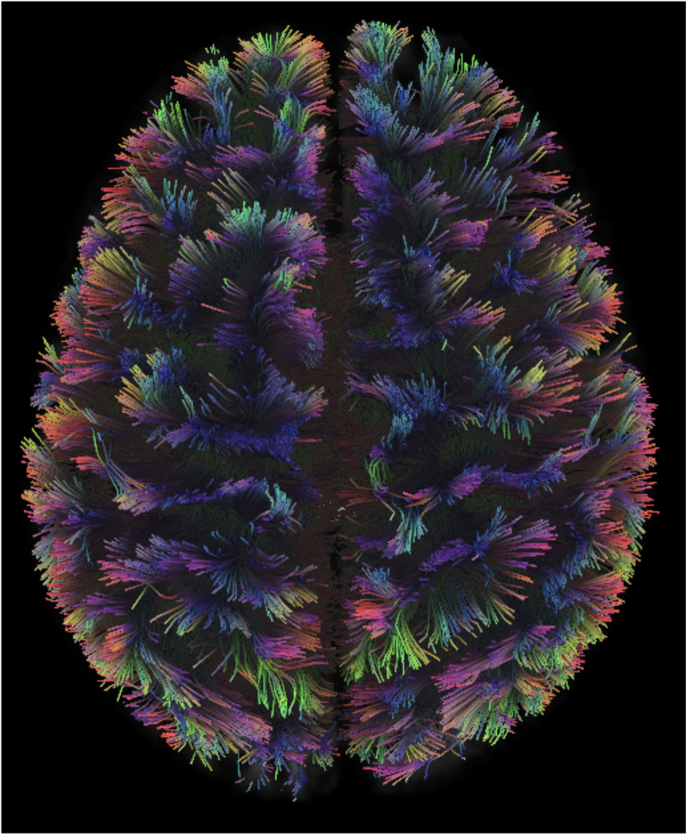
What is DSI Studio?
A tractography software tool used to visualize diffusion weighted imaging
Maps brain connections – in this case fiber tracking

Slide 20
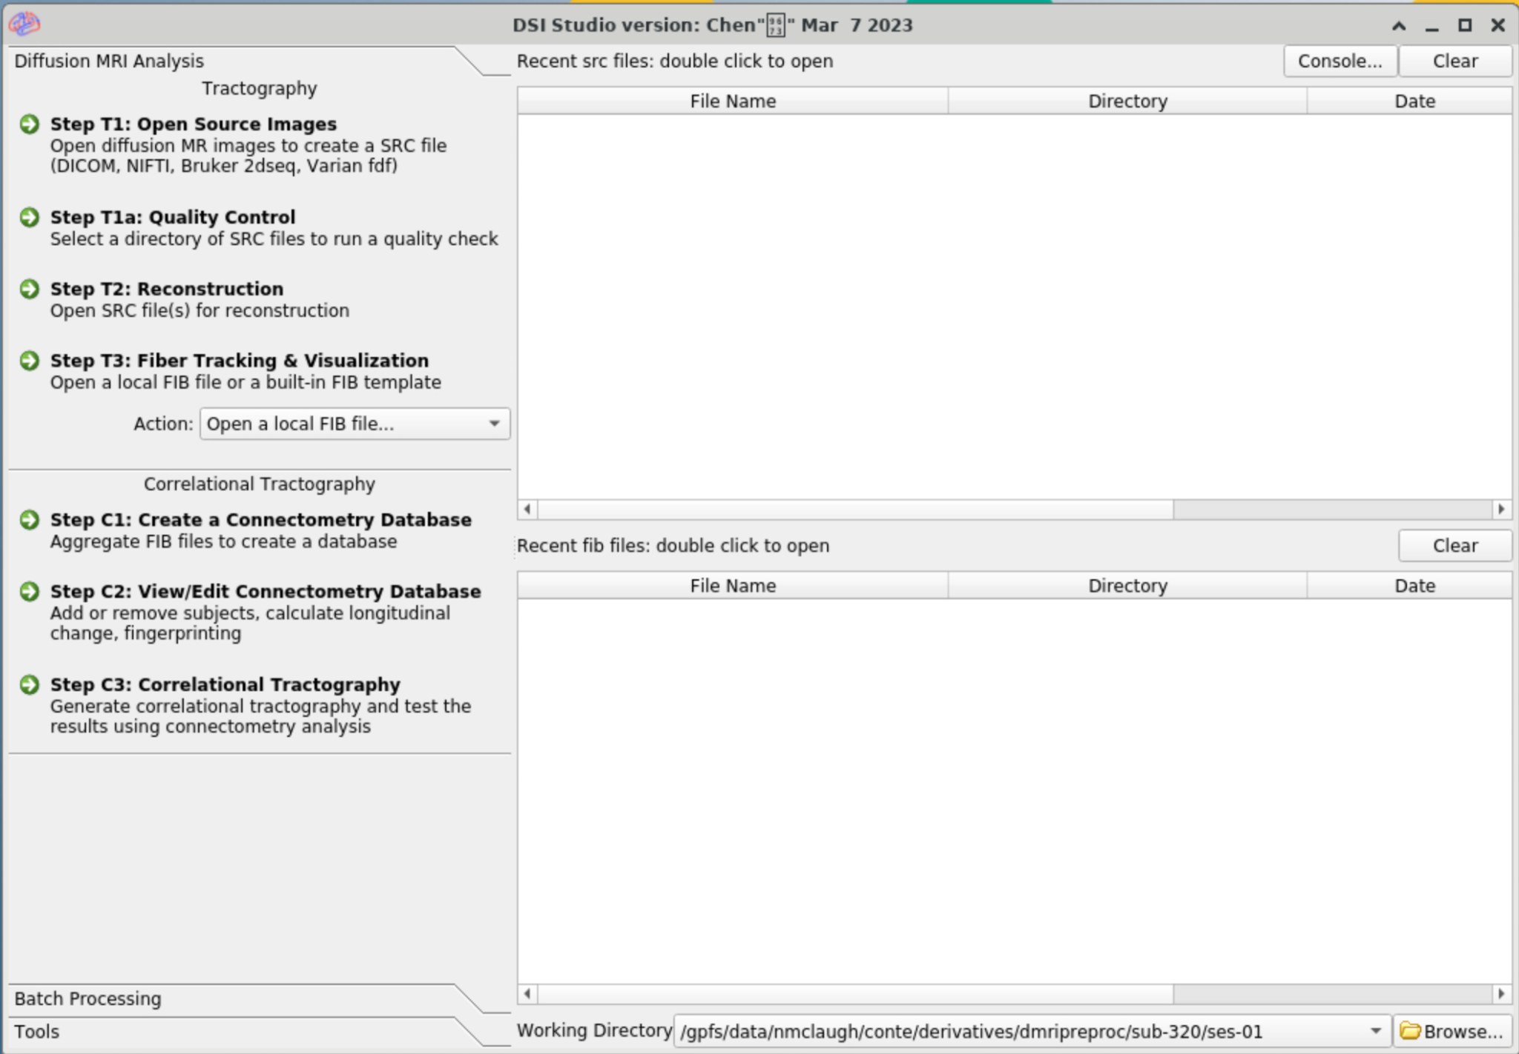
Opening DSI Studio on Oscar
Copy the following into the command line to load the DSI Singularity:
module load dsi/chen-march2023
Next enter the following as one line to display the DSI GUI
singularity exec -B /gpfs/data
/gpfs/runtime/opt/dsi/chen-march2023/dsistudio_chen-2023-03-07.sif dsi_studio
Execute as singularity
Binds the singularity to gpfs/data
Where the DSI singularity is located on Oscar
1.
2.
3.

Slide 21
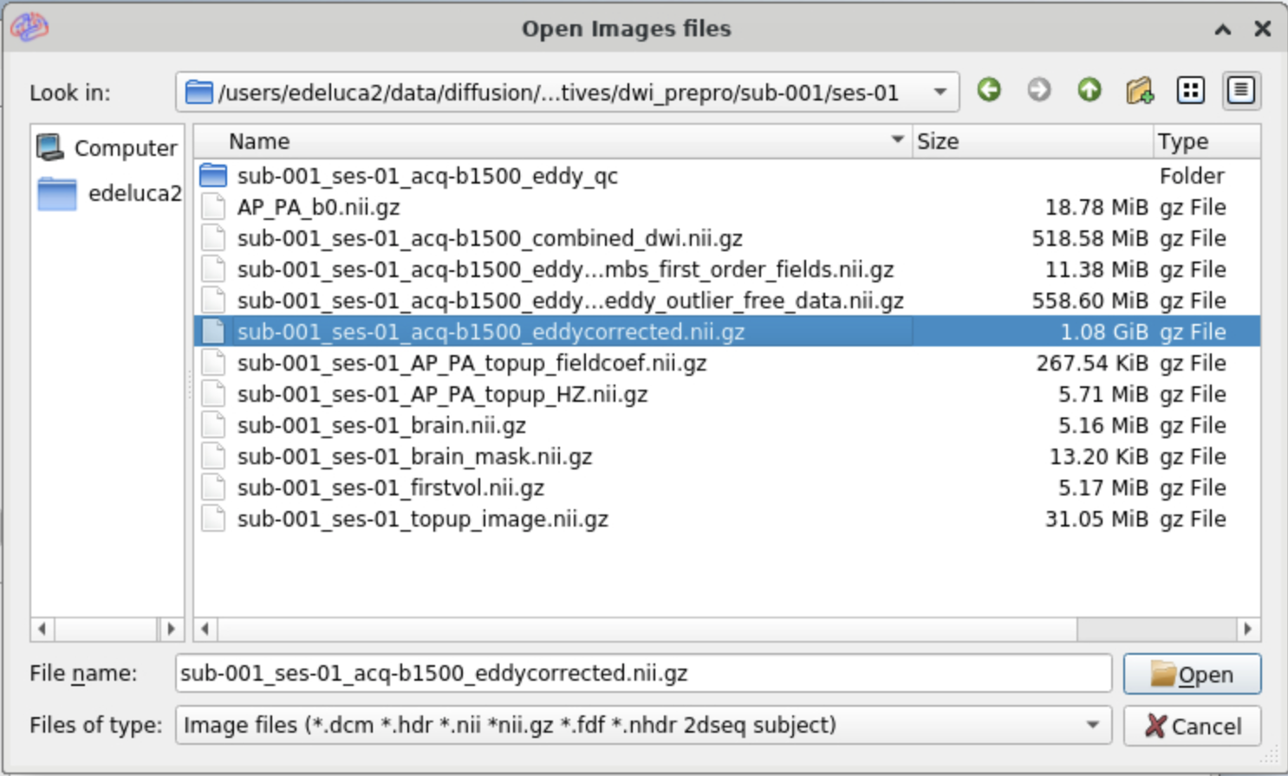
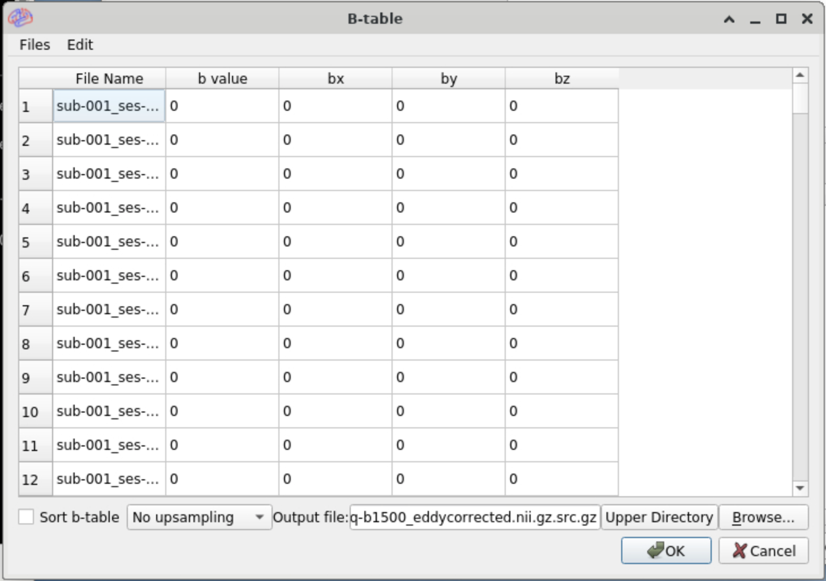
Step One
Select Step T1: Open Source Images
Select the eddy corrected file to create and SRC file for
This should pop up a B-table that displays all the bval & bvec values
If the DSI cannot find the bvec and bval files load them in from the Files button in the right hand corner
Bvec and Bval files will be located in the rawdata folder
Select OK when done, SRC file will be generated and output in the subject’s derivatives folder
Select the T1a: Quality Control
Should already be in the subject’s derivatives folder, hit OK

Slide 22
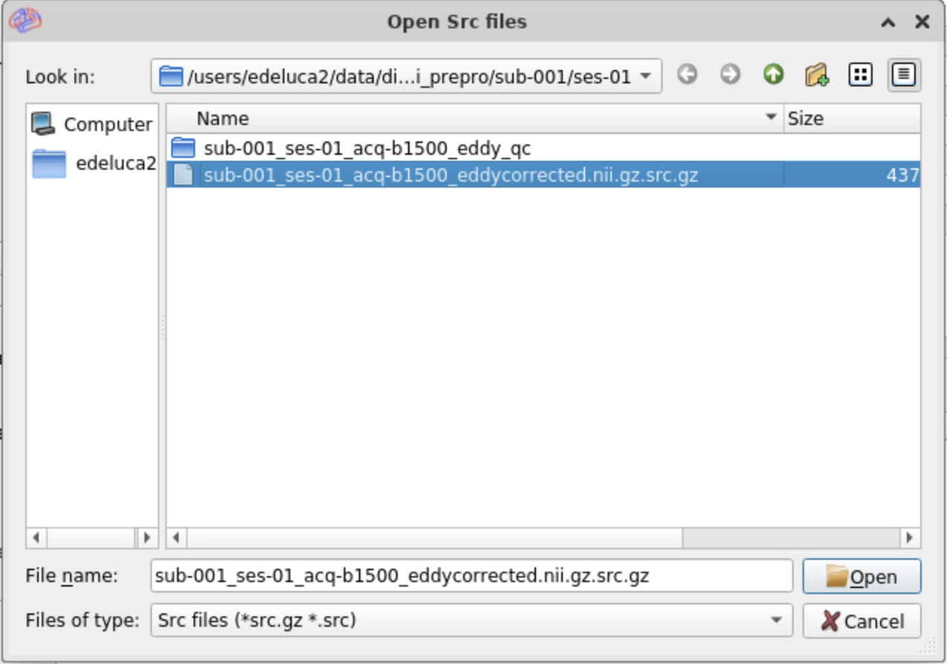
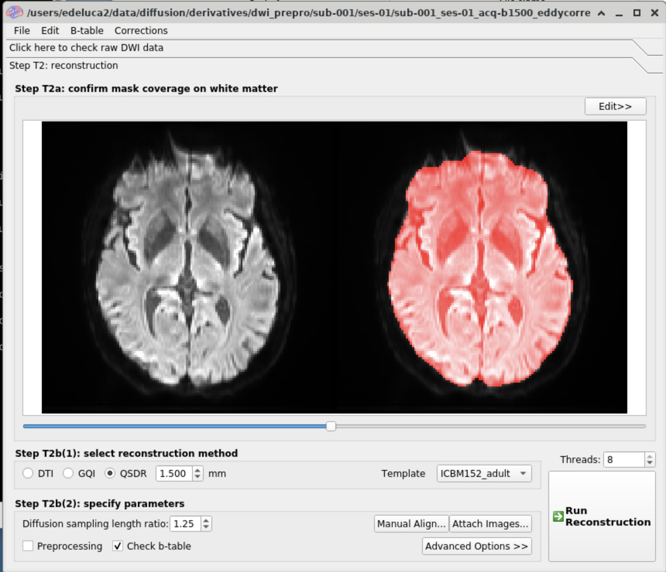
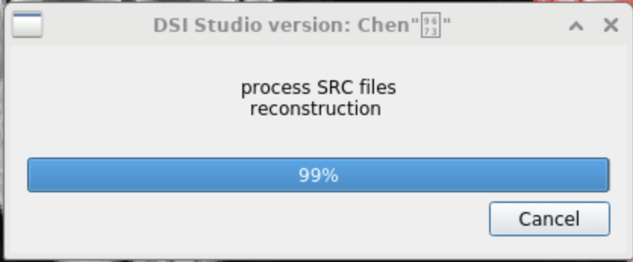
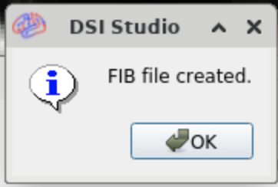
Step Two
Select Step T2: Reconstruction
Select the src file and hit Open
Select reconstruction method in step T2b(1)
Select Run Reconstruction
Processing SRC files reconstruction box will pop up – will take a few minutes to run
When completed Fib file created will pop up – Click OK

Slide 23
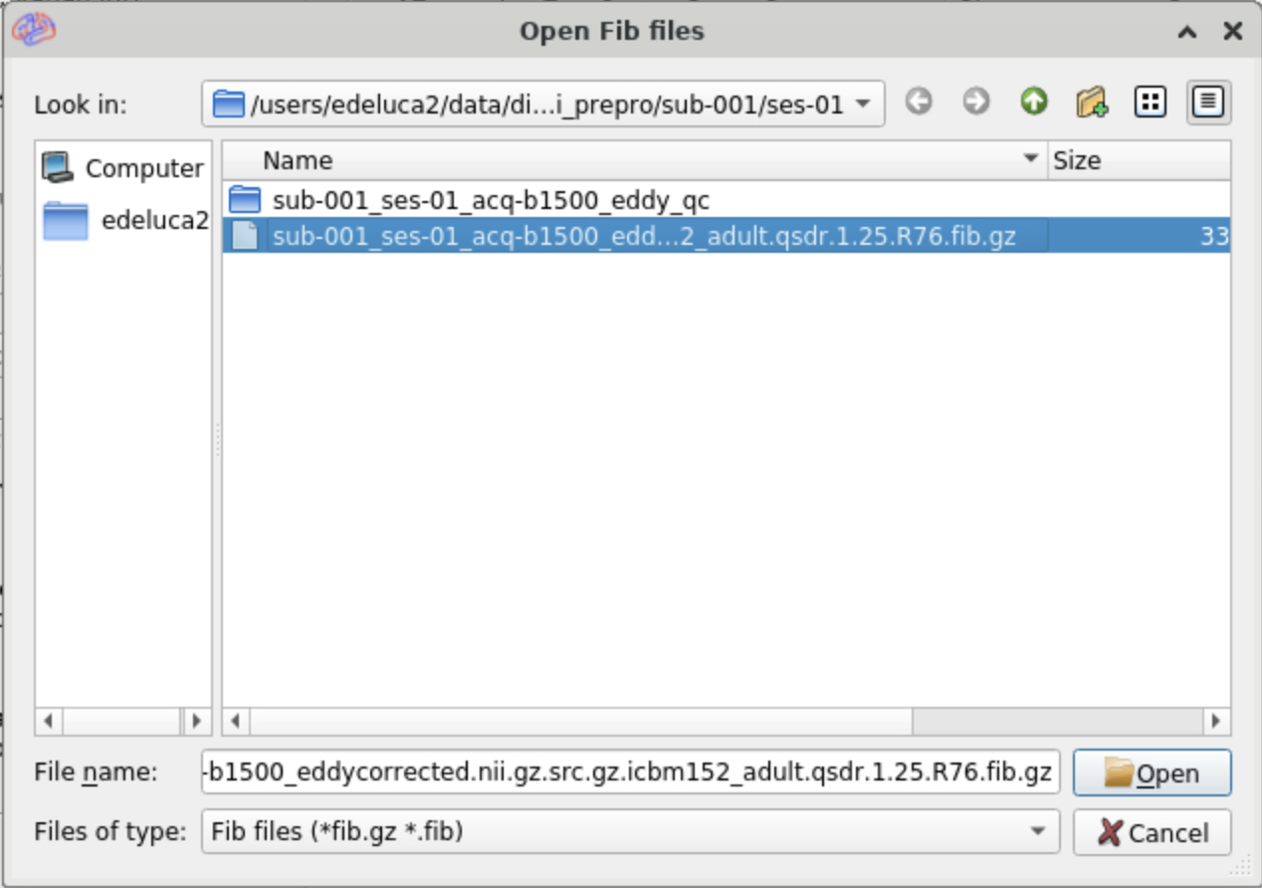
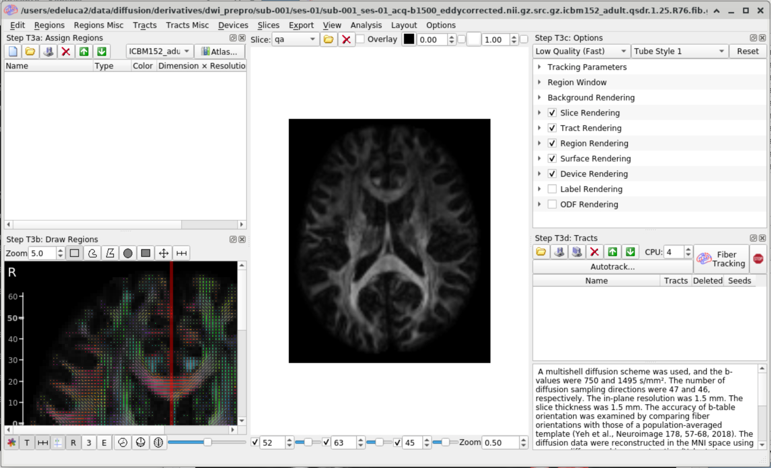
Step Three
Select Step T3: Fiber Tracking & Visualization
Select the .fib file that was created during the previous step
Select Fiber Tracking
An image like the one on the far right will pop up showing the fiber tracts

Slide 24
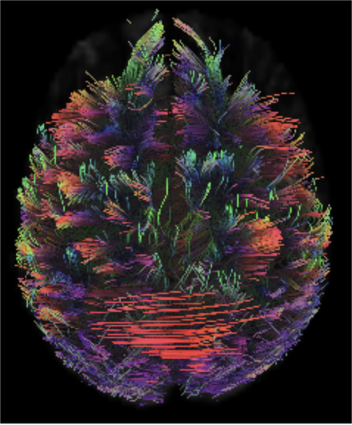
DSI Tips
Recommend doing fiber tracking for both the raw dwi image and the preprocessed image to compare
If the preprocessed image fiber tracts come out looking weird or worse than the original raw image you know something is off with how the image was preprocessed
The image on the right was successfully preprocessed, the image on the left was not

Slide 25
Helpful Links
Full script can be found at
https://github.com/brown-bnc/dwi_preprocessing
Andy’s Brain Book
Eddy User Page
Topup User Page
DSI Studio Info

