Slide 1
Introducing BIDS
Part I
The Brain Imaging Data Structure
Brown University Clinical Neuroimaging Research Core
Version Date 4/27/2023

Slide 2
What is BIDS and why should I care?
BIDS is a standardized framework for data organization
Standardizing handling procedures increases your lab’s operational efficiency
Reduces data loss and labeling errors
Easier to share data with other sites using BIDS
Easier to leverage open source analytic tools
Ensures compatibility and efficiency when creating or using data pipelines
https://bids.neuroimaging.io/
BIDS is a community developed standardized data structure that makes organizing and sharing data easier
Notes:
I

Slide 3
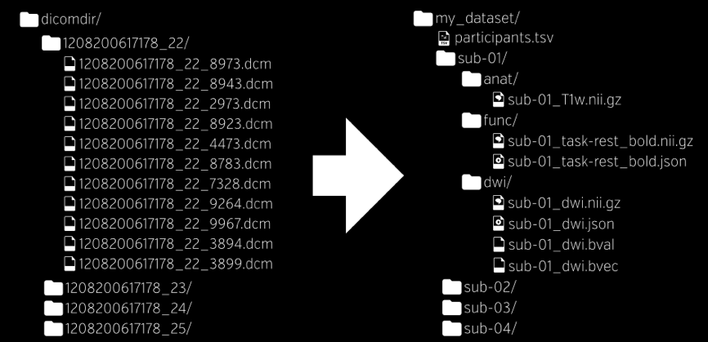
How does BIDS work?
Data organized using standardized naming conventions and folder hierarchies
Best practice: BIDS applied during dicom to .nii conversion with vetted software
Heudiconv
XNAT
Alternative: retroactive scripted reformatting
If you do this must create .json file by hand
A BIDS compliant directory
<sub-##>
<_ses-##>
<_task-name>
<_run-#>
<_modality>
.nii.gz
sub-01_ses-01_task-nback_run-1_bold.nii.gz
Notes:
Some graphic highlighting the major parts
Add infor about xnat and heudiconv here
Move json to later
.json file created during conversion contains full dicom metadata

Slide 4
The three BIDS directories + the code directory
Raw unconverted data (e.g., DICOMs, E-Prime event logs). For archival purposes, not tested for BIDS compliance.
/gpfs/data/<username>/<project>/sourcedata
/rawdata
/derivatives
/code
Minimally processed data e.g., converted files (.nii, .csv, etc.) and metadata files (.json sidecars) stored according to BIDS, tested for compliance.
***Tips***: Keep your paths as short as possible (e.g., don’t add additional PI directories at VA, BH). Extra nested folders cause problems for some automated analysis pipelines. Study folders can be access controlled eliminating need for additional PI directory.
Keep your study names as short as possible, use lower case, don’t use spaces or other special characters.
Output from processing and analysis pipelines (e.g., preprocessing, fmri_univariate, eeg_model1). Not tested for compliance.
Code repository. All elements needed for independent replication from raw data. Where scripts are stored.
Notes:
Named all bids files according to standard and in the folder hierarchy

Slide 5
Uploading to “sourcedata”
CCV at Brown
/gpfs/data/<pi username>/<project>/sourcedata/<subject>/<session>
FOX at CCN
Upload DICOM folders collected for the pre-TMS session here.
/Volumes/Ext1/fox/sourcedata/sub-01/ses-01
NSTB at VA
/Volumes/milner/nstb/sourcedata/sub-01/ses-02
Upload DICOM folders collected for the post-TMS session here.
***Tips***: The session folder is optional for single time point studies. But, if there’s a remote chance that you may add sessions in the future, use the ses-01 flag. Adding the session flag retroactively creates more opportunity for miscommunication, mislabeled sessions, especially for long running studies or labs that rotate staff through multiple projects.

Slide 6
Uploading to “sourcedata” on CCV
Two different file path options, we recommend using the second
/users/<your username>/data/<project>/sourcedata/subject/session
Uses the alias “data” as a shortcut to get to your PIs data directory
/gpfs/data/<pi account>/<project>/sourcedata/subject/session
Uses the full path to the project directory
Request access to PI data folder:
New users:
Establish an Oscar account here
Request the option “Exploratory Account with PI.”
Current users: you can email IT and copy a new PI if you’d like to add the new PI’s group to your account: support@ccv.brown.edu
Notes:
Second is more generalizable and does not rely on the data alias

Slide 7
Transferring your data to CCV
There’s more than one way to transfer data to CCV, but it’s fastest to use one of the transfer nodes from the command line
Nodes are devices in a network
Transfer nodes are optimized for data I/O performance
Steps once you log in through terminal
Click on Shell in the top left hand corner of your screen
From there click on New Window → New Window with Profile - Basic
In the new shell navigate to the directory your file is located in
From here you can run the following transfer commands
Transferring data from your computer to Oscar:
rsync -a /path/to/source/file <username>@ssh.ccv.brown.edu:/path/to/file/destination
Transferring data from Oscar to your computer:
rsync -a <username>@ssh.ccv.brown.edu:/path/to/source/file /path/to/file/destination
Please note that “- a” copies files recursively and preserves symbolic links, file permissions, user & group ownerships, and timestamps.
Notes:
How do you find the full path to your destination file?
Login to the server and navigate to the folder where you want to store your files.
Type pwd on the command line and hit return. Now copy this path into the destination folder.

Slide 8
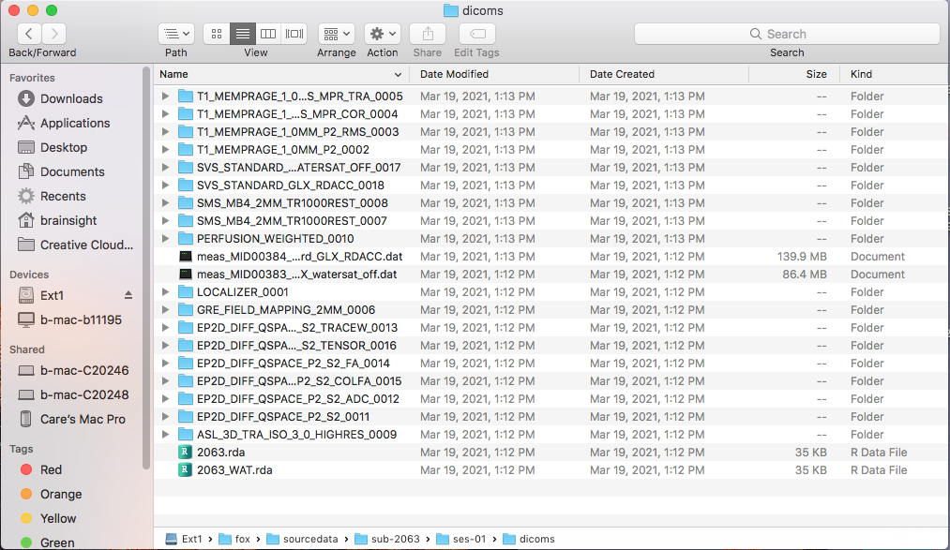
Inside the sourcedata directory
FOX at CCN
/Volumes/Ext1/fox/sourcedata/sub-4000/ses-01/
The BIDS specs for sourcedata are less structured than for rawdata, the directory typically tested for BIDS compliance
Unprocessed data can be uploaded into this directory as individual files or in subfolders
Notes:
This is where you put your unprocessed or untouched. Reason for separate -> In case something goes wrong -> More detail but simplified

Slide 9
Inside the rawdata directory
Ascribes to the BIDS folder hierarchy
/rawdata/<subject>/<ses>/<image type>/<file name>
/rawdata/sub-2001/ses-01/func/sub-2001_ses-01_task-rest_run-1_bold.nii.gz
Includes other relevant BIDS files produced by conversion programs
.json
.tsv
README

Slide 10
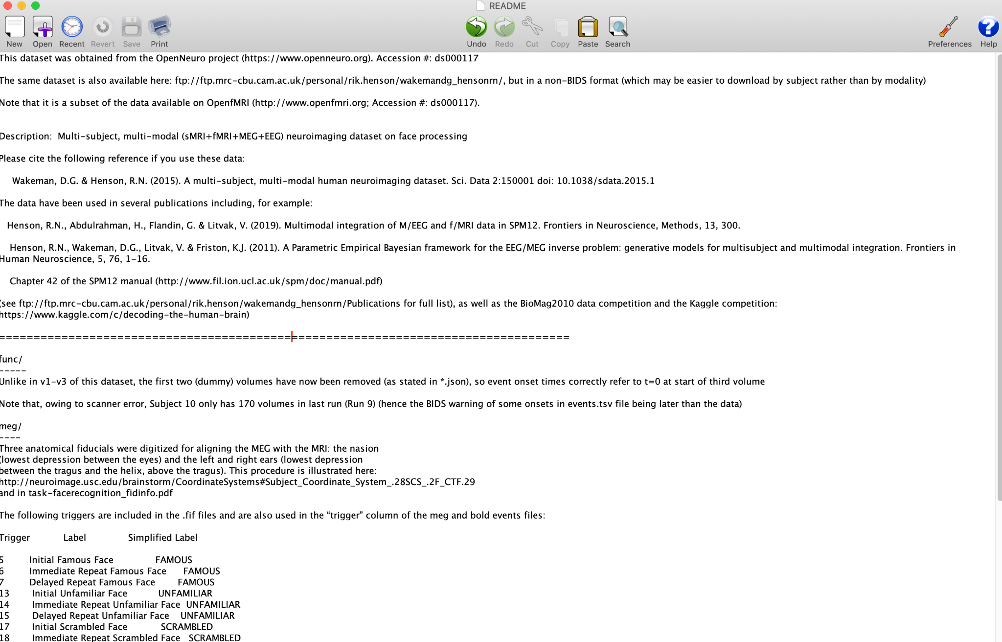
Other BIDS files
A README text file should be kept in the root of the project directory
File should describe the raw data stored in subject folders.
RECOMMEND also keeping a .pdf print out of the sequence parameters produced by the scanner.
The README file provides up-to-date information for all members, including newly hired employees.
Full BIDS README example
More information about the purpose of a README

Slide 11
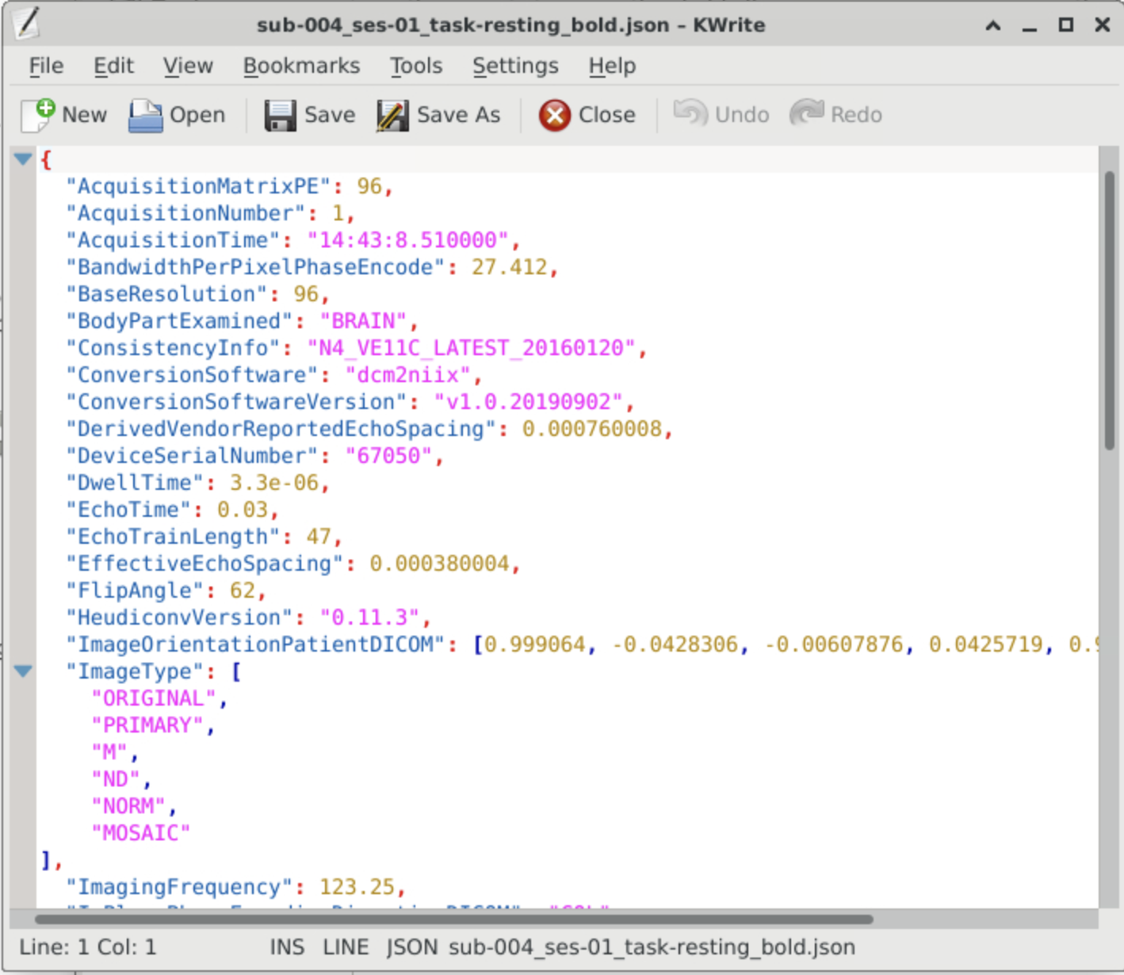
Json Files
file created during conversion contains full dicom metadata
Other data that describes the imaging data
Ex. where the scan was taken, slice timing, etc.

Slide 12
Setting research group permissions
To use CCV for data analysis and sharing, anyone running analyses or uploading data must have access to the PI’s data repository
Once added, these users can make new files and directories.
By default, new additions are created with read, write, and execute (rwx) permission restricted to the user who created them (the owner).
To ensure that users running analyses can write new files, the PI or designee managing the study should create all four directories and set directory (folder)permissions to:
chmod -R 770 /gpfs/data/<pi account>/<study name>
This sets group-level permissions to rwx recursively, meaning all group members should be able to work with all subfolders and contents of that directory.
Please see this video for changing permissions to include everyone

Slide 13
Exercise 1
Submit service tickets requesting access to PI account (group access) on CCV or other server.
Establish a data manager for each project. This person will create the study folder and will “own” the directory. This allows them to grant read, write, execute privileges to other staff working with study data. For small labs, this may be the PI.
Modify the BIDS path below to fit your study.
Create a README file for your sourcedata directory.
Make sure your README describes when each session was collected relative to the study’s timeline (e.g., ses-01=Visit 1, pre-TMS; ses-02=Visit 1, post-TMS; ses-03=treatment endpoint)
/Volumes/<drive name>/<project>/sourcedata/<subject>/<session>

Slide 14
Exercise 2
Open Text Editor in the Accessories Tab.
Write the word TestFile inside of it and save as “TestFile.txt.
Create a fake folder in your home directory -> “TestFile”
Save your new text file inside of it.
Then once you have saved it, open your terminal
In your terminal, set your directory to the “TestFile” folder
Then, a chmod command that you saw in the YouTube video to extend reading, writing, and executing permission to everyone.

