Slide 1
Introducing BIDS
Part II
The Brain Imaging Data Structure
Brown University Clinical Neuroimaging Research Core
Version Date 4/25/2023

Slide 2
BIDS file naming conventions -- subject and session
Subject field: a numeric subject identifier + the prefix “sub-” Zero pad to two digits
Ex., -> sub-01
Session field: scans collected together denoted by a two-digit identifier + the prefix “ses-”. Usually, but not always, defined by separate study visits. Zero pad to two digits
“ses-01” = pre-tx scans during Visit 1 before intervention.
“ses-02”= Visit 1 scans immediately after intervention
“ses-03”= scans during Visit 2 following the end of treatment course.
sub-<##>
_ses-<##>
sub-01_ses-01_task-nback_run-1_bold.nii.gz
Notes:
Some graphic highlighting the major parts
Zero padding — when?

Slide 3
BIDS file naming conventions -- task
Task field: a task is a structured set of activities occurring during one data acquisition or run. The task name is appended with “task-”
Applies to functional images
Task names. Keep them short. BIDS considers resting-state a task.
Resting state, “task-rest”
Stop signal reaction time, “task-ssrt”
_task-<name>
sub-01_ses-01_task-nback_run-1_bold.nii.gz
Notes:
Some graphic highlighting the major parts
Another complimentary presentation for behavioral data – add some of these slides in.

Slide 4
BIDS run and modality naming conventions
Run: a repeated data acquisition that uses the same scanning parameters and task. Denoted by a two digit numeric identifier + the prefix “run-”
Do not zero pad
Optional if acquisitions are not repeated
Example -> run-1
Modality: the category of brain data recorded in a file. Different MRI pulse sequences are considered distinct modalities
MRI: T1w, bold, dwi
T1w (anatomical), bold (functional), dwi (diffusion weighted)
Passive recordings: eeg, meg, ieeg
_run-<#>
_<modality>
sub-01_ses-01_task-nback_run-1_bold.nii.gz
Notes:
Some graphic highlighting the major parts
Clarify tw1 is anatomical

Slide 5
BIDS exceptions and references
Suffix
Describes that the file is a nifti file
A behavioral data might be .tsv, .csv or .txt
EEG data would be .edf or .set
File extension
This compressed your file into a smaller size to decrease the amount of memory for storage
Some programs require unzipped files
To unzip type the following into your command line
gzip -d <name of file>
To rezip type
gzip <name of file>
nii
sub-01_ses-01_task-nback_run-1_bold.nii.gz
gz
Notes:
Include unzip code here
Zip is scanner/mri specific problem

Slide 6
Other BIDS Examples
MRI
sub-01_ses-01_task-ssrt_run-1_bold.nii.gz
sub-01_ses-01_T1w.nii.gz
EEG
sub-01_ses-01_task-provac_run-2_eeg.edf
Behavioral
sub-01_ses-02_task-ssrt_run-2_beh.csv
subject_session_task_run_modality.suffix

Slide 7
BIDS exceptions and references
BIDS is evolving, standards aren’t set for some data types
Positron Emission Tomography (PET)
Computed Tomography (CT)
Spectroscopy
Eye Tracking Data
Non-compliant files can cause problems for analysis platforms that automatically perform BIDS validation
Datasets with non-compliant files are tagged as invalid and generate errors, especially with data pipelines
Including a ‘BIDS ignore’ text file in your directory can help
See next slide for details
Notes:
I would move that bullet point about manual in the references section. Data types aren’t set for BIDS – some diffusion data
Add bids ignore file on next slide
Remove extra bullet point, add part about not working
Expand on BIDS ignore file -> for data types without a bids type or non standard data types include the bids text file will help.

Slide 8
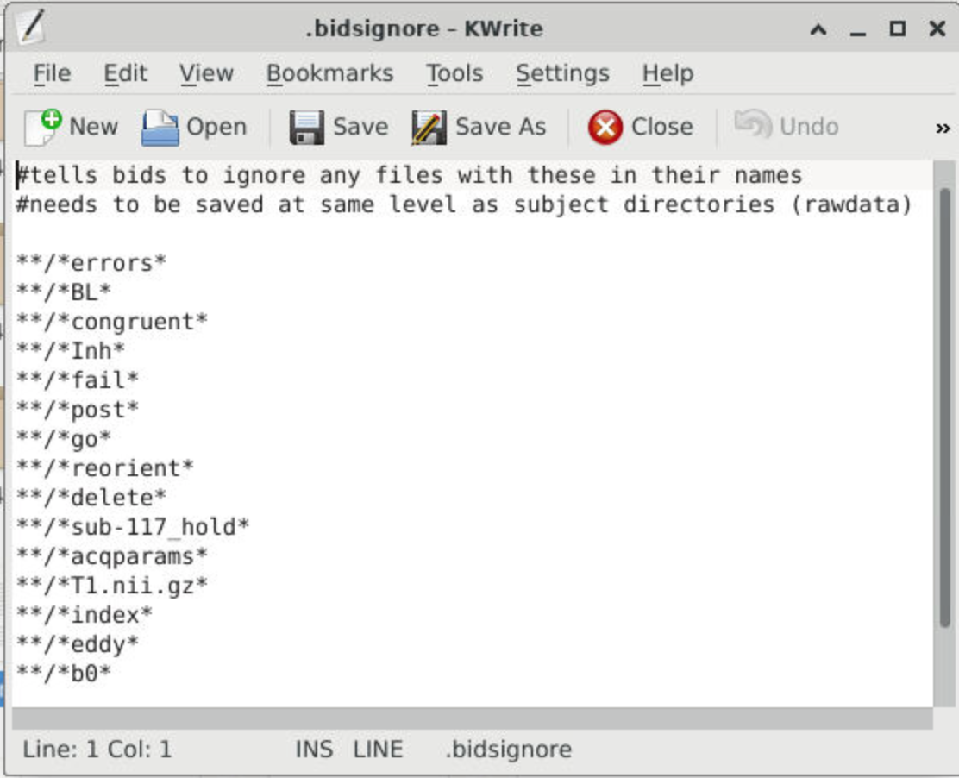
How to make a .bidsignore file
Name the file .bidsignore
Save it in the rawdata folder
This file tells the BIDS validator or other programs that use bids to certain files that do not follow BIDS structure
**/*errors* tells programs to ignore any file containing the word errors in its name
Uses wildcards * to allow for generalizability

Slide 9
Exercises - Part 1
Create a name for a stop signal reaction time task for a subject (3221).
When doing so, add the following components for the BIDS file name
Session number two
The task will be a stop signal reaction time task
This will be the second run
The modality involves a bold recording
Use the required suffix and file extension
Create a name for a Stroop task for a subject (2716).
When doing so, add the following components for the BIDS file name
Session number one
The task will be a Stroop task
This will be the first run
The modality involves a T1w recording
Use the required suffix and file extension
Example
sub-001_ses-01_task-nback_run-1_bold.nii.gz
Notes:
GOALS -> Goals need stated little bit more clearly -> For the first bullet point, “Create the name for stop signal reaction time task for subject give me” Break down the steps, Walk through the step by step process, run identifier, subject name, session, task type, run number, bold.
Make a list of data types and ask which are not compliant -> Have a link for non-compliant on the manual -> Example: Diffusion – Variations that don’t play well w/ BIDS
You could run spectrospecty, diffusion data,

Slide 10
Exercises - Part 2
Below are a list of data types – Place an “X” on the data types that are not compliant with BIDS. Hint: There are three.
Positron Emission Tomography (PET)
Functional Magnetic Resonance Imaging (fMRI)
Electroencephalogram (EEG)
Eye Tracking Data
Magnetoencephalography (MEG)
Computed Tomography (CT)
Notes:
GOALS -> Goals need stated little bit more clearly -> For the first bullet point, “Create the name for stop signal reaction time task for subject give me” Break down the steps, Walk through the step by step process, run identifier, subject name, session, task type, run number, bold.
Make a list of data types and ask which are not compliant -> Have a link for non-compliant on the manual -> Example: Diffusion – Variations that don’t play well w/ BIDS
You could run spectrospecty, diffusion data,

Slide 11
For further guidance
Check out the BIDS Specification website and the manual for more guidance
BIDS Manual – For a comprehensive review
https://zenodo.org/record/4710751#.YSPUrNNKj9B
Please refer to pages 150 - 161 for common data types that are often utilized in BIDS.
BIDS Data Reference Guide – For a quick start reference
https://bids-specification.readthedocs.io/en/stable/04-modality-specific-files/01-magnetic-resonance-imaging-data.html
Please refer to the extension proposals page for further inquiry on types of data that are currently not compatible with BIDS.
BNC BIDS Guide
https://docs.ccv.brown.edu/bnc-user-manual/bids/introduction-to-bids
Notes:
Add link for bnc
Add slide for optional naming conventions

