Slide 1
MRI Fundamentals
Introduction to Magnetic Resonance Imaging
Brown University Clinical Neuroimaging Research Core
Version Date 1/19/2023

Slide 2
1. Basic Terms and Concepts

Slide 3
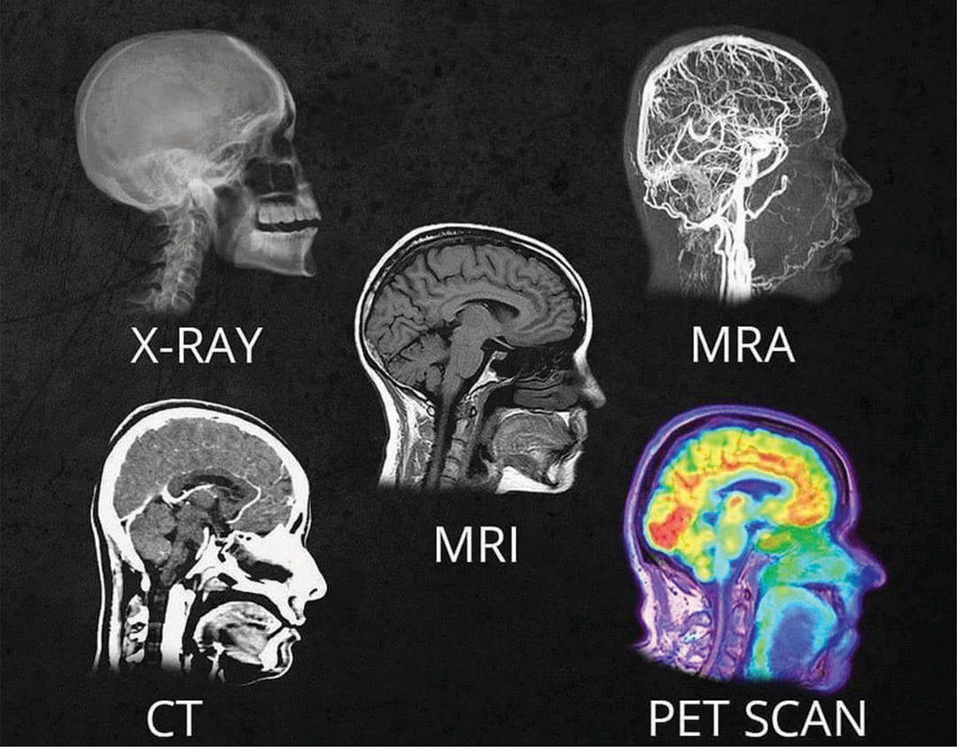
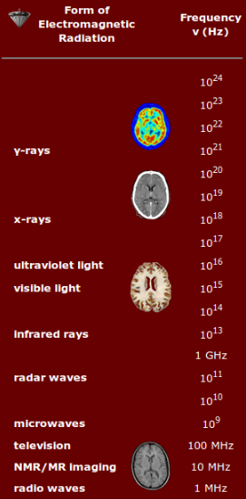
What is MRI?
MRI (magnetic resonance imaging)
Non-invasive imaging technique
Uses powerful magnets and radio frequencies to produce three-dimensional images of the brain
Different frequencies of radio waves and much smaller amounts compared to x-rays; non-hazardous
Great for imaging soft tissue in the body
Used for research and diagnostic imaging that involves tissue (muscles, organs, fat, etc.), like the brain
Notes:
Mention all 3 planes

Slide 4
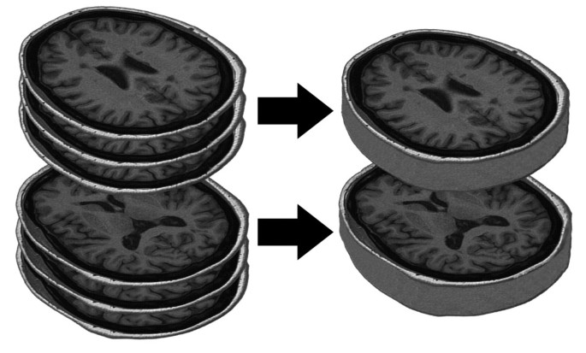
Basic Terminology (1/2)
Slices
Volumes
Slice: A particular plane of the brain
Volume: A stack of slices
Voxel: Three-dimensional pixel; one unit of a slice
Multiband imaging: Multiple slices are captured simultaneously (also called simultaneous multi-slice)
It might be helpful to think of a volume like a loaf of bread, slices like the pieces that make up the loaf, and voxels like the many grains that make up the pieces
Notes:
Multiband imaging
Slice of bread and loaf
Mention all 3 planes

Slide 5
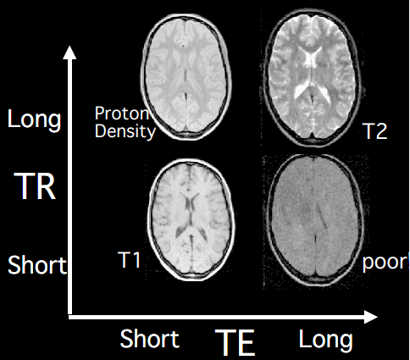
Basic Terminology (2/2)
TR (repetition time): The time it takes to collect a full volume
TE (echo time): The time at which the induced electrical signal is measured
The lengths of TR and TE determine the contrast between different tissues in the image
See this document for more information
Notes:
Mention all 3 planes

Slide 6
What is fMRI?
fMRI (functional magnetic resonance imaging)
Indirect measurement of functional changes in brain activity from moment to moment
Captures the change in blood flow over time
Shows us which parts of the brain are involved in the subject’s different mental operations

Slide 7
2. Common Scan Types

Slide 8
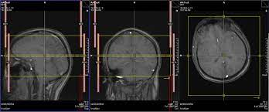
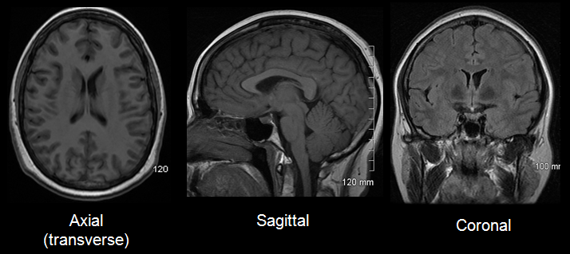
Anatomical Scan Types (1/4)
Localizer: Low-resolution images produced as the first step of the scan; used to adjust scan parameters (i.e., the positions and angles of the slices) to the subject’s brain; provides views of head in three axes (axial, sagittal, coronal)
Scout: Complements localizer by comparing it to set of landmarks from internal database?* This series makes a low resolution whole-head scan and compares the result to a brain atlas on the scanner. It generates new scout images where the orientation is determined with reference to skull landmarks and with reference to the built-in atlas. The resulting images can be used to increase consistency of slice positioning between participants and across scan sessions.
Produces low-resolution scan of head and compares result to built-in atlas on the scanner; generates new images that reference skull landmarks; increases consistency of slice positioning between participants and across sessions
Notes:
https://docs.ccv.brown.edu/bnc-user-manual/demo-dataset/protocol-information#details-on-scans-and-series

Slide 9
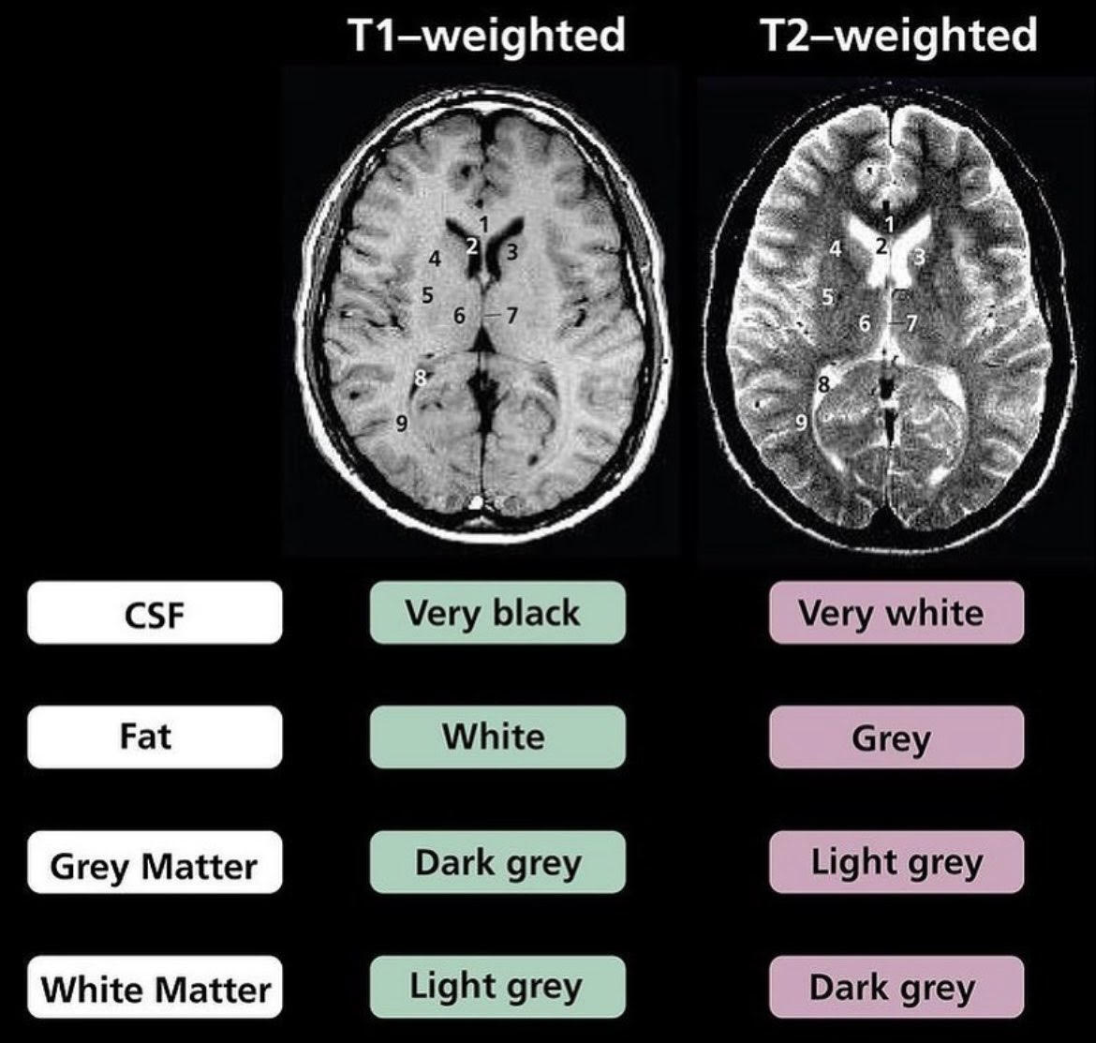
Anatomical Scan Types (2/4)
T1-weighted: grey matter is dark, white matter is light, CSF is black
T2-weighted: inverse of T1; grey matter is light, white matter is dark, CSF is white
See this chapter for a detailed explanation of T1 versus T2
Multi-Echo MPRAGE: This is a multi-echo T1 weighted (anatomical) structural series; Compared to a single-echo MPRAGE, the multi-echo MPRAGE provides enhanced tissue contrast and reduced geometric distortion.

Slide 10
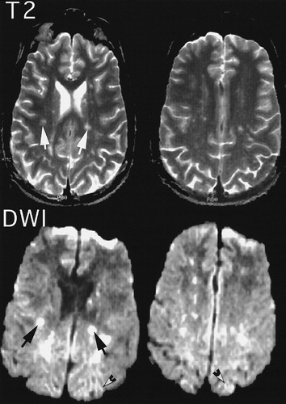
Anatomical Scan Types (3/4)
Diffusion-weighted (DWI): Contrast is generated by the diffusion of water molecules; these images are used to make inferences about white matter bundles; provides different contrasts than conventional T1w and T2w
Gets its own bids category
https://www.wjgnet.com/1949-8470/full/v8/i9/785.htm

Slide 11
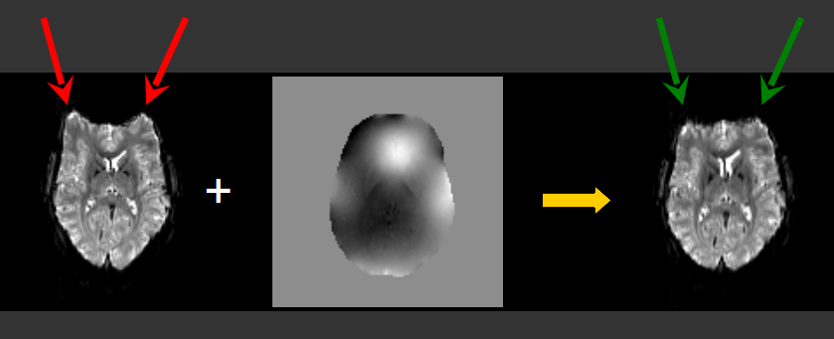
Anatomical Scan Types (4/4)
Field Maps are useful for correcting geometric distortions that result from inhomogeneities in the scanner environment. Different field maps can be used to correct different types of scans (i.e functional or diffusion). In this dataset, gradient-echo field maps were collected to correct for geometric distortion in the functional scans and spin-echo field maps were collected for use with the diffusion images. In general, the geometry of the field maps (voxel dimensions and slice placement) should match those images that they will be used to correct.
Field maps: functional image before BOLD that looks at magnetic susceptibility; plots susceptibility across magnetic field
https://crnl.readthedocs.io/fieldmaps/index.html

Slide 12
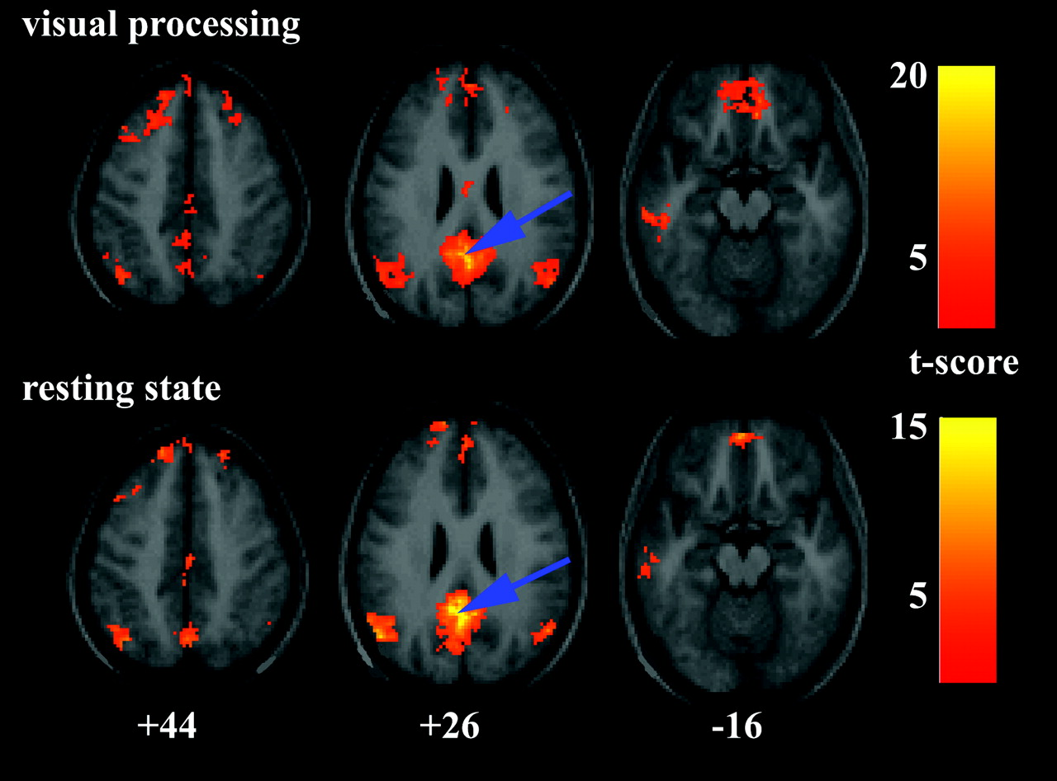
Functional Scan Types
BOLD (blood oxygen level dependent): Results from blood concentrations of oxyhemoglobin and deoxyhemoglobin changing across brain regions
See this page for a detailed explanation of BOLD imaging
Resting state: BOLD scan of subject’s brain activity “at rest”; serves as baseline brain activity
Task: BOLD scan of subject’s brain activity as they perform a behavioral task
Notes:
Indirect measure of function
Ratio between oxy to deoxy

Slide 13
QUICK GUIDE: Common Scan Types
Modality | Scan Type | Scan Subtype
ANAT (anatomical) | LOC (localizer) | SCOUT (scout)
 | T1W (T1-weighted) | MPRAGE (magnetization-prepared rapid acquisition gradient echo)
 |  | ME-MPRAGE (multi-echo MPRAGE)
 | T2W (T2-weighted)
FUNC (functional) | BOLD (blood oxygen level dependent) | REST (resting state)
 |  | TASK (task)
 | FMAP (field map)
*Diffusion-weighted imaging (DWI) is classified as its own modality
Notes:
The two leftmost columns are standard abbreviations that you will see used to indicate these scan types.

Slide 14
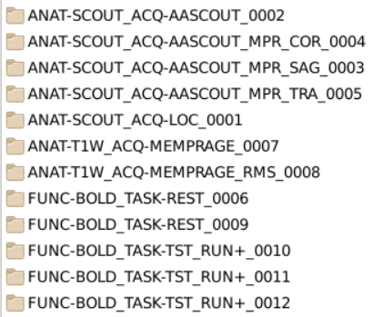
QUIZ: Scan Types
1
This is an example of a real study’s raw output from the Brown MRF.
Based on the previous slides, can you deduce what type of scans each of these folder groups contain?
2
3
4
Notes:
Answers:
T1w scans (ANAT, T1W)
Localizer scans (ANAT, SCOUT)
Resting state scans (BOLD, REST)
Behavioral task scans (BOLD, TASK)

Slide 15
3. Common File Types

Slide 16
QUICK GUIDE: Common File Types
Default Output | .ima | DICOM (Digital Imaging and Communications in Medicine): The standard medical imaging file format. Raw imaging data is saved as many 2D images.
Post- Conversion | .nii .nii.gz (compressed) | NIFTI (Neuroimaging Informatics Technology Initiative): This file format contains a set of DICOM images that are saved as a single 3D image. The NIFTI format was developed as a means to simplify neuroimaging data.
 | .json | JSON (JavaScript Object Notation): Text-based file format that contains metadata* about specific scanner specifications and the scan sessions themselves.
*Metadata: Data that describes and provides information about other data (i.e., data about data)
Notes:
Identification data in conversion
NIFTI files are the chosen imaging format
Key data is accompanied by json file providing parameters and descriptions
Folder structure and files are named in a consistent manner as prescribed by the specification

Slide 17
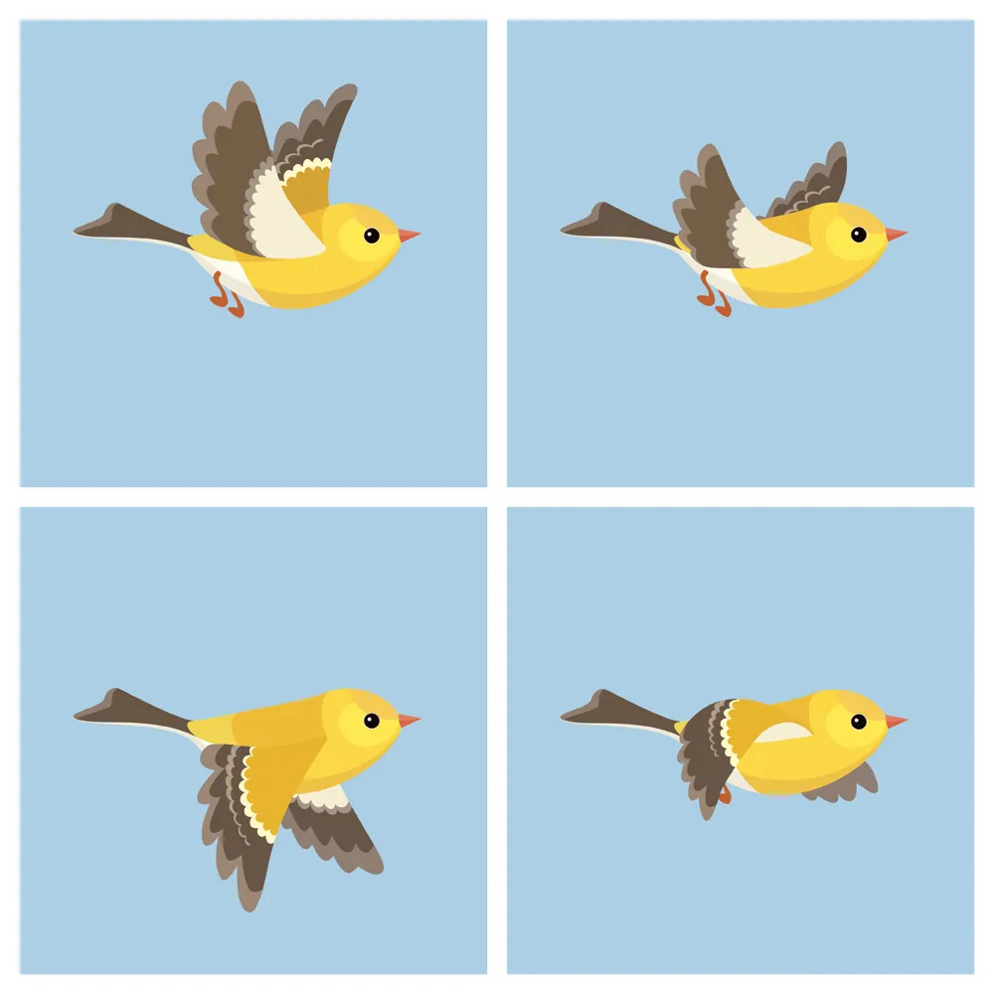
DICOMs and NIFTIs
It has become standard practice to convert DICOMs to NIFTIs in order to simplify the packaging and reading of neuroimaging data. Many preprocessing scripts are designed around the NIFTI file format.
It may be helpful to think of DICOM files as the frames of an animation and NIFTI output like the resulting animation.
DICOMs
NIFTI
Like the animated GIF above, a NIFTI file is a singular package of multiple DICOMs that retains all information from the individual files
Imagine that these frames are individual MRI slices
Notes:
Combined images = full pic of bird and then combined 3d images → nifti – look into this

Slide 18
References & Resources
https://mriquestions.com/
http://trtf.eu/textbook.htm
https://www.magnetic-resonance.org/ch/02-01.html
https://www.nibib.nih.gov/science-education/science-topics/magnetic-resonance-imaging-mri
https://www.learner.org/series/neuroscience-in-the-classroom/different-brains/tools-of-neuroscience-mri-fmri/
https://cfmi.georgetown.edu/downloads/training/2/MRI-basics.pdf

