Slide 1
MRI Quality Control (MRIQC)
PT 3: Artifacts
Overview of some common types of artifacts
Brown University Clinical Neuroimaging Research Core
Version Date 02/10/2022
Notes:
Should we split into running MRIQC and understanding IQMs
And then MRIQC outputs

Slide 2
What are Artifacts?
A feature appearing in an image that is not in the original object
May cause unwanted distortions in brain images
Do not always affect image quality but can affect diagnostic quality -- i.e. an artifact may be confused with pathology
Some artifacts cannot be detected by the human eye - programs like MRIQC help to detect these
Two main overarching categories:
Machine specific artifacts
Patient related artifacts
Notes:
https://www.ncbi.nlm.nih.gov/pmc/articles/PMC4340093/
https://radiopaedia.org/articles/mri-artifacts-1?lang=us

Slide 3
What are Artifacts? - Pt. 2
Different types of artifacts caused by
Hardware issues
Improper calibration
Software problems
Programming errors
Physiological phenomena
Participant motion
Physics limitations
Chemical shift, metal

Slide 4
Common Artifacts
Chemical Shift Artifact
Aliasing/Wrap Around Artifact
Black Boundary/Black Line Artifacts
Gibbs Ringing/Gibbs Phenomenon/Transaction Artifact
Zipper Artifact
Motion Artifact
Entry Slice (inflow) Phenomenon Artifact
Field (B0) Inhomogeneity Paramagnetic/Ferromagnetic Implants Artifacts
Slice-Overlap/Cross-slice Artifact
Moire Fringes Artifact
RF Overflow/Clipping Artifact
Central Point Artifact
Quadrature Ghost Artifact
Susceptibility Artifact
Eddy Current Artifact
RF inhomogeneity Artifact
Gradient failure (B1 inhomogeneity) Artifact
Partial Volume Artifact
Flow Artifact
RF noise Artifact
Notes:
On following slides picked motion artifact, ghosting, INU artifacts, aliasing, and ringing -- all were mentioned throughout the MRIQC paper

Slide 5
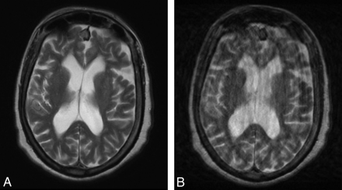
Motion Artifact
Caused by voluntary or involuntary participant motion during the scan
Eye movement
Breathing
Participant shifting
Results in inconsistencies in phase and amplitude which leads to blurring and ghosting (see next slide)
One of the most frequently seen artifacts
No Motion Motion
Image from:
E. Nyberg, G.S. Sandhu, J. Jesberger, K.A. Blackham, D.P. Hsu, M.A. Griswold, J.L. Sunshine
American Journal of Neuroradiology Jan 2012, 33 (1) 77-82; DOI: 10.3174/ajnr.A2737
Notes:
https://www.ncbi.nlm.nih.gov/pmc/articles/PMC4517972/
http://www.ajnr.org/content/33/1/77
https://www.hindawi.com/journals/jme/2017/4501647/

Slide 6
Ghosting
Structured noise appearing as repeated versions of the main object
Generally caused by motion or signal instability between pulse cycle repetitions
Worsens with intensity and amplitude of movement
Happens in phase encoding direction
Amplitude modulations
Constant-phase shifts
Echo-timing mis-registrations
Looks blurred, smeared, and shifted
Ghosts
Image from: https://web.stanford.edu/group/vista/cgi-bin/wiki/index.php/Local_software_projects/MRI_ghost_artifact_detection
Notes:
http://mriquestions.com/ghosting.html

Slide 7
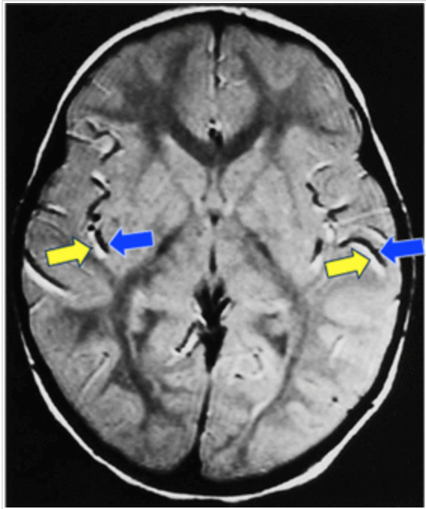
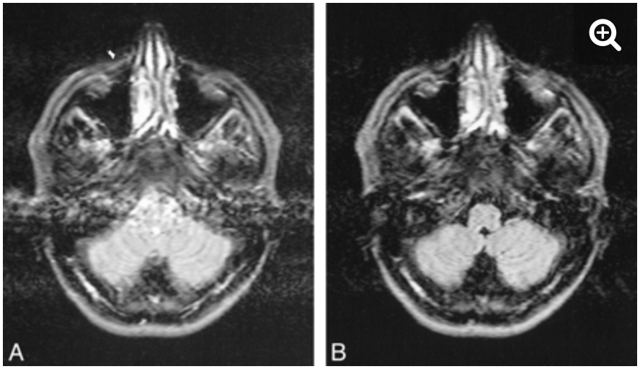
Flow Artifact
Occurs from movement of body fluid during the scan sequence
Motion artifact caused by the motion of liquids such as blood or cerebrospinal fluid (CSF)
A liquid flowing through a slice can experience an RF pulse and then flow out of the slice by the time the signal is recorded
Notes:
https://www.cis.rit.edu/htbooks/mri/chap-11/chap-11.htm
http://www.ajnr.org/content/22/5/896/tab-figures-data
http://mriquestions.com/flow-misregistration.html

Slide 8
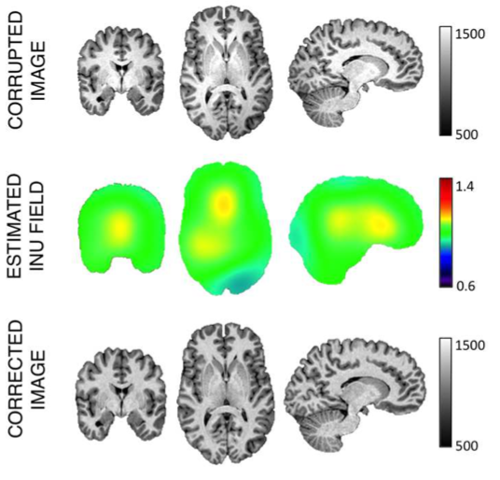
INU (Intensity Non-Uniformity) Artifacts
Slow, nonanatomic intensity variations of the same tissue over the image
Occurs from inhomogeneity in the magnetic field
Produced by improper acquisition process
Static field inhomogeneity, radiofrequency coil non-uniformity, gradient-driven eddy currents, inhomogeneous reception sensitivity profile, overall subjects anatomy both inside and outside the field of view
Can degrade the performance of automatic quantitative analysis
I.e. segmentation, registration, etc.
Image from:
Ganzetti, M., Wenderoth, N., & Mantini, D. (2016). Intensity inhomogeneity correction of structural MR images: a data-driven approach to define input algorithm parameters. Frontiers in neuroinformatics, 10, 10.
Notes:
https://www.biorxiv.org/content/10.1101/111294v1.full
arises due to inhomogeneity in the magnetic field, and manifests itself as an unwanted low frequency bias term modulating the signal. The cause is usually due to either a non-uniform B1 field or a non-uniform sensitivity in the receiver coil. The inhomogeneity could also be caused by the interaction of the acquisition system with the patient such as RF attenuation. RF coil field strength inhomogeneity can yield intensity variations on the order of 10-20% in image amplitudes over the patient volume on a 1.5T magnet. The problem becomes even more pronounced at higher field strength. While such variations usually have no effect on diagnostic accuracies, they do cause significant problems for segmentation and statistical clustering tasks that are based on voxel intensity distributions. When such intensity variation becomes significant compared to the image contrast, it can easily affect the interpretation of an MR image.

Slide 9
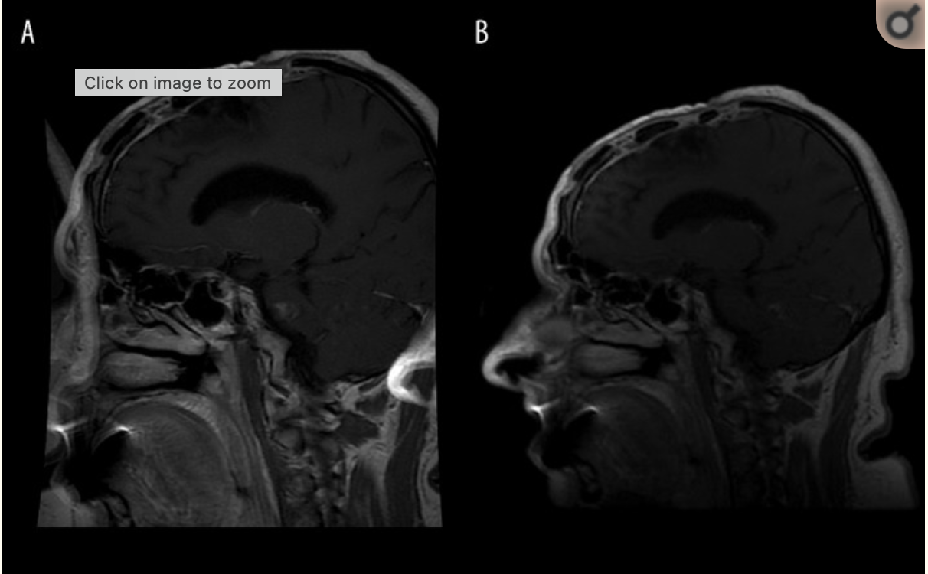
Aliasing Artifact (Wrap Around)
Happens when the field of view (FOV) is smaller than what is being imaged
Causes what is outside the field of view to be projected onto the other side of the image
Occurs in phase encode direction
In the image on the right you can see the subjects nose projected onto the right side of the image
Nose projected onto other side
Image from:
Krupa, K., & Bekiesińska-Figatowska, M. (2015). Artifacts in magnetic resonance imaging. Polish journal of radiology, 80, 93–106. https://doi.org/10.12659/PJR.892628
Notes:
https://www.imaios.com/en/e-Courses/e-MRI/Image-quality-and-artifacts/aliasing

Slide 10
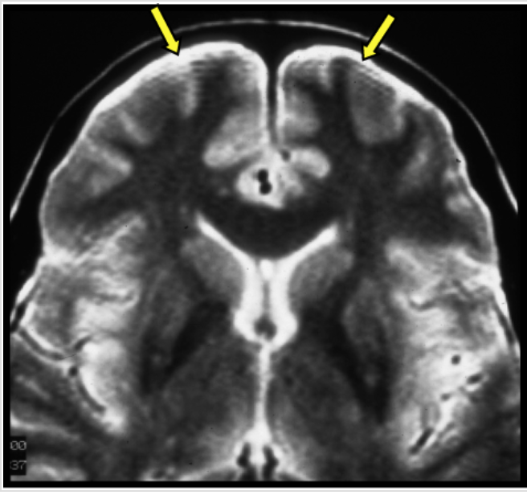
Ringing Artifact (Gibbs)
Bright or dark lines on that are parallel and adjacent to borders of abrupt intensity change
Can appear as multiple fine parallel lines right next to high-contrast interfaces
Caused by under-sampling of high spatial frequencies at sharp boundaries in the image
Image from:
http://mriquestions.com/gibbs-artifact.html
Notes:
http://mriquestions.com/gibbs-artifact.html

Slide 11
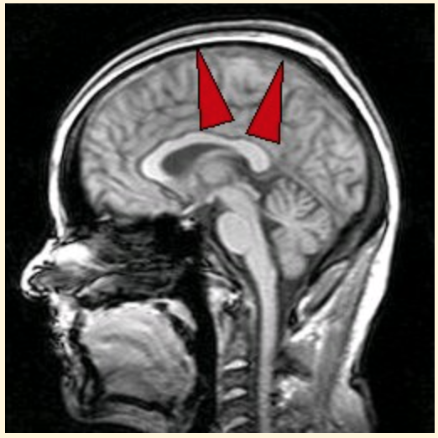
Chemical Shift Artifact (Misregistration)
Caused by differences in the resonant frequency of precessing protons (fat and water)
Fat protons resonate at a lower frequency than water
Causes misregistration of image data
Occurs at the fat/water interface and is visible as a bright or dark band running perpendicular to the frequency-encoding direction
In image on the right the artifact is visible as a dark border at the top of the head
Image from:
https://www.mr-tip.com/serv1.php?type=art&sub=chemical%20shift%20artifact
Notes:
https://pubs.rsna.org/doi/10.1148/radiographics.19.2.g99mr07357

Slide 12
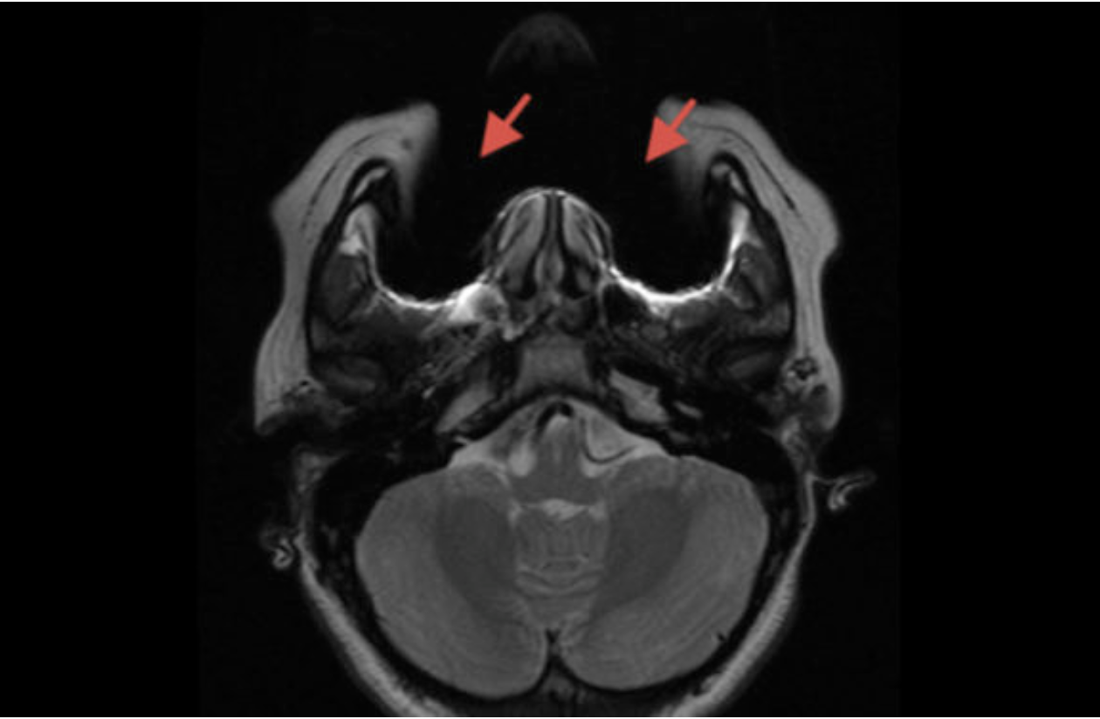
Susceptibility Artifact
Caused by microscopic gradients or variations in the magnetic field strength -- often metal objects on or in the body
Often seen with metal dental work (i.e. braces)
The image on the right shows a susceptibility artifact caused by the subject’s braces
Image from:
https://blog.cincinnatichildrens.org/radiology/mri-orthodontics-child-braces-safe-child-mri

Slide 13
Links for more information
https://www.ncbi.nlm.nih.gov/pmc/articles/PMC4340093/
https://radiopaedia.org/articles/mri-artifacts-1?lang=us
http://clinicauniversitariaradiologia.pt/curso_fisica_RM/MRI_Course_Artifacts.pdf

