Slide 1
MRI Quality Control (MRIQC)
PT 4: Interpreting Results
How to run your data through the MRIQC Singularity container on CCV and locally through Docker
Brown University Clinical Neuroimaging Research Core
Version Date 02/10/2022

Slide 2
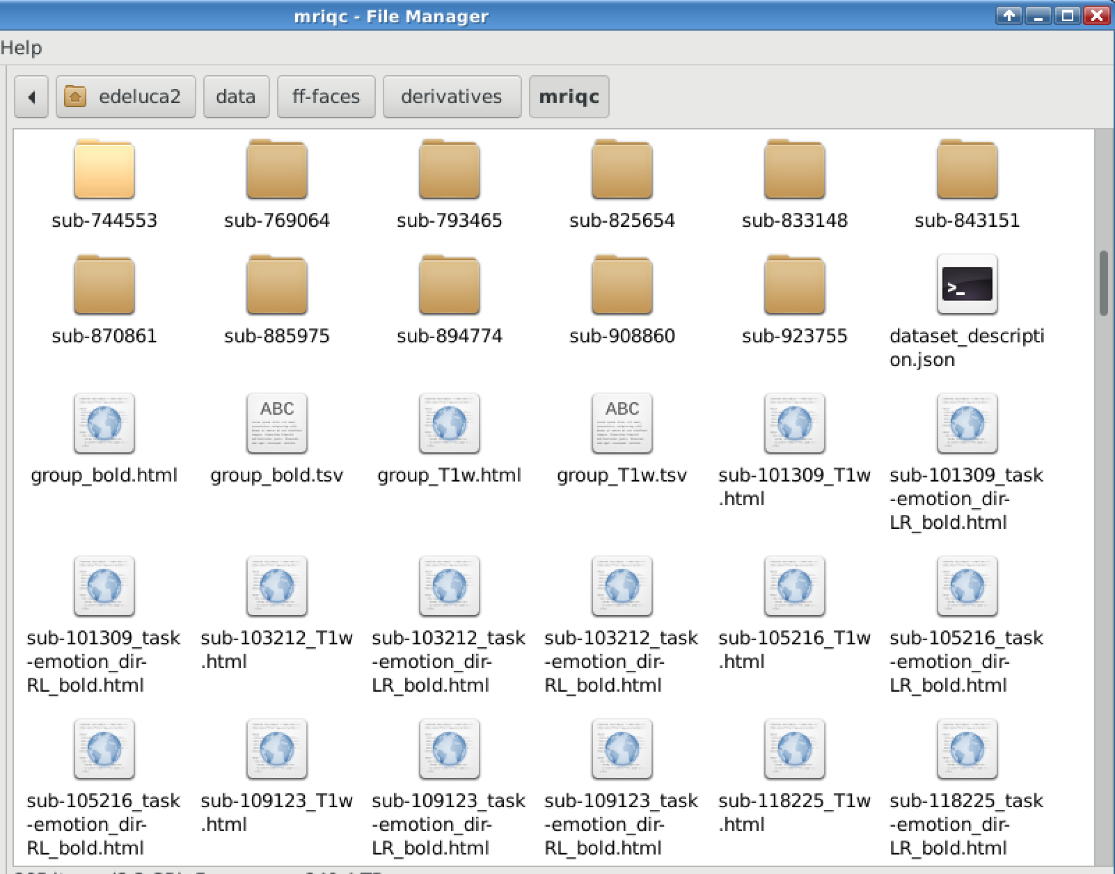
Where to find MRIQC Output Files
After running the Individual Level MRIQC will output:
Subject folders containing .json files
.html files for each type of scan run (T1w, T2w, Bold) for each subject -- located outside of the subject folders
After running the Group Level MRIQC will output
.html and .tsv files for each scan type
These will be located in:
/gpfs/data/<PIusername/<studydir>/derivatives/mriqc

Slide 3
Example Reports

Slide 4
Individual Reports: Summary
Summarizes important info like:
Subject identifier
Date & time or execution of mriqc
Software version
Workflow details and flags raised during execution
Extracted IQMs
Following slides take information from: https://mriqc.readthedocs.io/en/stable/reports/smri.html

Slide 5
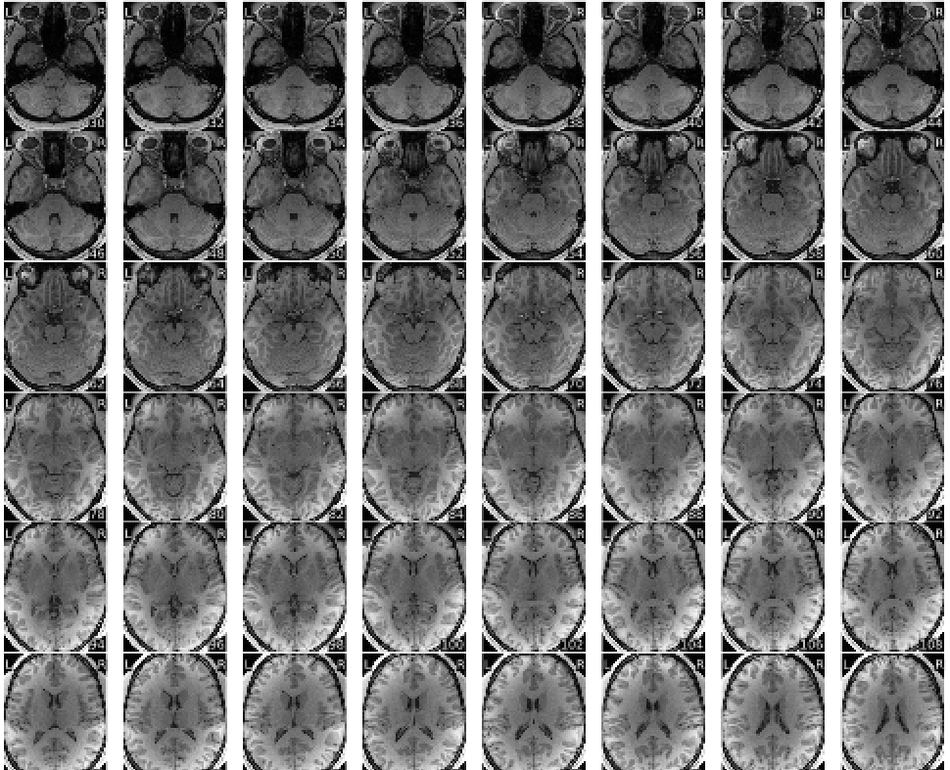
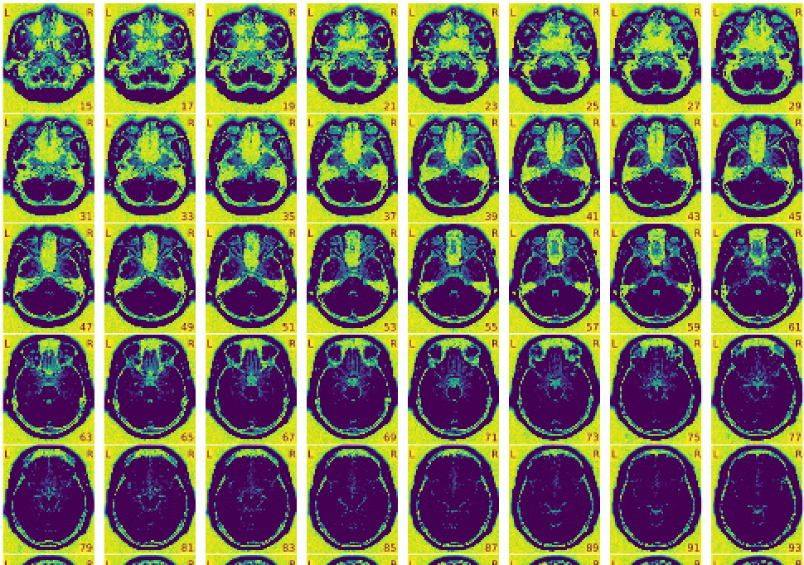
Individual Reports: Visual for T1w and T2w Images
Mosaic view, zoomed in over the parenchyma of the brain
Mosaic view with background noise enhancement
These images can be used to quickly scan for overall signal quality – look for blurriness etc.
Notes:
Can be used to quickly scan for overall signal quality

Slide 6
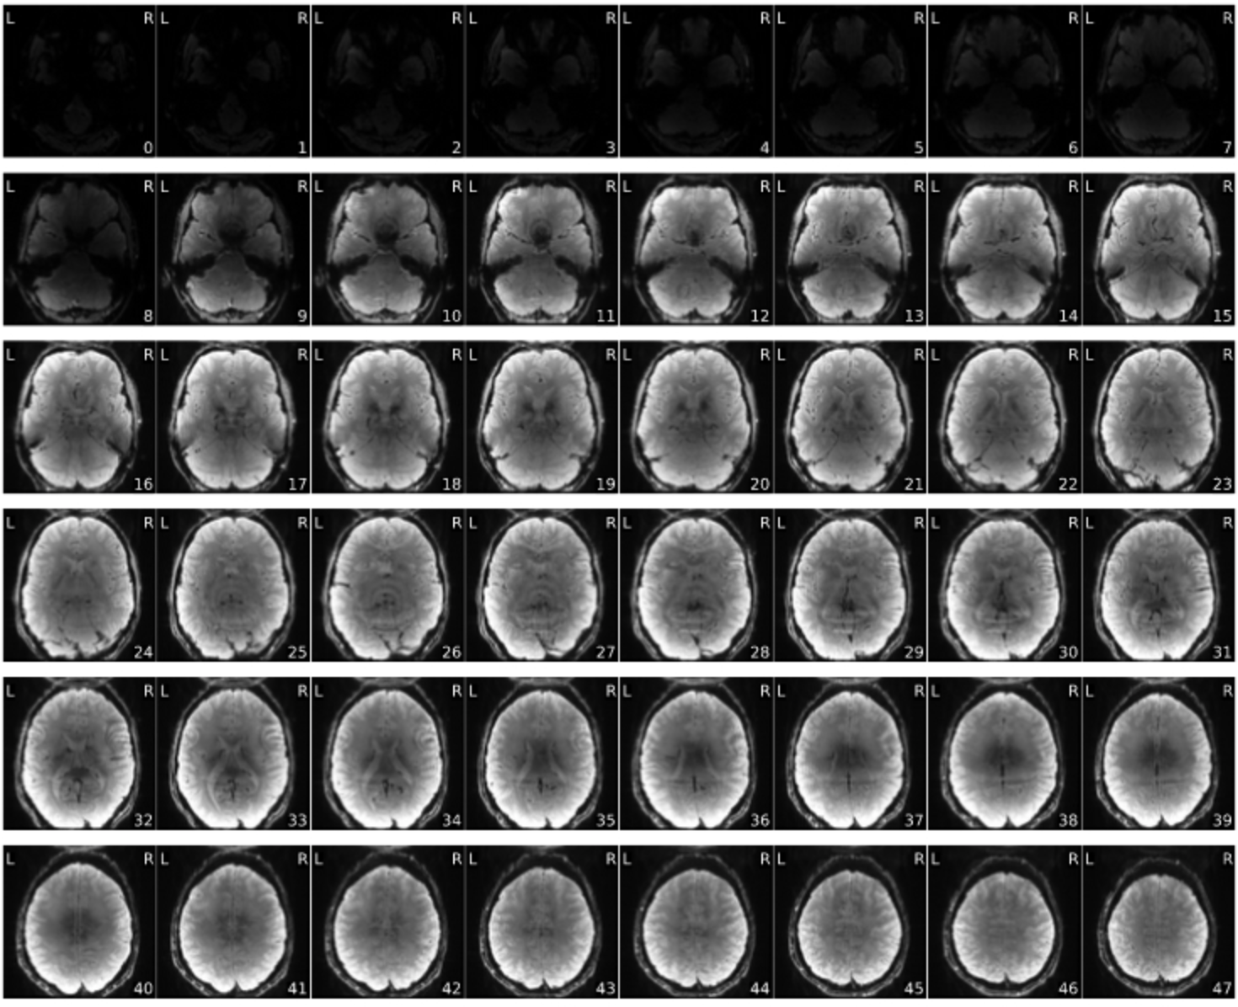
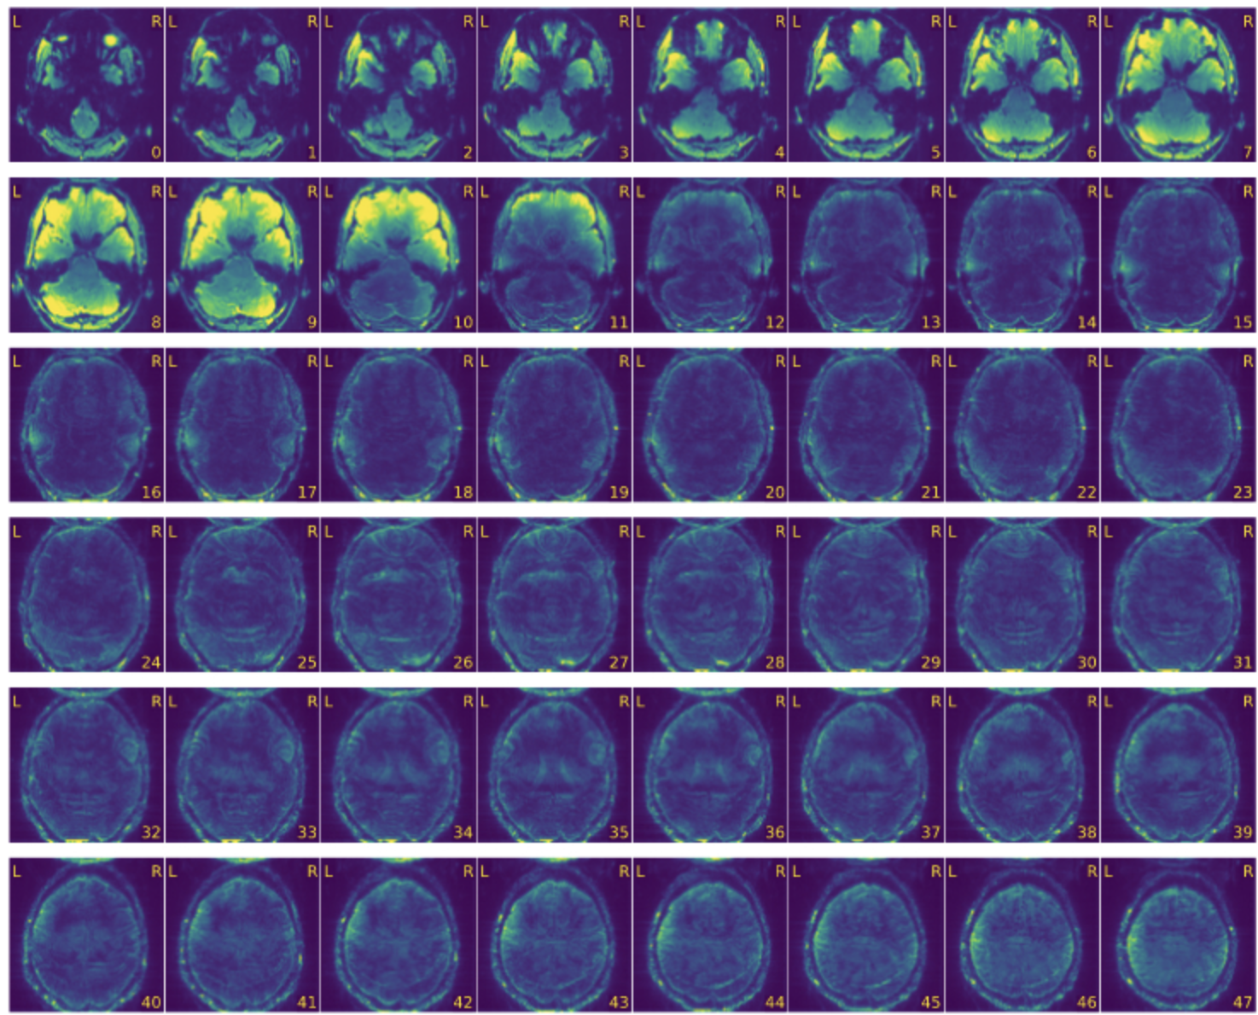
Visual for BOLD Images
Mosaic view of the average BOLD signal
Mosaic view of the temporal standard deviation

Slide 7
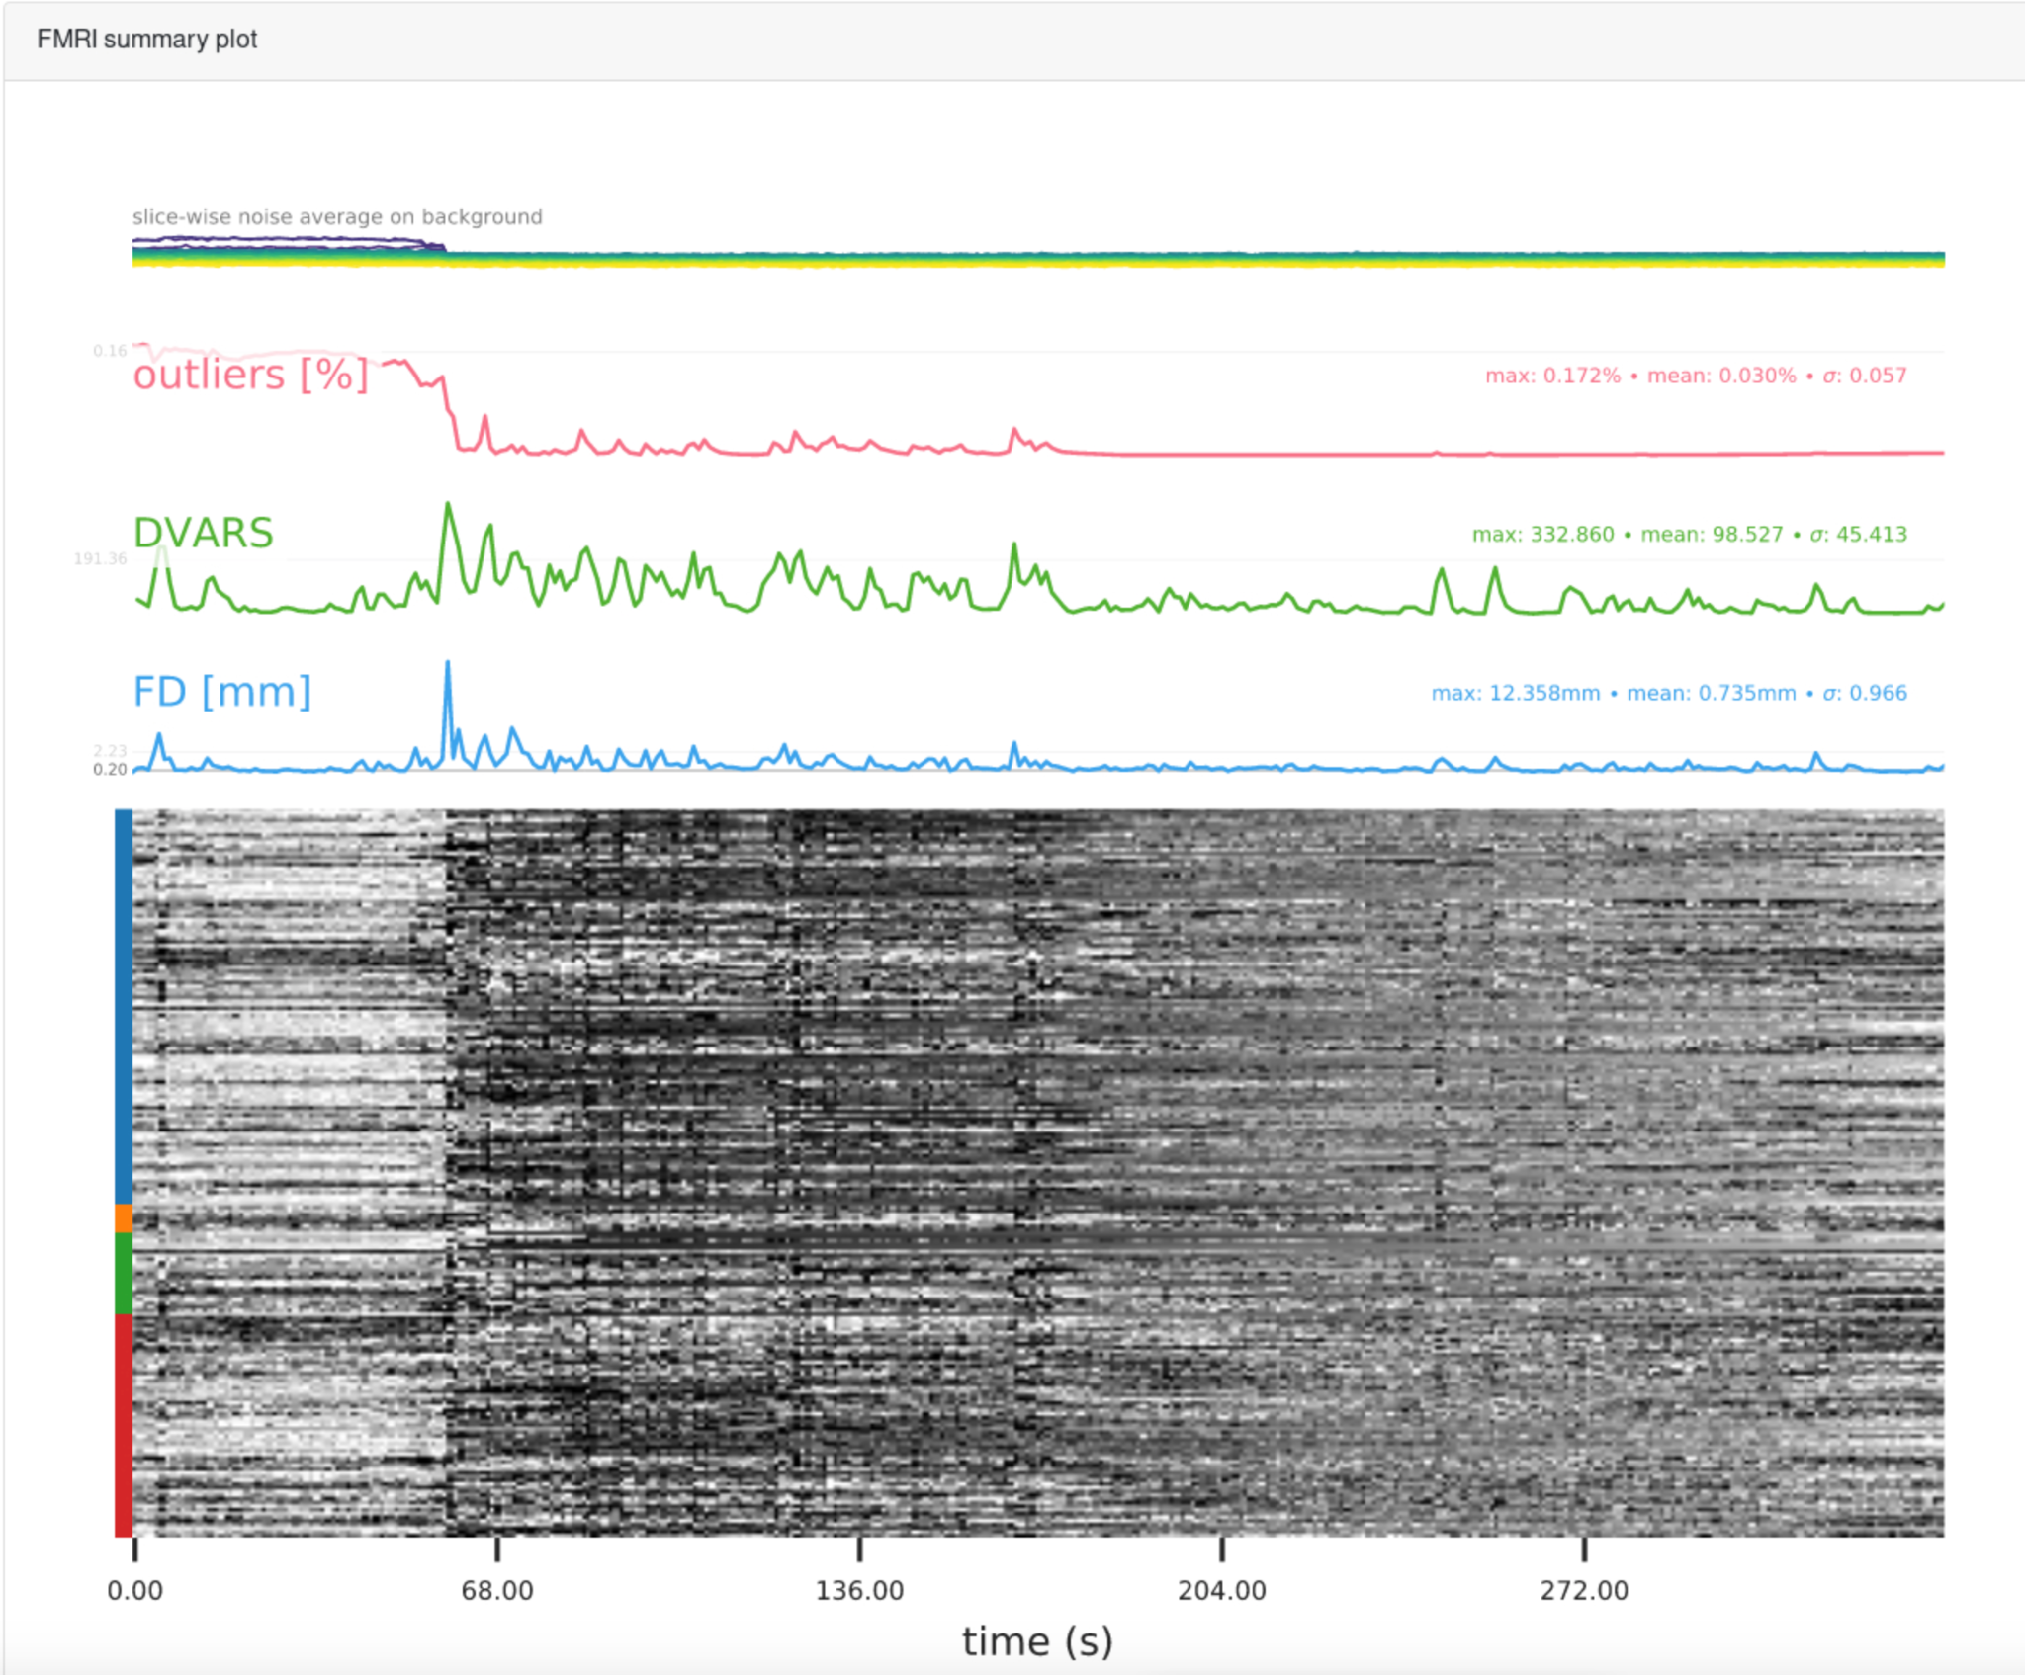
FMRI Summary Plot
Top shows the slice-wise signal intensity for the outliers metric, DVARS & FD
Bottom carpet plot
Rows follow the voxelwise timeseries
Colors on the side correspond to brain regions
Blue: cortical GM
Orange: deep GM
Green: WM + CSF
Red: Cerebellum

Slide 8
FMRI Summary Plot Cont.
Looking for spikes or lines of distinction in the timeseries/carpet plot
Outliers
Shows the amount of outliers in each volume
DVARS
Rate of change of BOLD signal across the entire brain at each frame of data
The spikes indicate greater motion
FD
In mm shows the brains movement outside of the original field of view
Measures movement of the head between volumes

Slide 9
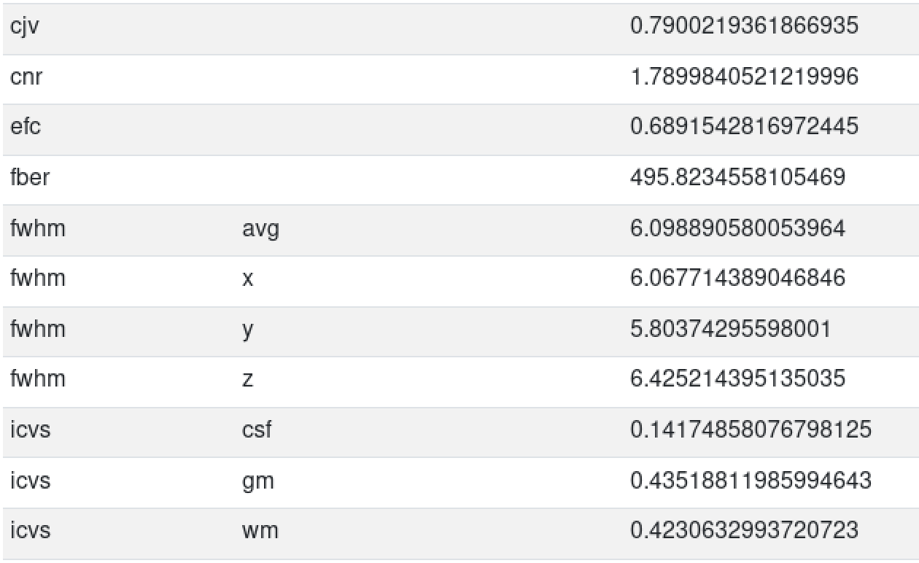
Individual Reports: Extracted IQMs

Slide 10
Individual Reports: Metadata

Slide 11
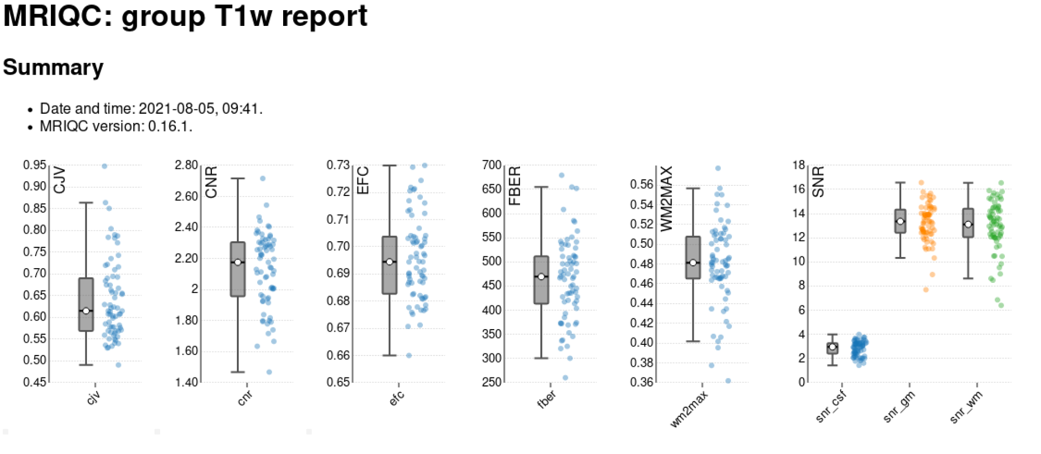
Group Report
Interactive scatter plots, clicking on a subject will open their individual report

Slide 12
Steps for Investigating Outliers
Go through the group report and make note of all outliers or subject scans outside of the main cluster
Certain subjects will appear as outliers on multiple IQMs
Click on the dot corresponding to the subject/image you want to view
Scan through the visual reports and the carpet plot
Check images on FSL (enter below commands into command line)
module load fsl/6.0.5.2
fsleyes
Flag outliers in MRIQC Reporting Template
Follow instructions in the template for creating a MRIQC Report
Describe the spread of the box plot, flag outliers, describe an issues seen in their visual reports, carpet plot, visual inspection, etc.

Slide 13
How to Find and Interpret Outliers - Ex 1
This is a box plot for Coefficient of Joint Variation (CJV) -- a structural IQM
The box plot contains all of the subjects’ CJV measures
Everything outside of the main whiskers is normally considered to be an outlier
There is only one clear outlier – circled in green
Check the subjects circled in pink as well – they are separate from the main cluster

Slide 14
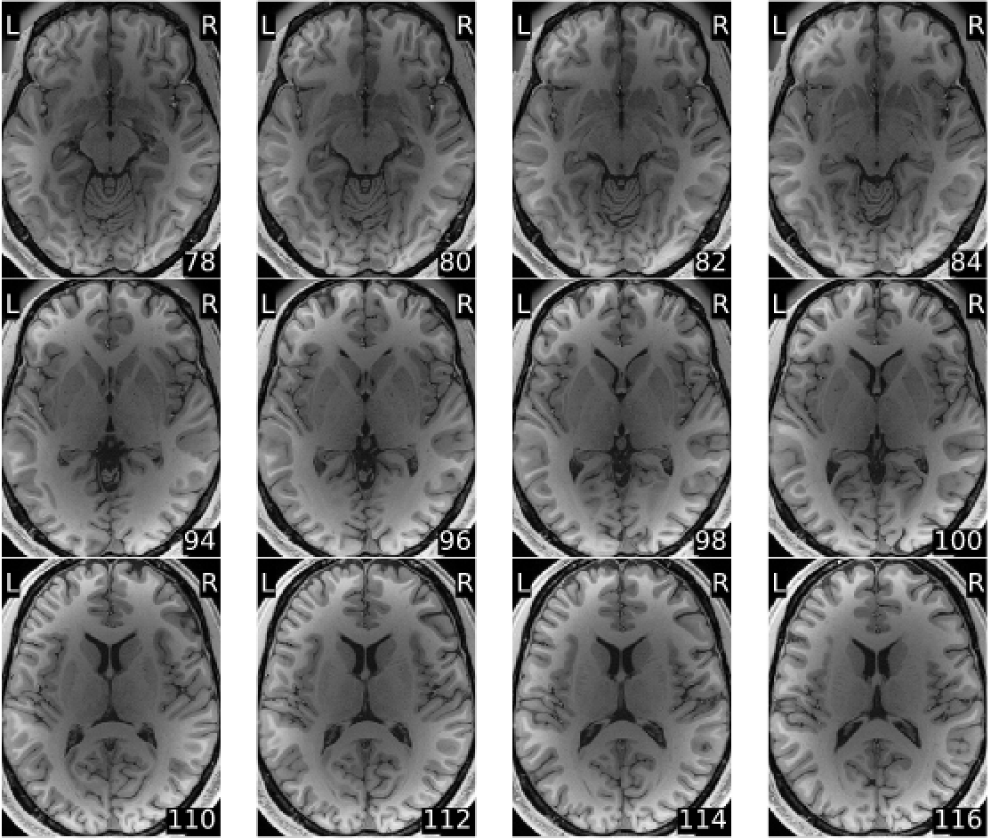
Ex. How to Find and Interpret Outliers
The CJV value for the outlier we identified is higher than others in the box plot
Indicates presence of head motion and artifacts
Click on the outlier which would take us to the individual report for that subject
Conduct a visual inspection to check for head motion and artifacts
In the picture on the right the center of each image is shadowy -- indicating an intensity normalization problem
Might check where it falls on INU IQM
Nothing to exclude at this point

Slide 15
How to Find and Interpret Outliers
The quality issues we have identified do not necessarily mean we would exclude the subject’s image data
At this time we would mark their structural scan quality as questionable and reconsider it at a later point in image quality analysis
If the study’s main focus is on Functional Imaging then we could exclude portions of the structural scans while still using the functional
Other good practices
Always do a visual inspection of data yourself
Put into a tool like FSL and watch as a movie to really check for motion, etc.

Slide 16
Helpful Links
https://mriqc.readthedocs.io/en/stable/about.html
https://rpubs.com/sarenseeley/bids-fmriprep-mriqc

Slide 17
References
Esteban, O., Birman, D., Schaer, M., Koyejo, O. O., Poldrack, R. A., & Gorgolewski, K. J. (2017). MRIQC: Advancing the automatic prediction of image quality in MRI from unseen sites. PLOS ONE, 12(9). https://doi.org/10.1371/journal.pone.0184661
Jarrahi, B., & Mackey, S. (2018). Characterizing the effects of MR image quality metrics on intrinsic connectivity brain networks: A multivariate approach. Annual International Conference of the IEEE Engineering in Medicine and Biology Society. IEEE Engineering in Medicine and Biology Society. Annual International Conference, 2018, 1041–1045. https://doi.org/10.1109/EMBC.2018.8512478

