Slide 1
Setting Up Oscar Lab Accounts & Signing In
How to request a CCV Account and then sign in
Brown University Clinical Neuroimaging Research Core
Version Date 1/06/2023

Slide 2
PT I: Prepping for Oscar
Denotes the page is for PIs only
Denotes the page is for general staff

Slide 3
Step 1: Set up lab members’ Brown email & Sponsored ID
Need both to establish a CCV account (linked to Brown ID)
PIs can send requests for staff IDs and emails to:
Holly_Wilker@brown.edu
Template for sponsor request here:
https://drive.google.com/drive/folders/1BY7fEi7by-NNTSf60JIn02c_RG1xnGWz?usp=sharing

Slide 4
Step 2: Establishing your Carney Affiliation (PIs)
Carney affiliated faculty can utilize the institute’s priority processing and 10TB of data storage at no charge.
Must be affiliated with Carney before requesting extra data storage.
Go here to submit request: https://www.brown.edu/carney/faculty

Slide 5
Step 2 Continued: Carney condo at CCV
High performance computing environment
Faster -- run multiple jobs, simultaneously
Managed storage and data backup
Advantages to using the condo
Reduces equipment purchases
Easy access to Brown-licensed software
Remote work, remote assistance

Slide 6
Step 3: Setup CCV PI Accounts
Request PI account by emailing support@ccv.brown.edu
Copy Jerome_Sanes@brown.edu on your email to CCV support -- he approves all Carney requests.
I am a (faculty appointment) in the Dept. of X and am affiliated with the Carney Institute. I am requesting 10TB of data storage on the Carney condo. I have copied Dr. Jerome Sanes to this email for verification of my affiliation with the Carney Institute, Brown University’s MRI facility, and grant #P20GM12345.
Template language for access request

Slide 7
Step 4: Setup non-PI CCV Accounts
Staff should request an account attached to a PI
Attached accounts are setup with access to the PI’s data folder
CCV will email PIs for verification
It may take a few days for your request to be approved
Link to request
https://ccv.brown.edu/

Slide 8
PT II: Logging into Oscar

Slide 9
How Do I Login to Oscar?
Open OnDemand (OOD) Web Portal
Displays a graphical user interface (GUI), which allows for pointing and clicking.
Ideal for many Matlab operations.
Terminal ssh protocol
Uses command line interactions through your computer’s terminal application
Either way, Oscar will take you home ~

Slide 10
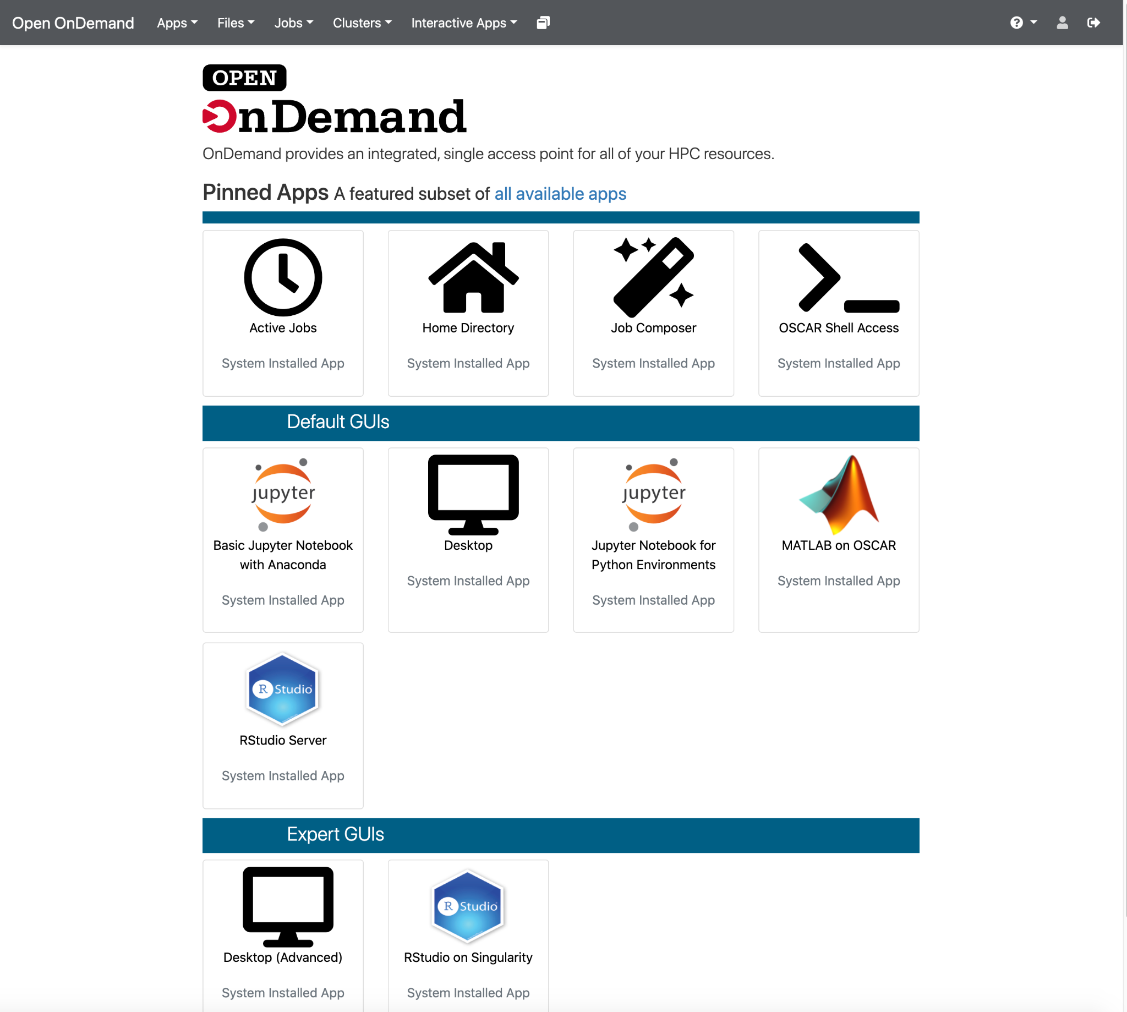
Login via OOD
Access/login through preferred web browser
Enter your brown credentials at the following link
https://ood.ccv.brown.edu
Do not need to download or install anything in order to access
Helpful links on OOD
https://docs.ccv.brown.edu/oscar/connecting-to-oscar/open-ondemand
Notes:
Running an intensive job run with more memory

Slide 11
Login via Terminal -- VPN Download
In order to login through your terminal you will need to be on Brown’s network or download a VPN
Use this link to navigate to Brown’s software page where you can download the VPN software
https://www.brown.edu/information-technology/software/
Scroll to the bottom of the page and click on VPN F5 Desktop Client
Once downloaded you will need to sign into Brown’s VPN
Everytime before you log into Oscar through your terminal you will need to click on the VPN icon in the top right corner of your screen and turn the VPN on if you are not already on a Brown network

Slide 12
Login via Terminal
Using your computer’s terminal application, enter this command:
ssh username@ssh.ccv.brown.edu
You will receive a prompt for your password
When you enter your password, you will not see entry of any characters for security reasons
ssh -Y (Mac flag) or -X (Linux flag) provides some graphical output even though it’s not a GUI
You are first connected to a gateway node or login node
These nodes (ex. Like one computer of the many) are used just to login to CCV on
Remember not to run any computationally intensive operations on login nodes
You can enter a compute node by using the interact command or by submitting a batch job (stay tuned!)
Exit the ssh terminal with this command:
exit

Slide 13
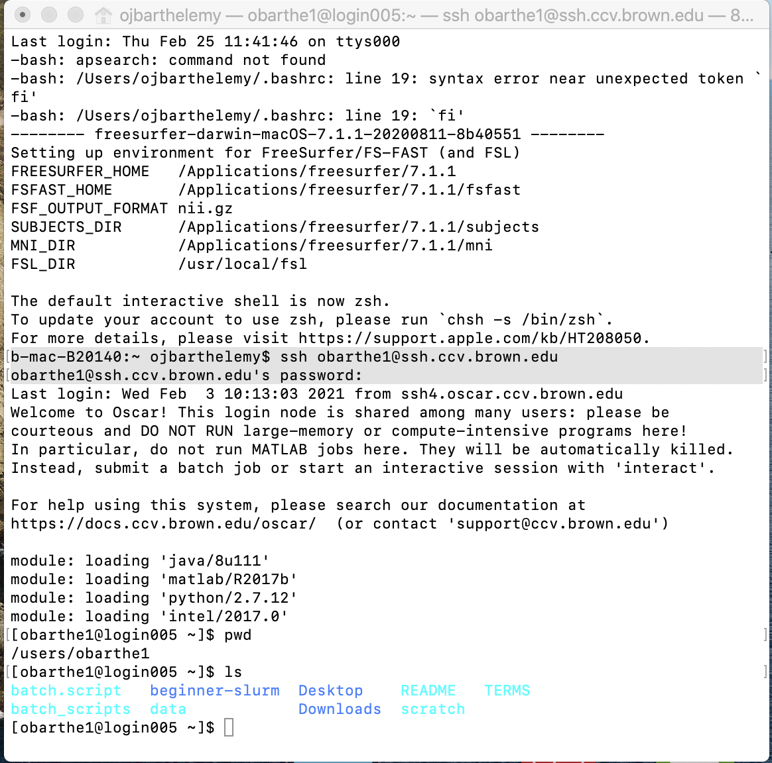

Slide 14
Resources and Contact Information
https://docs.ccv.brown.edu/oscar/
support@ccv.brown.edu
hpc@brown.edu (for high-powered computing consultation)
CCV_ANNOUNCE@listserv.brown.edu
Paul Hall, Ph.D., Paul_Hall@brown.edu

