Slide 1
Intro to CCV and Oscar
Brown University’s Center for Computation & Visualization & Cluster Computing Resources
Brown University Clinical Neuroimaging Research Core
Version Date 4/28/2023

Slide 2
Who or What is Oscar?
Oscar -- Ocean State Center for Advanced Resources -- is Brown's supercomputer maintained and supported by CCV -- The Center for Computation & Visualization
The supercomputer is made up of a bunch of individual computers or nodes
In the image on the right think of each computer as a node
Each node has multiple central processing units (CPUs) or cores
OSCAR’s 400+ nodes contain 11000+ cores
OSCAR’s operating system (OS): Linux (Red Hat 7)

Slide 3
Why Should I Learn to Use Oscar?
Oscar provides:
Remote access to data
Copious, secure data storage with managed backups
For greater security and esurance
Free access to university licensed software (ex. Matlab)
High-powered computing for intensive tasks that may not be handled by your normal computer
Oscar is free to most PIs and staff
Most programming consultations with CCV staff are also free
Oscar

Slide 4
Oscar’s Anatomy
Login Node
Gateway or ‘login’ nodes:
These are Oscar’s entry portals
Do not perform computationally intensive operations or use Matlab on them.
Compute nodes:
Where you can run intensive operations or Matlab
Submit an interact job or batch job to get run on a compute node
Transfer nodes:
The fastest nodes for data transfer
Storage:
~ (home),~ /data, and ~/scratch
Compute Node
Transfer Node

Slide 5
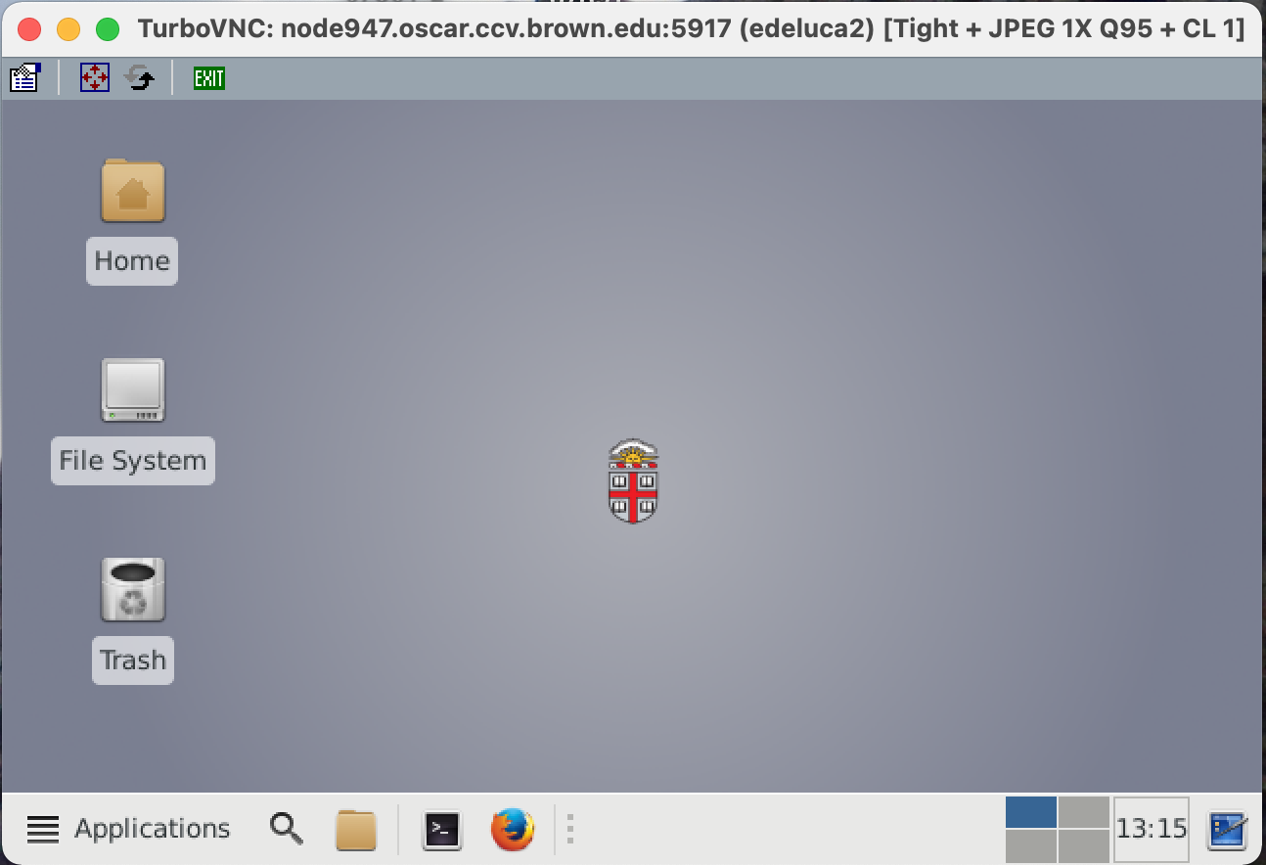
Important Folders: ~ (home)
50 gb Private, persistent storage (sysadmin can look, with your permission)
Good for source code, scripts
Utilize this folder rather than your data/user folder for any analyses or personal data
Notes:
Notes from PK: -> Good visual illustration with clear instructions and description

Slide 6
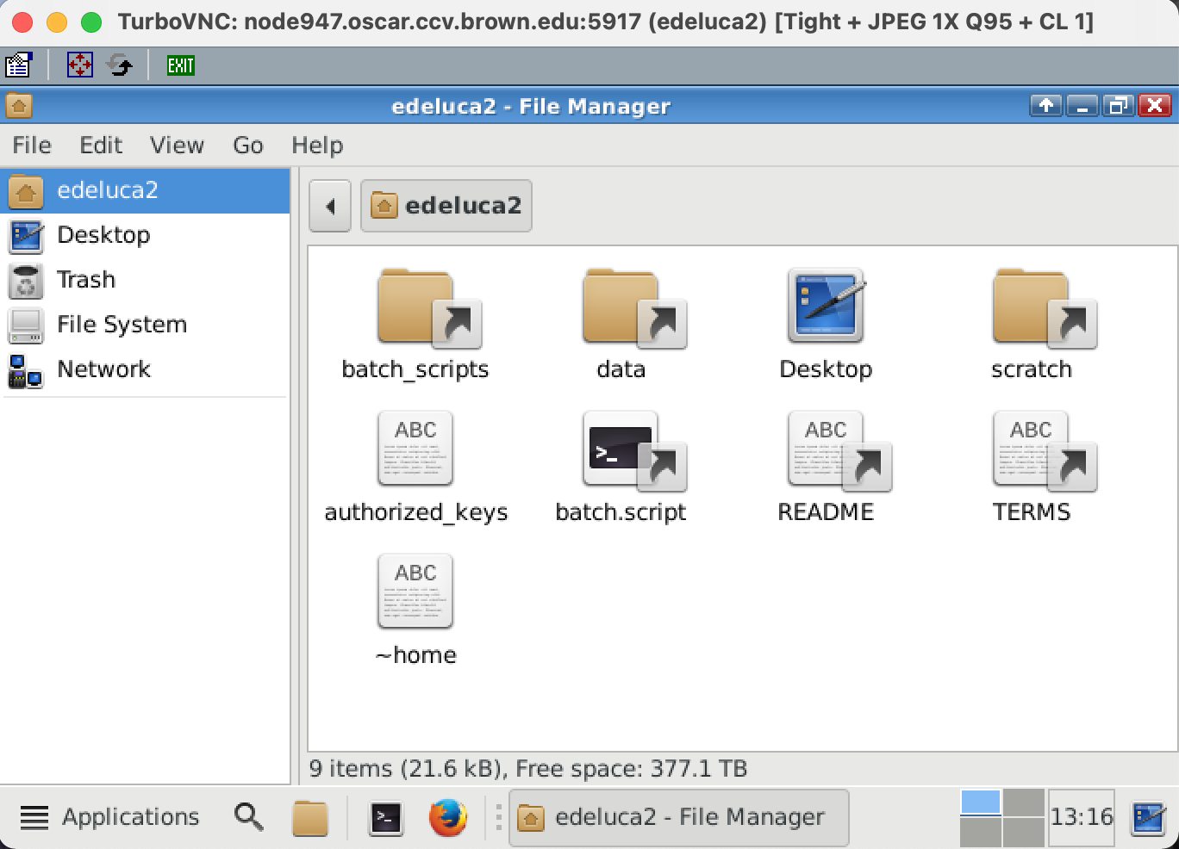
Important Folders: ~/data
Alias (a shortcut) to your PIs data folder that you can access from your home directory
Shared by members of PI’s group
512 gb of space
See lesson 2 for instructions for additional space requests
Permissions can be set to limit how others can interact with your data within this folder
Data for projects related to your main PIs projects will be stored here
Good for long term storage
Notes:
Notes from PK: -> Good visual illustration with clear instructions and description

Slide 7
Important Folders: ~/scratch
512gb-12tb
Files older than 30 days are purged
Automatic deletion
Private, temporary storage e.g., could download open access federal data in large amounts

Slide 8
How is Oscar Different than Your Computer?
You are not an administrator -- this limits your ability to install software programs.
To install a software program, you will have to file a request with CCV support
You need to run programs and software through a terminal using an interact node or by submitting a batch job
Must specify resources needed for the interactive session or batch job before it starts
Memory, cores, runtime
Default resource allocation parameters may not be sufficient for big jobs
Software environment involves loading modules
To use different programs type into command line
module load <name of program/version>
Ex: module load matlab/R2021a
See next slide for list of programs on Oscar
Linux OS and terminal
Notes:
Emily Note: I find this page a little confusing, not quite sure how I would re-word it yet

Slide 9
Neuroimaging, stats, and programming modules
Programming
anaconda (multiple versions between 2-4.3.0 and 3-5.2.0)
caffe 1.0 (also CPU only and with cudnn versions)
golang 1.15.6
idl 8.5.1
idl_DEEPS 8.7.2
java jdk-12.0.2
julia (multiple versions between 0.5.1 and 1.5.3)
lua 5.3.4
mallet 2.0.8rc3
material studio 2020
matlab (multiple versions between R2016a and R2019a
perl (multiple versions between 5.16.0 and 5.8.9)
python (multiple versions between 2.7.12 and 3.9.0)
qt (multiple versions between 3.3.8b and 5.9.0)
ruby 2.4.0
rust 1.45.1
Neuroimaging
afni (multiple versions between 17.1.00 and 20.1.06)
ants (multiple versions between 2.1.0 and 2.3.4)
brainiak Feb 2018
freesurfer (multiple versions between 6.0.0 and 7.1.1)
fsl (multiple versions between 5.0.10 and 6.0.3)
mriconvert 2.1.0
mricrogl 1.0
mricron (multiple versions between 05-2016 and 09-2019)
perl (multiple versions between 5.16.0 and 5.8.9)
Stats
R (multiple versions between 3.3.2 and 4.0.3)
rstudio (multiple versions between 1.0.44 and 1.3.1093)
SAS 9.4 and 9.4b
JAGS 4.2.0 and 4.3.0
Mathematica (multipole versions between 10.3.1 and 12.0.1

Slide 10
Transferring your data to CCV – Command Line
There’s more than one way to transfer data to CCV, but it’s fastest to use one of the transfer nodes from the command line
Nodes are devices in a network
Transfer nodes are optimized for data I/O performance
Steps once you log in through terminal
Click on Shell in the top left hand corner of your screen
From there click on New Window → New Window with Profile - Basic
In the new shell submit an interact job
ex. interact -n 4 -t 04:00:00 -m 20g
From here you can run the following transfer commands
Transferring data from your computer to Oscar:
rsync -a /path/to/source/file <username>@ssh.ccv.brown.edu:/path/to/file/destination
Transferring data from Oscar to your computer:
rsync -a <username>@ssh.ccv.brown.edu:/path/to/source/file /path/to/file/destination
Notes:
How do you find the full path to your destination file?
Login to the server and navigate to the folder where you want to store your files.
Type pwd on the command line and hit return. Now copy this path into the destination folder.
Notes from PK: pwd will state what directory you’re in.

Slide 11
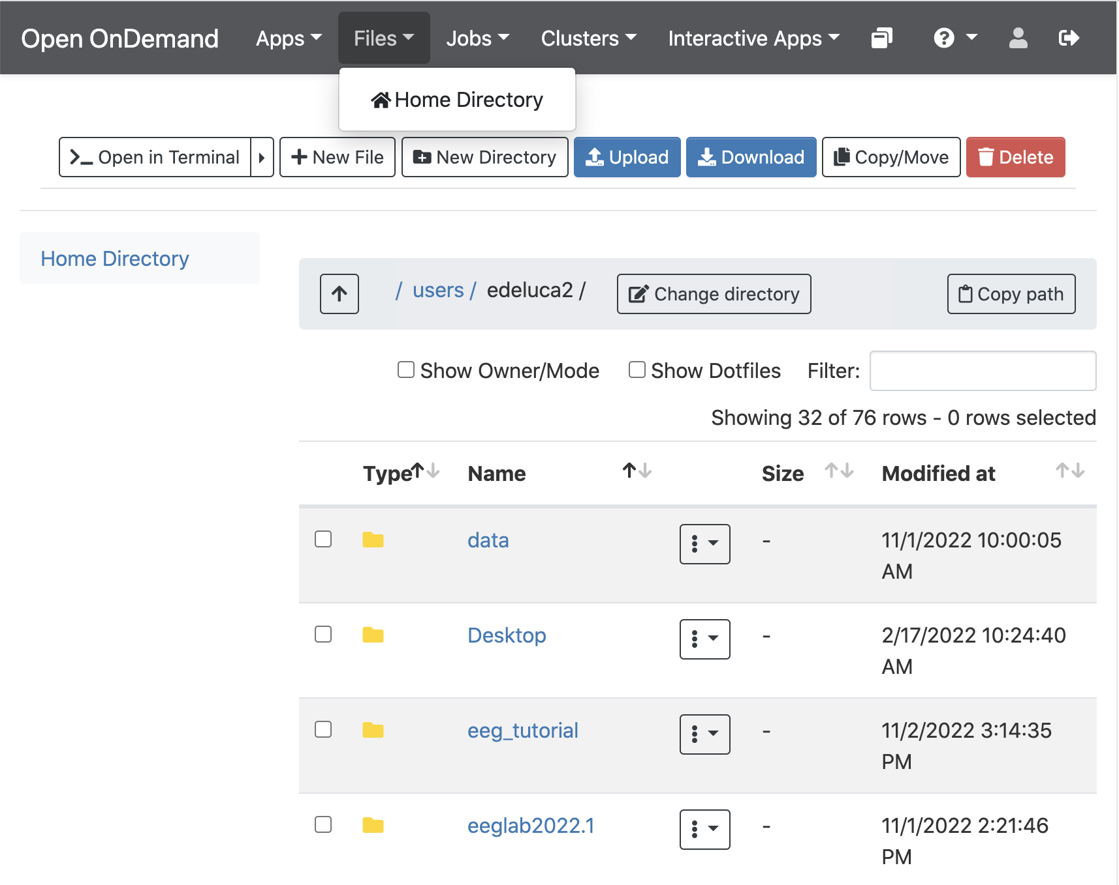
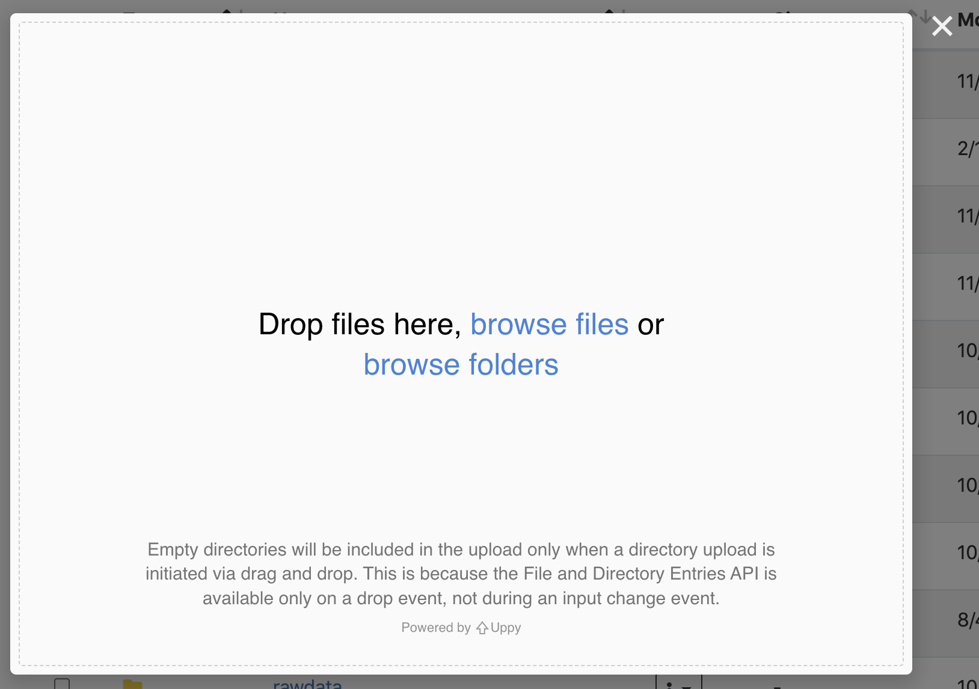
Transferring your data to CCV – OOD
In the upper left hand corner go to Files → Home Directory
Select Change directory and enter the path to wherever folder you want to upload into
e.g. /gpfs/data/<username>/ <studyname>/sourcedata
Select Upload and drag and drop all the folders/files you want to upload into the drop box
Once you have dropped all desired files select Upload files

Slide 12
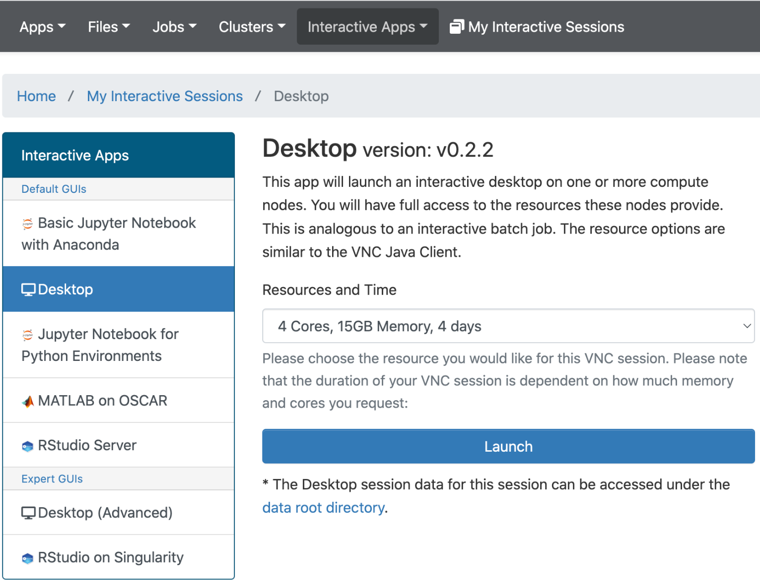
Starting an Interactive Desktop Session
Select Interactive Apps → Desktop (or another app you wish you use)
Click the down arrow under Resources and Time to select the resources for the session you want
Amount of resources depends on what you want to do – the basic 2 Cores, 7GB Memory, 1 Week normally suffices
Select Launch to begin the session
Keep track of or go back to you sessions by selecting My Interactive Sessions

Slide 13
Common Problems: File Permissions
What is a File Permission?
Users in a PIs group will have permissions to read (r), write (w), and execute (x) directories and files
How do you check file permissions?
Navigate to the directory the file you want to check is in
Type the following command
Permission check outputs
The d or - at the front tells you if it is a directory (d) or regular file (-)
The rwx iterations tell you the permissions of the user/file owner, the group, and others respectively
Do so per permission
The following example is the output you would get from checking permissions on a directory where everyone has the ability to read, write, and execute
ls -l <file or directory you want to check>
drwxrwxrwx <owner/user> <group> <other>

Slide 14
On the Output
Permission check outputs
The d or - at the front tells you if it is a directory (d) or regular file (-)
The rwx iterations tell you the permissions of the user/file owner, the group, and others respectively
The following example is the output you would get from checking permissions on a code directory where the user and the PI group have the ability to read, write, and execute
others/users outside of the PIs group do not have any permissions

Slide 15
Common Problems: File Permissions
How do you change file permissions?
Can change permissions using the chmod command
You can change permissions for the user (u), group (g), others (o), or all (a) three at once
Include -R to recursively change permissions
The following command recursively gives execute permissions for everyone in the group for myfile.txt
More information on file permissions can be found here
Video How-to: https://youtu.be/_I2cmILCvvg
chmod -R g+x myfile.txt

Slide 16
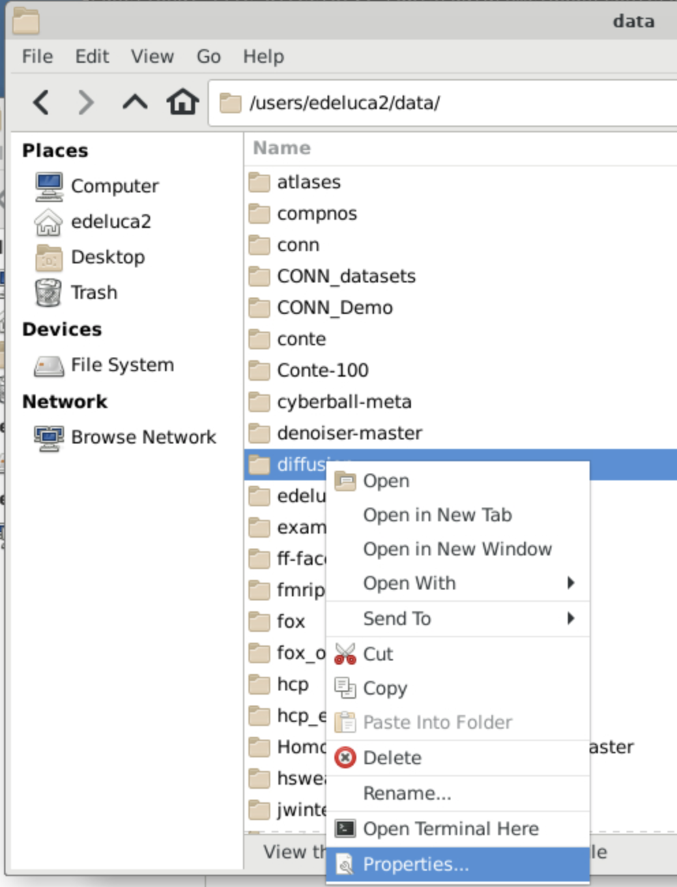
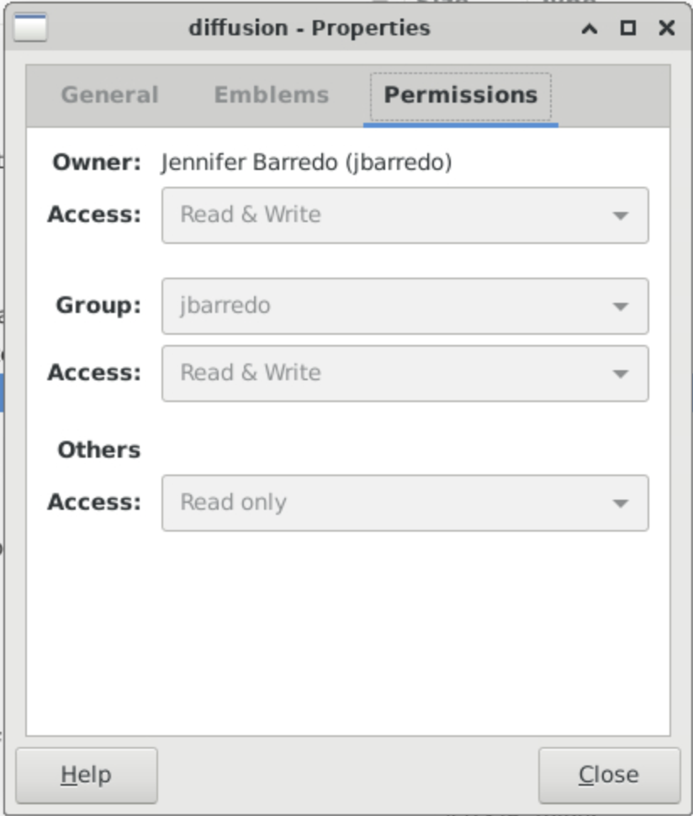
Changing File Permissions Through the GUI
When logged into Oscar through the OOD desktop can also change permissions through the GUI
In the file finder navigate to the directory or file you wish to change the permissions for
Right click on the file/folder and select Properties
Select Permissions
Change access on the Group level to give other group members Read & Write permissions
If you change permissions for a directory it will change the permissions for all of the files within it

Slide 17
CCV Events
http://events.brown.edu/ccv
Workshops on select Monday afternoons at 3pm (Zoom)
Office Hours every Friday from 10-11:30am

Slide 18
Resources and Contact Information
https://docs.ccv.brown.edu/oscar/
support@ccv.brown.edu
hpc@brown.edu (for high-powered computing consultation)
CCV_ANNOUNCE@listserv.brown.edu
Paul Hall, Ph.D., Paul_Hall@brown.edu
MAC OS Command Line Lists and Directories
https://ss64.com/osx/
https://www.makeuseof.com/tag/mac-terminal-commands-cheat-sheet/
https://github.com/0nn0/terminal-mac-cheatsheet#english-version

