Slide 1
Shell Basics
Learning how to use the terminal and a bash shell
Brown University Clinical Neuroimaging Research Core
Version Date 04/28/2023

Slide 2
Learning goals
Tutorial introduces basic programs, languages, and concepts used by computing clusters and neuroimaging pipelines
Explain shells and the command line
Know the difference between a path and a directory
Write a simple bash program
Notes:
Introduce some of the basic programs and languages used in neuroimaging in and out of cluster computing environment

Slide 3
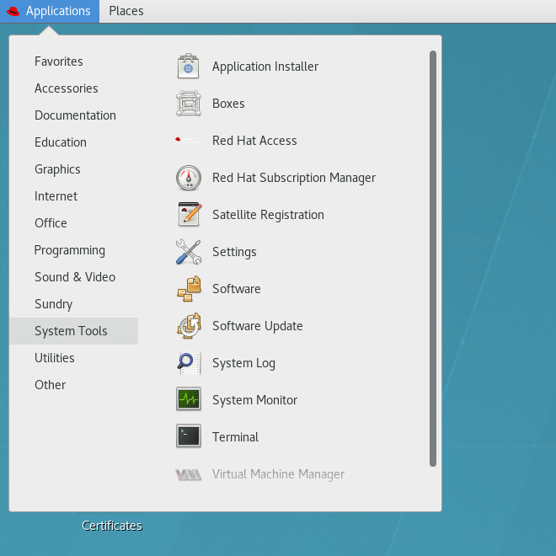
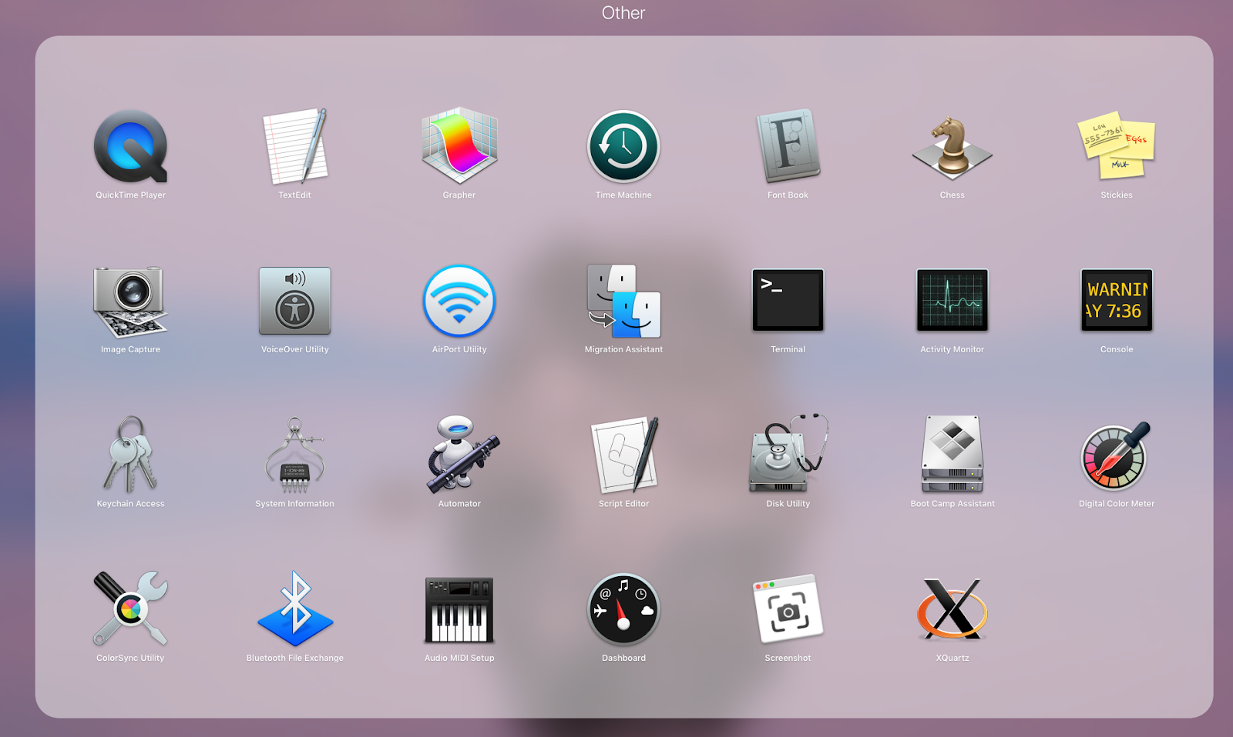
Shells
“The shell” -- program that interprets user commands to the operating system (OS)
Multiple languages (sh, bash, zsh, tcsh, etc.)
  Bash = Bourne-again SHell
Users interact with shells through the terminal or “command line”
Linux: Applications/System Tools/Terminal
MacOS (Unix): /Applications/Utilities/Terminal
Notes:
Commands are programs stored as binaries in the /bin/bash
Bash means bourne again shell
Bash is a type of shell

Slide 4
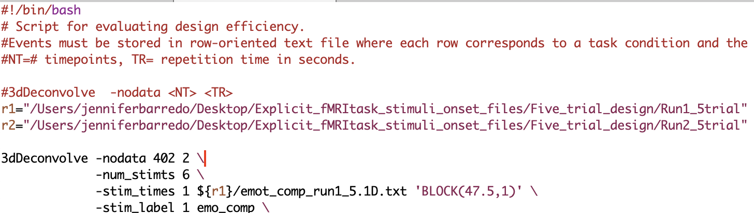
Bash (Bourne Again SHell)
Enhanced version of the original Bourne Shell
Still can use .sh at the end of file names
Most commonly used shell
Start bash shell script with #!/bin/bash to denote that it should be interpreted as bash
Notes:
Why we’re mostly using bash, what are its advantages relative to other shells.

Slide 5
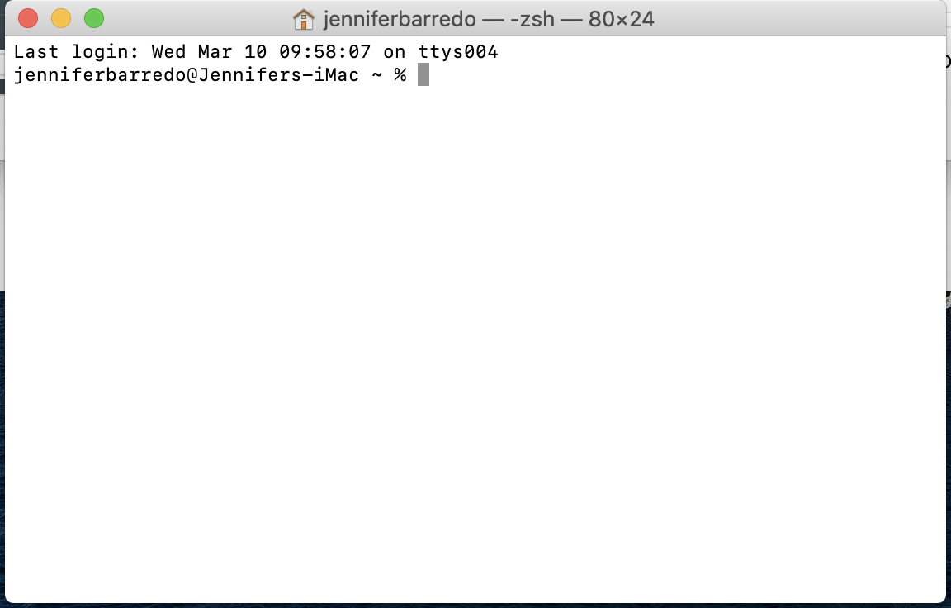
How to Change Shells
Shell opens in your home directory (user folder) by default.
Change shells by entering the shell’s name on the command line:
>> bash
To permanently change the default shell on a Unix machine:
>> chsh -s /bin/bash
Enter your user password at the prompt and restart terminal
Notes:
Why we’re mostly using bash, what are its advantages relative to other shells.

Slide 6
Notation
Double carrot >> statement to be entered in the command line (terminal).
<user entered value>
~ or ~/ is shorthand for the “home directory”
# tells the shell interpreter to ignore or “comment out” subsequent text in a single line of code
Notes:
Describe shorthand used in the rest of the tutorials
State that you will explain the home and current directory in a few slides

Slide 7

Directories (folders)
Common Commands
cd <folder or path> change directory
cd ~ change to home directory
cd . . change to parent directory
mkdir make directory
pwd print working directory
ls list
cd - change directory to previous
directory
Click on the box above for a demonstration
Notes:
Demo in order: pwd, mkdir, cd to new directory, mkdir in new directory, cd back to first mkdir using ..,cd to home directory using ~
Talk about alias — basically a shortcut – pull up teachers data shortcut
Butler hospital street name analogy
/ slashs when you need them

Slide 8
Shell Shortcuts
The caret (^) symbol represents the CTRL key for terminal commands. Even on MacOS, you still use the CTRL key
^L : Clear screen (can also use < clear > )
UpArrow & DownArrow: scroll through recently used commands
^U : Erase the current line
^A : Go to beginning of line
^E : Go to end of line
^R : Search for recently used command (Reverse keyword search; e.g. find recently used commands with “ls”)
<TAB> : auto-complete command, path, etc.
^C : stop running the current command

Slide 9
Paths (directions)
A path points to a directory or file location
Absolute or full paths are independent of the current directory
Describes location of a directory or file within a parent directory
  User login parent: /Users/hannah
  OS parents: /bin, /usr/lib, etc.
  CCV home: /gpfs/home/userID
  CCV data: /gpfs/data/userID
Relative paths reference the current directory
Click on the box above for a demonstration
Notes:
Demonstrate relative path by cd to 2nd mkdir from 1st mkdir vs ~/
Start in “Documents” and demo pwd to see full path
Demonstrate relative paths showing cd ../
Combination of pound sign and !
$PATH
775
Change permissions through GUI

Slide 10
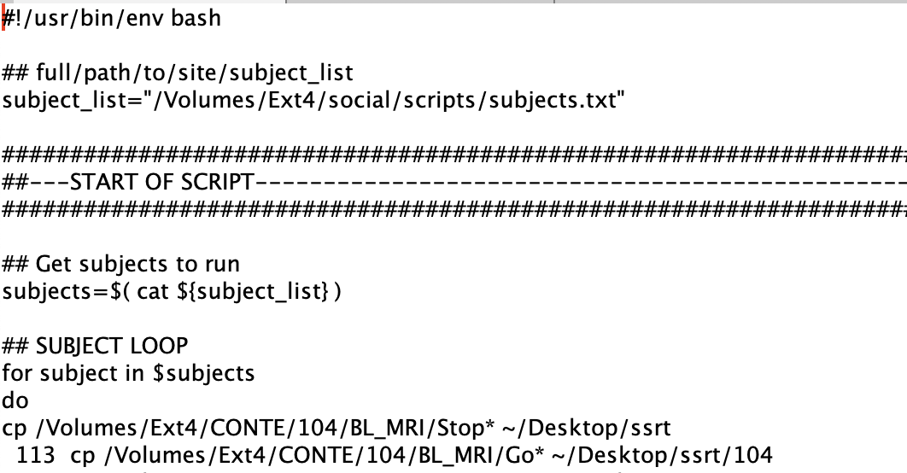
Shell Scripting
A script is a set of commands executed in sequence to automate a task
First line contains the “shebang” -- syntax telling the OS which interpreter to use (e.g., bash, python)
#!/bin/bash or #!/usr/bin/env bash
Notes:
A script is a set of commands executed in sequence that automates a task. Easiest to using a text editor. First line tells the OS which interpreter to use. Explain shebang and describe difference between #!/bin/bash and #!/usr/bin/env bash
Shebang is syntax used in scripts to indicate which interpreter to use, such as using bash or even python.
Show “env” in current bash shell
#!/bin/bash is the standard shebang and it ensures that bash will be used to interpret the script
#!/usr/bin/env bash runs bash in a modified environment and makes your bash script portable; advantage is that it will use whatever bash executable first appears in your path… if you create multiple bash profiles, you can use this shebang to execute your program in that environment

Slide 11

Other resources
Shell tutorial: Introduces basic concepts at greater depth. Built around Linux, but also applies to Unix, though with the occasional exception

Slide 12
Test your knowledge
Get help
Office hours:
Hannah Swearingen
Wednesdays 2PM - 4PM
https://zoom.us/j/7604990871?pwd=NlJLWHRmczRSRGUzeURMbUZOZERkQT09
Write a script including commands to do the following:
Makes a directory in your home folder called “test1”
Makes a directory in test1 named “test2”
Go to the test2
Prints the full path to your final location to the command line
Go to the directory where you saved your script and make it executable:
>> chmod 770 <your script name>
To run your script from the directory where it’s saved:
./<your script name>

