Slide 1
XNAT
Creating an XNAT Account and getting your data onto OSCAR
Brown University Clinical Neuroimaging Research Core
Version Date 1/18/23

Slide 2
What is XNAT
Open source imaging informatics platform that can support a variety of neuroimaging projects
Functions to manage the import, archival, processing, and distributing data
When properly set up data from the MRF scanner at Brown can be sent directly to XNAT
From XNAT, project data can be uploaded onto CCV and converted to BIDS formatting simultaneously
For more in depth information see:
https://docs.ccv.brown.edu/bnc-user-manual/xnat/getting-started

Slide 3
Setting Up for XNAT
At the scanner level your scans will need to be named
Contact Mike Worden to inquire about getting your study set up for XNAT
worden@brown.edu
Recommend contacting prior to collecting data

Slide 4
XNAT to CCV Process
Scanner —> XNAT-Relay —> XNAT —> Xnat2bids —> Oscar Study Directory
Oscar

Slide 5
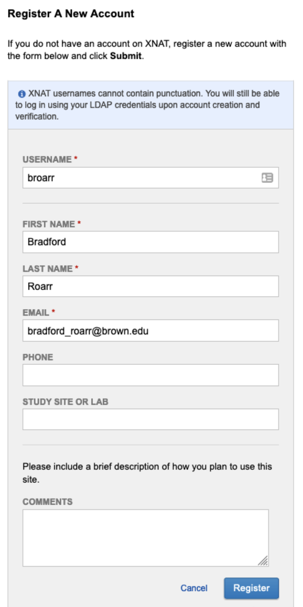
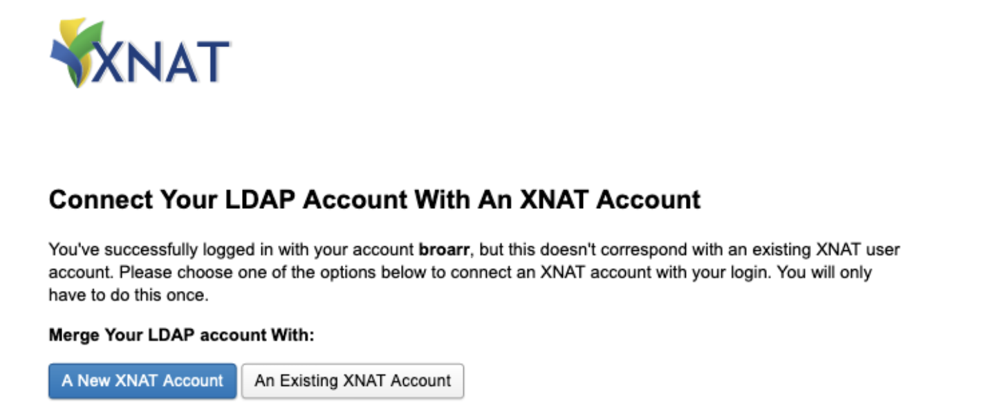
Creating an XNAT Account
3
Go to: https://xnat.bnc.brown.edu/
Make sure Brown LDAP is selected
Enter your brown username and password and select Login
DO NOT click register yet
Select A New XNAT Account
Enter your Brown account Information
Select Register
1
2

Slide 6
Finding XNAT scripts on Oscar
Through the terminal on Oscar Desktop navigate to the BNC’s shared scripts folder
cd /gpfs/data/bnc/shared/scripts/oscar-scripts/
Type ls to see the below XNAT scripts in the folder
run_xnat2bids.py
x2b_example_user_config.toml – for s single subject
x2b_example_user_mult_sessions_config.toml – for multiple subjects/sessions
Copy the relevant .toml script into the directory where you want to store study data
Name it something relevant to your study
cp x2b_example_user_config.toml /gpfs/data/<pi_username>/<studydirectory>/x2b_studyconfig.toml
Open the .toml file using your favorite text editor (e.g. emacs, vscode, kwrite)
To open vscode type the below text in your command line
module load vscode
code

Slide 7
Changing Default Configurations
The arguments on the right are default
You DO NOT need to change them, or add them to your script unless want to specify something else
The memory, time, node, etc specifications have been picked to work for most data
The arguments request the amount of resources you want to run the job – in this case “xnat2bids”
[slurm-args]
time = "04:00:00"
mem = 16000
nodes = 1
cpus-per-task = 2
job-name = "xnat2bids"
[xnat2bids-args]
host="https://xnat.bnc.brown.edu"

Slide 8
Editing XNAT Config File - Single Subject
mail-user =
Enter your brown email address
sessions =
Enter the accession number for the subject you want to upload to Oscar
See the next slide (slide 10)for how to find this number
includeseq =
Enter the numbers for the scan type you want to upload to Oscar
See slide 11 for how to find scan numbers
If you do not specify any sequences all scans will be uploaded
skipseq =
Enter the numbers for the scans you do not want to upload
#Configuring arguments here will override default parameters
[slurm-args]
mail-user = “example-user@brown.edu”
mail-type = “ALL”
[xnat2bids-args]
sessions = [“XNAT_E00080”]
includeseq = [7,10]
skipseq = [6]

Slide 9
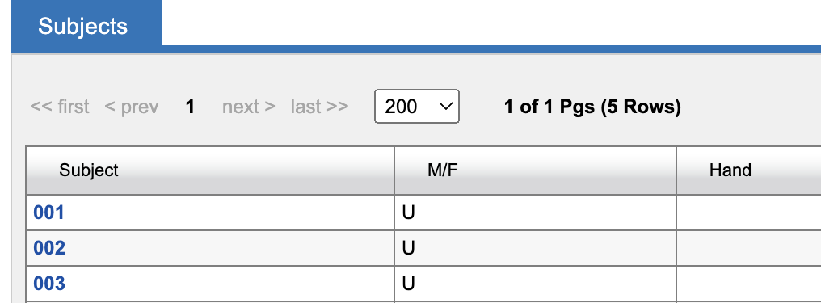
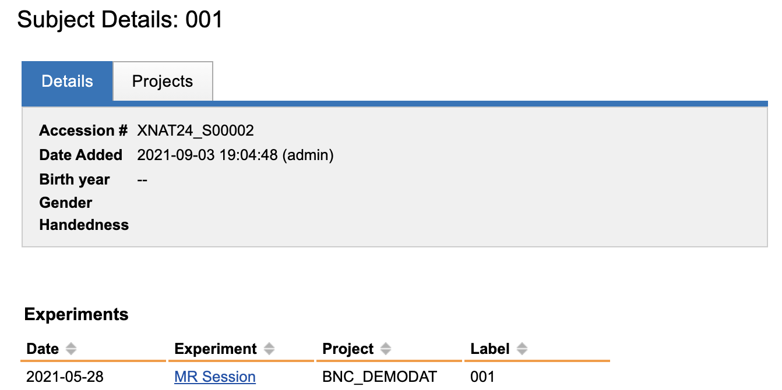
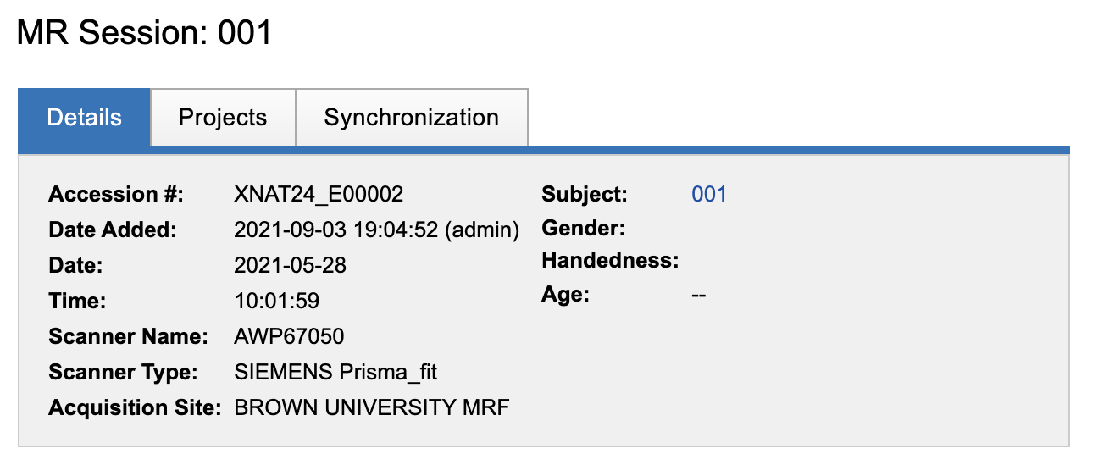
Finding the Accession Number
1. Select the study you want data from
2. Select the subject you want data from
3. Click on the MR session
4. Get the accession number

Slide 10
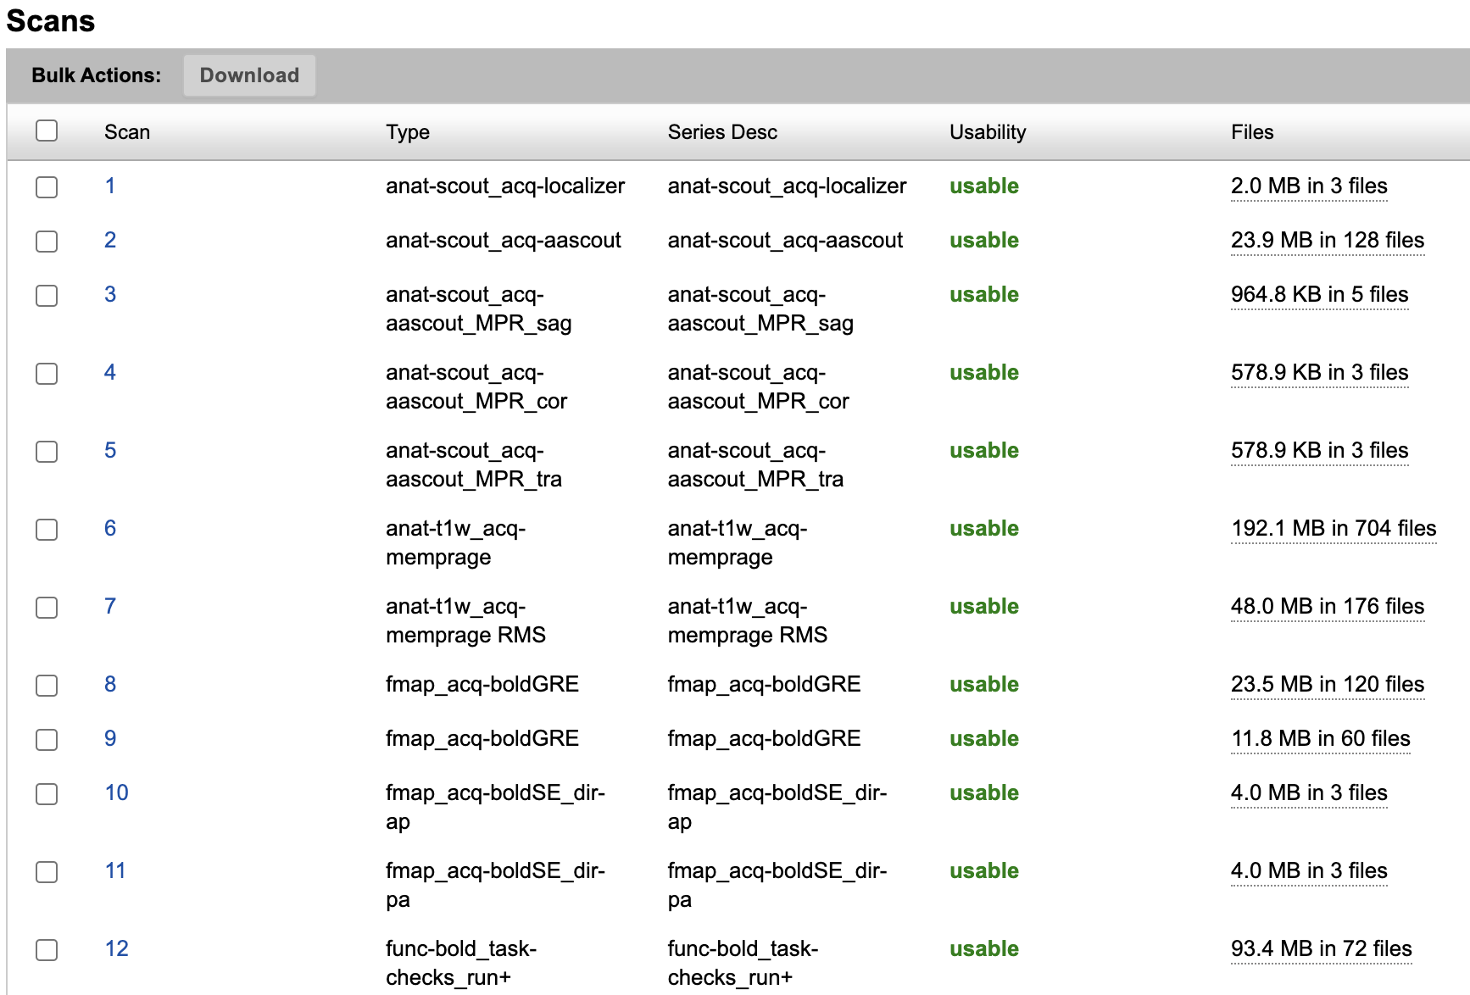
Finding Scan Sequences
Log onto XNAT
Select the study you want data from
Select the subject you want data from
Under Experiments select MR Session
The numbers under scan are the numbers you use for the scan sequence
Ex to include anat-t1w_acq-memprage RMS includeseq = [7]

Slide 11
Editing XNAT Config File - Multiple Subjects
To run for multiple subjects the sessions = section will include multiple accession numbers
The rest of the script can stay the same
overwrite = true
Will overwrite any existing processed data for a subject if it already exists on Oscar
verbose =
Setting as 1 will show more detail in the output logs – helpful when debugging
[slurm-args]
mail-user = "example-user@brown.edu"
mail-type = "ALL"
[xnat2bids-args]
sessions = [
"XNAT_E00080",
"XNAT_E00114",
"XNAT_E00152"
]
skipseq=[6]
overwrite=true
verbose=0

Slide 12
Editing XNAT Config File – Custom Parameters
Add to bottom of the script if you want to specify different parameters for each subject that you have listed in the sessions = section
Can change the level of verbosity with verbose =
Include different sequences for each subject with includeseq =
Include cleanup = true to have the program get rid of dicom data after running
Do not recommend doing
[XNAT_E00080]
includeseq=[19, 21]
[XNAT_E00114]
includeseq=[7,8,11,14]
verbose=2
[XNAT_E00152]
includeseq=[7,8,9,10,11]
verbose=1

Slide 13
Running xnat2bids
Through the command line navigate back to the BNC’s shared scripts folder
cd /gpfs/data/bnc/shared/scripts/oscar-scripts/
Enter the below commands into your command line
module load anaconda/latest
python run_xnat2bids.py --config /gpfs/data/<pi_username>/<studydirectory>/x2b_studyconfig.toml
Runs xnat2bids.py (standard script located in shared scripts folder) using the configurations you have set up in x2b_studyconfig.toml located in your study directory
After running can check BIDS compliance through the BIDS validator (see link to ppt)

Slide 14
Helpful Links
Please see the below link for more in depth information about XNAT from the BNC
https://docs.ccv.brown.edu/bnc-user-manual/xnat-to-bids-intro/using-oscar/oscar-utility-script

