Slide 1
fMRI Pre-Processing
What is pre-processing and why do we do it
Brown Clinical Neuroimaging Core
Version Date 01/11/2022

Slide 2
What is Pre-Processing?
The fMRI signal includes a lot of information that is unrelated to the signal of interest
Unrelated information, i.e. noise, can often be as large or larger than the signal of interest
In these cases, researchers will be unable to determine if a significant change in BOLD signal was caused by task-related activity or a source of noise
Pre-processing steps remove the noise and isolate the signal of interest, which makes statistical analysis more powerful

Slide 3
Sources of Noise

Slide 4
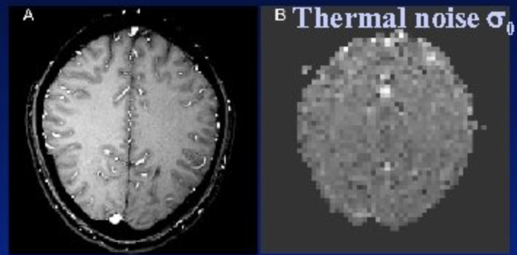
Thermal Noise
Arises from thermal fluctuations (heat) of the participant or the machine hardware
Unavoidable/ever-present in MRI data collection
Images with lots of thermal noise would have low smoothness estimates
Can cause undesired fluctuations in signal
Thermal noise increases linearly with field strength and has no spatial structure
Ex. A 7T, vs a 3T scan, will have much higher levels of thermal noise
Notes:
STILL TRYING TO FIND GOOD PICTURES

Slide 5
System Noise
System noise refers to MR/BOLD signal fluctuations caused by imperfect functioning of the MRI hardware (Huettel, Song, & McCarthy, 2009)
Scanner drift
Scanner drift refers to a gradual change in voxel intensity over time caused by changes in the MRI hardware
One common cause of scanner drift is a slow change in the strength of the static magnetic field
Scanner drift can affect the whole brain or only parts of the brain
Geometric distortions of the image can be caused by inhomogeneities in the magnetic field
Notes:
https://www.semanticscholar.org/paper/Simultaneous-correction-of-ghost-and-geometric-in-a-Schmithorst-Dardzinski/5a310e412a829844c8a1a7cf63dc81f3ca9b2562/figure/4 from left to right, first echo image of multiecho reference scan, uncorrected, corrected

Slide 6
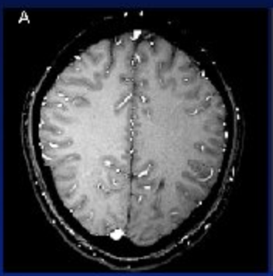
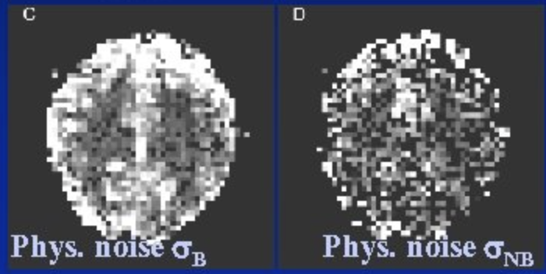
Physiological Noise
Signal changes in a mri image that arise from the scanned subject’s physiology, outside of the brain activity of interest (Jezzard, 1999)
Most often due to cardiac and respiratory cycles
I.e. Blood flow, heart beat, & breathing
Can induce signal changes in BOLD (Functional) scans that appear similar to those of activations from regions of interest in the brain
Can cause movement or disruptions of the main magnetic field
Increases with main field strength
In higher scanners (7T) thermal noise can become more prominent
Anatomical Image
Images with Physiological Noise

Slide 7
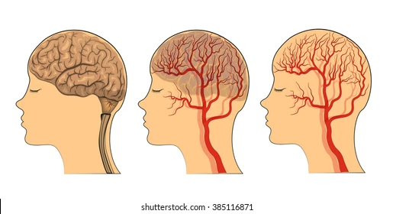
Physiological Noise
Cardiac
Cerebral blood flow, cerebral blood volume, etc. all change throughout the scan
Essentially the participant’s blood moving throughout their body
Different cardiac phenomena can change the distribution of brain tissue, blood, and cerebrospinal fluid (CSF) throughout the course of image acquisition
This cardiac noise is most noticeable around arteries
Notes:
Find diagram of cardiac system

Slide 8
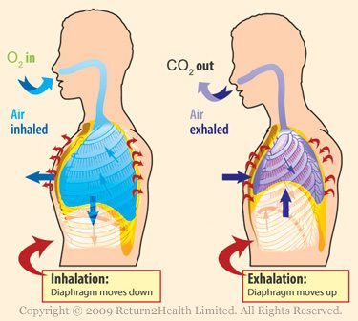
Physiological Noise
Respiratory
The act of breathing causes movement
Ex. When an anxious participant takes a big breath many parts of their body may move
Could cause head movement or magnetic field fluctuations that leads to an artifact
Changes in C02 levels from breathing can also cause changes in cerebral blood flow
Breathing moderates CO2 levels & CO2 is a vasodilator
Notes:
Find diagram of lungs

Slide 9
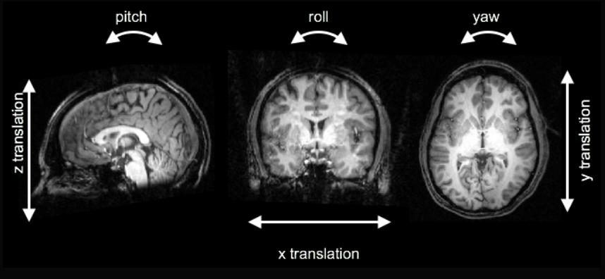
Motion
Head motion is often the largest source of noise in MRI data
The head can move in six different directions (see image below)

Slide 10
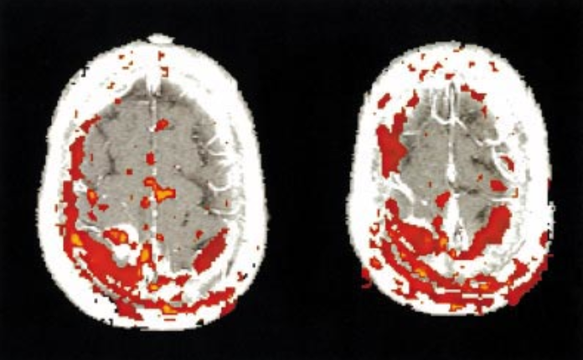
Motion
fMRI analyses assume that every voxel contains an unchanging cube of brain tissue that is repeatedly sampled over time.
Head movement changes the brain tissue within each voxel, leading to non-task related changes in BOLD signal intensity.
Changing brain tissue within a voxel can lead to far greater BOLD signal changes than task-related activation.
This effect is particularly pronounced at the edge of the brain and at the boundaries of tissue types with different BOLD signal intensities.
Notes:
https://www.researchgate.net/figure/Movement-related-artefacts-This-figure-shows-the-typical-motion-artefact-present-during_fig1_11954127

Slide 11
What Are The Steps Within Pre-Processing?

Slide 12
Types of Pre-Processing
Anatomical
Skull Stripping
Segmentation
Spatial Normalization
Functional
Slice Time Correction
Head Motion Correction
Distortion Correction
Functional-Structural Coregistration
Temporal Filtering
Spatial Filtering

Slide 13
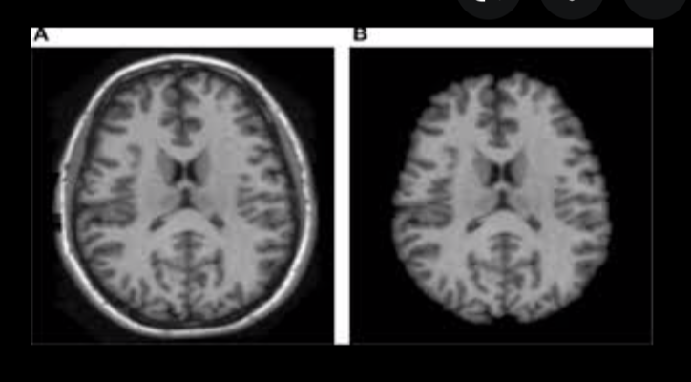
Skull-Stripping
Skull-stripping isolates and removes the skull from the image to limit the analysis to brain tissue
The skull has a different intensity than other parts of the brain
An MR image before skull-stripping (left) and after skull-stripping (right)
Notes:
https://ejmcm.com/article_8354_84562ddd65a48045d81d4065941691ec.pdf

Slide 14
Segmentation
Separates MRI images into different tissue classes
White matter (WM)
Grey matter (GM)
Cerebrospinal fluid (CSF)
Tumors, etc.
Done so that different tissue types and anatomical landmarks can be identified
Partial Volume Effect
An issue that arises when one voxel may contain more than one tissue type
Makes segmentation and future analysis more complicated

Slide 15
Spatial Normalization
Different brains have very different shapes and sizes, causing issues for comparisons across subjects
Spatial normalization manipulates brains to match a ‘normal’ template and allow for easier comparisons
The most common template for normalization is the MNI template, which was formed by averaging a large number of healthy brains
Four brains of different shapes and sizes

Slide 16
Slice-Time Correction
Unlike a regular photograph slices, essentially sections of the MRI image, are not taken simultaneously
Different types of slice acquisition
Sequential/Ascending/Descending
Start at one end of the brain and go one slice at a time to the other end of the brain
Interleaved
Collect all odd slices and then all even slices
Avoids cross-slice excitation
Multiband 4/simultaneous multislice
Excites and then receives signals from multiple slices at one time
The number of volumes collected increases by the “MB factor”
Ex. Multiband 4 increases the volumes four-fold, multiband 8 increases eight-fold
Improves spatial resolution and sensitivity to signal fluctuation detection
When looking at data it is assumed that all slices were taken at the same time
To allow for this we need to do slice-time correction
Notes:
https://andysbrainbook.readthedocs.io/en/latest/fMRI_Short_Course/Preprocessing/Slice_Timing_Correction.html
Using multiband 4 add..
https://www.sciencedirect.com/science/article/pii/S1053811921002421

Slide 17
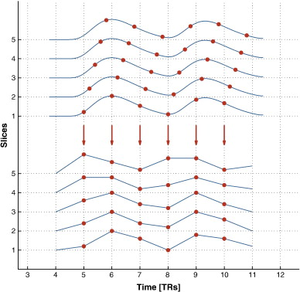
Slice-Time Correction
Corrects slice-timing effects that can significantly distort fMRI results
Shifts the time series of every slice in order to align all of the slices to a reference time-point
Shift the time-series back by the amount of time it took to acquire the slice (Sladky et al. 2011)
Temporal Interpolation
Common method of correcting for slice-timing
Uses info from adjacent slides to estimate activity during timepoints that were not samples
Gives an estimate of activation across the whole brain at every time point
Notes:
http://andysbrainblog.blogspot.com/2012/09/slice-timing-correction.html

Slide 18
Head Motion Correction
Head motion is easier to prevent than correct!!!
The size and shape of the brain remain constant during movement, so rigid-body transformations that translate and rotate the brain can correct head motion
Sometimes head motion leads to lost data. In these cases, spatial interpolation uses nearby voxels to estimate the activation in a voxel had there been no head motion

Slide 19
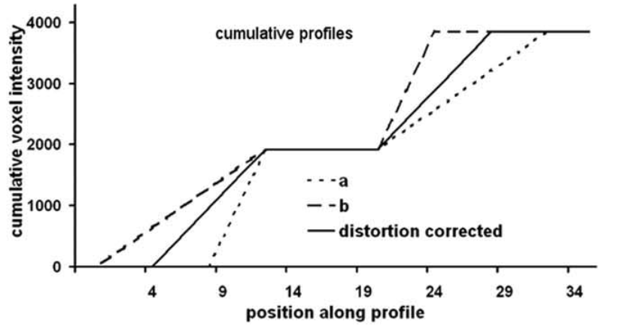
Distortion Correction
Inhomogeneities in the magnetic field can often cause geometric or intensity distortions
Large field inhomogeneities can lead to signal loss
These distortions need to be corrected in order to have an accurate representation of the geometry of the brain
Distortion correction makes an estimate of the field inhomogeneity map
Notes:
https://onlinelibrary.wiley.com/doi/epdf/10.1002/hbm.20959

Slide 20
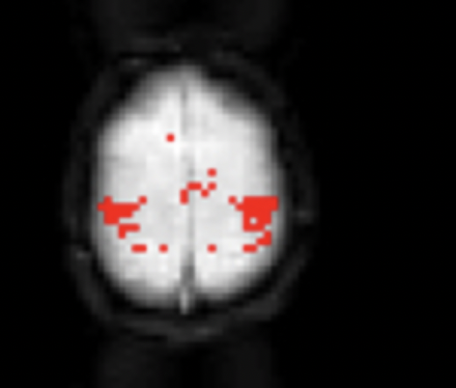
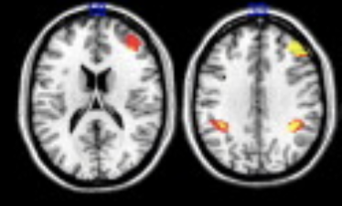
Functional-Structural Coregistration
Many anatomical landmarks are difficult or impossible to spot in functional images
The lower resolution functional image is mapped onto the higher resolution structural image to aid with spatial normalization and the interpretation of findings (i.e. identifying where a voxel is the brain relative to anatomical landmarks)
The anatomy in the structural image (left) is far more detailed than in the functional image (right)
Notes:
https://www.researchgate.net/figure/FMRI-activation-group-level-maps-from-session-1-left-side-of-each-panel-The-overlap_fig3_221828588

Slide 21
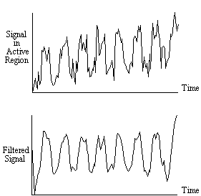
Temporal Filtering
Removes frequencies from the signal that are not of interest
Removes repetitive, predictable, non task related noise
Ex. Physiological noise
Can improve the signal to noise ratio (SNR)
The ratio of signal power to the noise power
Compares the level of desired signal to the level of background noise
Higher values are better
Notes:
https://en.wikibooks.org/wiki/Neuroimaging_Data_Processing/Processing/Steps/Temporal_Filtering
https://users.fmrib.ox.ac.uk/~stuart/thesis/chapter_6/section6_2.html

Slide 22
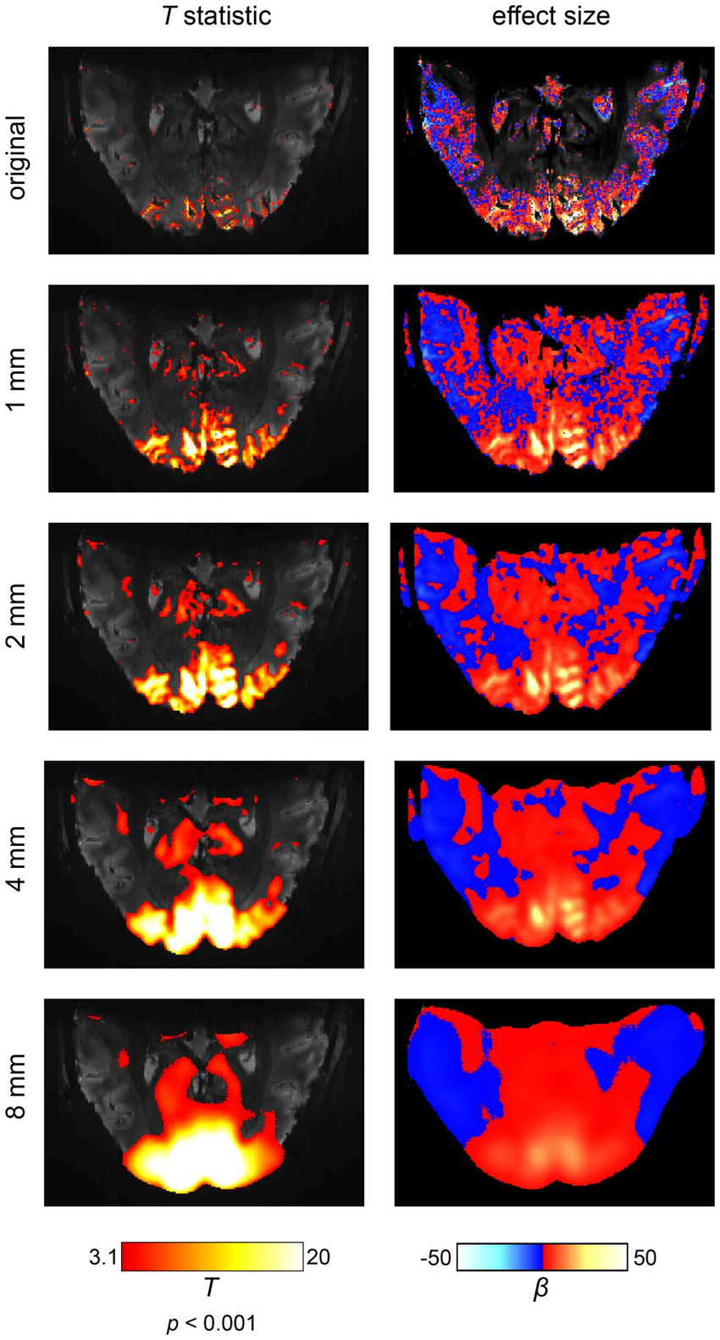
Spatial Filtering
Spatial filtering, or smoothing, spreads the signal from a voxel over nearby voxels
Smoothing increases the SNR and the validity of statistical tests
The image to the right illustrates the effects of progressively stronger smoothing
Smoothing is done with a kernel that is measured in mm
Larger kernels are stronger, as seen to the right
Optimal kernel size depends on the data and type of analysis
Notes:
https://www.researchgate.net/figure/The-effects-of-spatial-smoothing-illustrated-on-an-ultra-high-field-fMRI-data-set-at-a_fig4_264394222

