Slide 1
MRI Quality Control (MRIQC)
PT 1: How to Run
How to run your data through the MRIQC Singularity container on CCV and locally through Docker
Brown University Clinical Neuroimaging Research Core
Version Date 05/03/2023

Slide 2
What is MRIQC?
A software tool for extracting quality measures/performing quality assessments on T1w, T2w, and functional MRI data
Fully automated pipeline assesses data quality and enables visual examination of MRI scans
Outputs reports assessing Image Quality Metrics (IQMs) for each subject
Numerical output, can compare across subjects
Runs as a singularity (like Heudiconv) on CCV
Built on established software toolboxes (FSL, ANT’s, and AFNI)
Developed by the Poldrack Lab at Stanford University
Notes:
Understandable and straight to the point.

Slide 3
Features of MRIQC
Containerized versions bundle software dependencies together for easy installation on local servers and workstations
Can also be run through a free online service (OpenNeuro.org)
No-reference quality norms help quantify quality differences across study sites
Brain Imaging Data Structure (BIDS) compatible
Easy integration with popular pipelines (fMRIPrep; NiPy)
Automatically generates anonymized HTML reports
Can easily share the summarized QA data between group members and collaborators over email or other low-security apps
Notes:
Understandable and straight to the point.

Slide 4
How does MRIQC improve QA?
Problems with visual QA
Subjective
Impractical for large data sets
Time consuming
Prone to variability (inter-rater differences)
Some artifacts evade human detection
Help with large scale imaging efforts
Less subject to site or population-specific biases
Standardize procedures between sites

Slide 5
MRIQC Mechanisms
Image Quality Metrics (IQM)
No-reference metric of data quality
Structural IQM Categories
Signal and noise comparisons
Information theory measures
Mechanical artifacts
Functional IQM Categories
Spatial artifact detection
Temporal stability
For more information on IQM’s please see the the tutorial MRIQC PT2: IQMS

Slide 6
Other relevant info: What are Artifacts?
A feature appearing in an image that is not in the original object
May cause unwanted distortions in brain images
Do not always affect image quality but can affect diagnostic quality
i.e. an artifact may be confused with pathology
Some artifacts cannot be detected by the human eye - programs like MRIQC help to detect these
Two main overarching categories:
Machine specific artifacts
Patient related artifacts
See the tutorial titled MRIQC PT3: Artifacts for more information
Notes:
https://www.ncbi.nlm.nih.gov/pmc/articles/PMC4340093/
https://radiopaedia.org/articles/mri-artifacts-1?lang=us

Slide 7
How to Run MRIQC
Singularity container on CCV

Slide 8
Skills and access you need to run MRIQC
A CCV account
See Setting Up an Oscar Lab Account and Signing in for instructions
Access to a BIDS formatted dataset on Brown’s OSCAR server.
Know what a bash shell is and be able to use a few simple commands with the help of a cheat sheet
See Shell Basics for an introduction to shell
Notes:
Links to resources and self-tests.

Slide 9
Running MRIQC
Data needs to put into BIDS format to run it
Can run MRIQC at the participant level and group level
Running MRIQC at the participant level generates:
A summary .json file for each subject in the bids-root folder
Individual reports with mosaic views of a number of cutting planes and supporting information
Summary section, visual reports, and metadata for T1w & T2w images and BOLD images
Running MRIQC at the group level generates:
Scatter plots for each of the IQMs so that outliers are easily identified
One set for structural IQMs and another for functional
All the following Running MRIQC slides will detail how to run MRIQC using a SLURM Array Job

Slide 10
What is an array job?
Runs the same job on a list of subjects
i.e. we want to run MRIQC on every subject in the study
Completes the same program/job for every subject specified
You DO NOT need to re-enter the code for each individual subject
The code on the right requests the resources you need to run one job
These resources are then repeated, entirely separately for each subject
Using the code on the right EVERY subject will get their own 2 cores, 4 hours, and 30g of memory to run that job
array= specifies how many subjects you will be running the job on
#!/bin/bash
#SBATCH -N 1
#SBATCH -c 2
#SBATCH --mem-per-cpu=30G
#SBATCH --time 04:00:00
#SBATCH -J mriqc
#SBATCH --output /gpfs/scratch/%u/mriqc-log%A_%a.out
#SBATCH --array=1-3

Slide 11
Running MRIQC: Individual pt. 1
#!/bin/bash
#SBATCH -N 1
#SBATCH -c 2
#SBATCH --mem-per-cpu=30G
#SBATCH --time 04:00:00
#SBATCH -J mriqc
#SBATCH --output /gpfs/scratch/%u/mriqc-log%A_%a.out
#SBATCH --array=1
#---------CONFIGURE THESE VARIABLES--------------------
mkdir -p /tmp/$SLURM_JOB_ID
bids_root=/gpfs/data/<pathtostudyfolder> #the study folder
nthreads=2
mem=24 #gb
#---------END OF VARIABLES-----------------------------
#-----DICTIONARIES FOR SUBJECT SPECIFIC VARIABLES------
mriqc="`sed -n ${SLURM_ARRAY_TASK_ID}p subjects.txt`"
echo $mriqc
#--------------------RUN MRIQC-------------------------
singularity run --cleanenv \
--bind ${bids_root}:/data \
--bind /tmp/$SLURM_JOB_ID:/scratch \
/gpfs/data/bnc/simgs/nipreps/mriqc-latest.sif \
/data/rawdata \
/data/derivatives/mriqc \
participant --participant_label $mriqc \
--no-sub \
--n_proc $nthreads \
--mem_gb $mem \
--float32 \
--ants-nthreads $nthreads \
-m T1w bold \
-w /scratch/$mriqc
In your derivatives folder use the mkdir command to make a sub directory titles mriqc
Create an sbatch script in a text editor (emacs) and copy the code on the right into it
Save this in your code folder as mriqc_individual.sh
In the line mriqc= the symbol circled in pink ( ` ) is located in the top left hand corner of your keyboard -- under the tilde ( ~ ) – it is NOT a single quote mark
Sections that need to be changed for your individual study are circled and numbered
1: the number changes based on how many subjects you are running the job on
e.g.16 subjects would look like: array=1-16
1
2
3

Slide 12
Running MRIQC: Individual pt. 2
#!/bin/bash
#SBATCH -N 1
#SBATCH -c 2
#SBATCH --mem-per-cpu=30G
#SBATCH --time 04:00:00
#SBATCH -J mriqc
#SBATCH --output /gpfs/scratch/%u/mriqc-log%A_%a.out
#SBATCH --array=1
#---------CONFIGURE THESE VARIABLES--------------------
mkdir -p /tmp/$SLURM_JOB_ID
bids_root=/gpfs/data/<pathtostudyfolder> #the study folder
nthreads=2
mem=24 #gb
#---------END OF VARIABLES-----------------------------
#-----DICTIONARIES FOR SUBJECT SPECIFIC VARIABLES------
mriqc="`sed -n ${SLURM_ARRAY_TASK_ID}p subjects.txt`"
echo $mriqc
#--------------------RUN MRIQC-------------------------
singularity run --cleanenv \
--bind ${bids_root}:/data \
--bind /tmp/$SLURM_JOB_ID:/scratch \
/gpfs/data/bnc/simgs/nipreps/mriqc-latest.sif \
/data/rawdata \
/data/derivatives/mriqc \
participant --participant_label $mriqc \
--no-sub \
--n_proc $nthreads \
--mem_gb $mem \
--float32 \
--ants-nthreads $nthreads \
-m T1w bold \
-w /scratch/$mriqc
2: Enter the path to the study folder the image data is in
E.g. /jbarredo/studyname
3: Create a .txt file containing the names of all the subjects you wish to run MRIQC on
Save this in your code folder
See example txt file on next slide
This script runs MRIQC on all of the T1w and BOLD Images in the BIDS compliant folder
If you want to run just T1 or just BOLD erase the one you don't want to run from the line circled in pink
To run navigate to your code folder through your terminal and then enter the following command:
sbatch <scriptname>.sh
MRIQC takes around 20-30 min to run for every scan
1
2
3

Slide 13
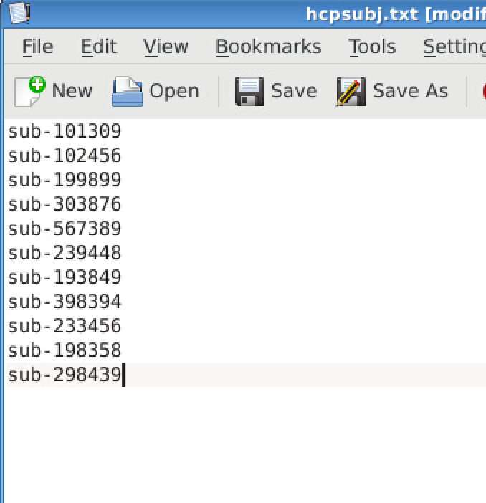
Example Subjects Text File
Make your text file using the Kwrite application
Subjects should be listed as they appear in the rawdata folder
i.e. sub-01
Subjects should be on separate lines
Do not list all the subjects on one line as sub-01, sub-02, sub-03 etc
The number of lines in your subject list is the amount of array jobs you will be running
This should match the number in array=

Slide 14
Running MRIQC: Group
#!/bin/bash
#SBATCH -N 1
#SBATCH -c 2
#SBATCH --mem-per-cpu=24G
#SBATCH --time 00:30:00
#SBATCH -J mriqc
#SBATCH --output /gpfs/scratch/%u/mriqc-log%A_%a.out
#---------CONFIGURE THESE VARIABLES--------------------
mkdir -p /tmp/$SLURM_JOB_ID
bids_root=/gpfs/data/<pathtostudyfolder> #the study folder
nthreads=2
mem=24 #gb
#---------END OF VARIABLES----------------------------
#--------------------RUN MRIQC-------------------------
singularity run --cleanenv \
--bind ${bids_root}:/data \
--bind /tmp/$SLURM_JOB_ID:/scratch \
/gpfs/data/bnc/simgs/nipreps/mriqc-latest.sif \
/data/rawdata \
/data/derivatives/mriqc \
group \
--no-sub \
--n_proc $nthreads \
--mem_gb $mem \
--float32 \
--ants-nthreads $nthreads \
-m T1w bold \
-w /scratch/mriqc
After running MRIQC at the individual level you can now run it at the Group level
The changes to the script are
Remove “SBATCH array=1-4”
Remove the “Dictionaries for subject specific variables” section of the script
Remove the Participant label and replace it with group
Enter the following into your command line:
sbatch <scriptname>.sh
Group MRIQC takes around 1-5 minutes to run

Slide 15
Recommendations & Other Flags
#!/bin/bash
#SBATCH -N 1
#SBATCH -c 2
#SBATCH --mem-per-cpu=30G
#SBATCH --time 04:00:00
#SBATCH -J mriqc
#SBATCH --output /gpfs/scratch/%u/mriqc-log%A_%a.out
#SBATCH --array=1
#---------CONFIGURE THESE VARIABLES--------------------
mkdir -p /tmp/$SLURM_JOB_ID
bids_root=/gpfs/data/<pathtostudyfolder> #the study folder
nthreads=2
mem=24 #gb
#---------END OF VARIABLES-----------------------------
#-----DICTIONARIES FOR SUBJECT SPECIFIC VARIABLES------
mriqc="`sed -n ${SLURM_ARRAY_TASK_ID}p subjects.txt`"
echo $mriqc
#--------------------RUN MRIQC-------------------------
singularity run --cleanenv \
--bind ${bids_root}:/data \
--bind /tmp/$SLURM_JOB_ID:/scratch \
/gpfs/data/bnc/simgs/nipreps/mriqc-latest.sif \
/data/rawdata \
/data/derivatives/mriqc_rest \
participant --participant_label $mriqc \
--no-sub \
--n_proc $nthreads \
--mem_gb $mem \
--float32 \
--ants-nthreads $nthreads \
--task-id rest \
-m T1w bold \
-w /scratch/$mriqc
You can run mriqc and specify just one task
i.e. run on just rest or ssrt tasks
Add the flag --task-id <taskname>
Recommend running mriqc separately for each and having the output go into a separate task-specific folder
i.e. mriqc_rest
When the group report is run it bunches all the bold scans together in the output box plots
Running mriqc separately for each task allows you to look at the IQMs for each task individually
Check to make sure you are running the latest version of mriqc
/gpfs/data/bnc/simgs/nipreps/ mriqc-latest.sif

Slide 16
How To Check The Status of Your Job pt. 1
Enter myq into the command line -- Will show you your job ID and if your job is pending or running
In the above example (circled in green) the JobID is 2034569_1 -- the 1 denoting what number array it is -- and the job is running normally

Slide 17
How To Check The Status of Your Job pt. 2
Once running, enter the below commands to follow along with the progress or the second to check for errors/job failure
tail -f ~/scratch/mriqc-log<jobid>.out → shows the last lines of the log output and updates as MRIQC continues to run – you will be able to see if an error occurs as it happens
OR
cat ~/scratch/mriqc-log<jobid>.out → shows the entirety of the log output and does not continue to update, allows you to scan entire log for warnings/errors

Slide 18
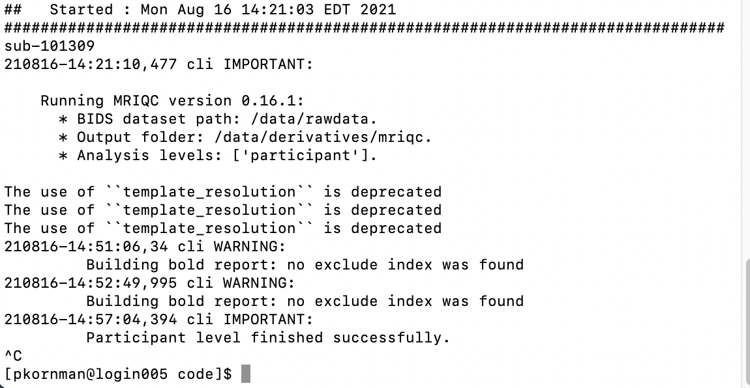
How to tell if MRIQC ran successfully
The following output indicates that MRIQC is done running
There may be lag time between the participant finishing and its files being shown in the output folder → If it seems to be taking a while exit out of and restart your CCV session
The outputs “The use of ‘ ‘template_resolution’ ‘ is deprecated” and “Building bold report: no exclude index was found” indicate that MRIQC is running as it should. The amount of them that show up depends on the number of images you are using
Entering “control c” into your terminal returns your command line to normal but does not kill any jobs that are running

Slide 19
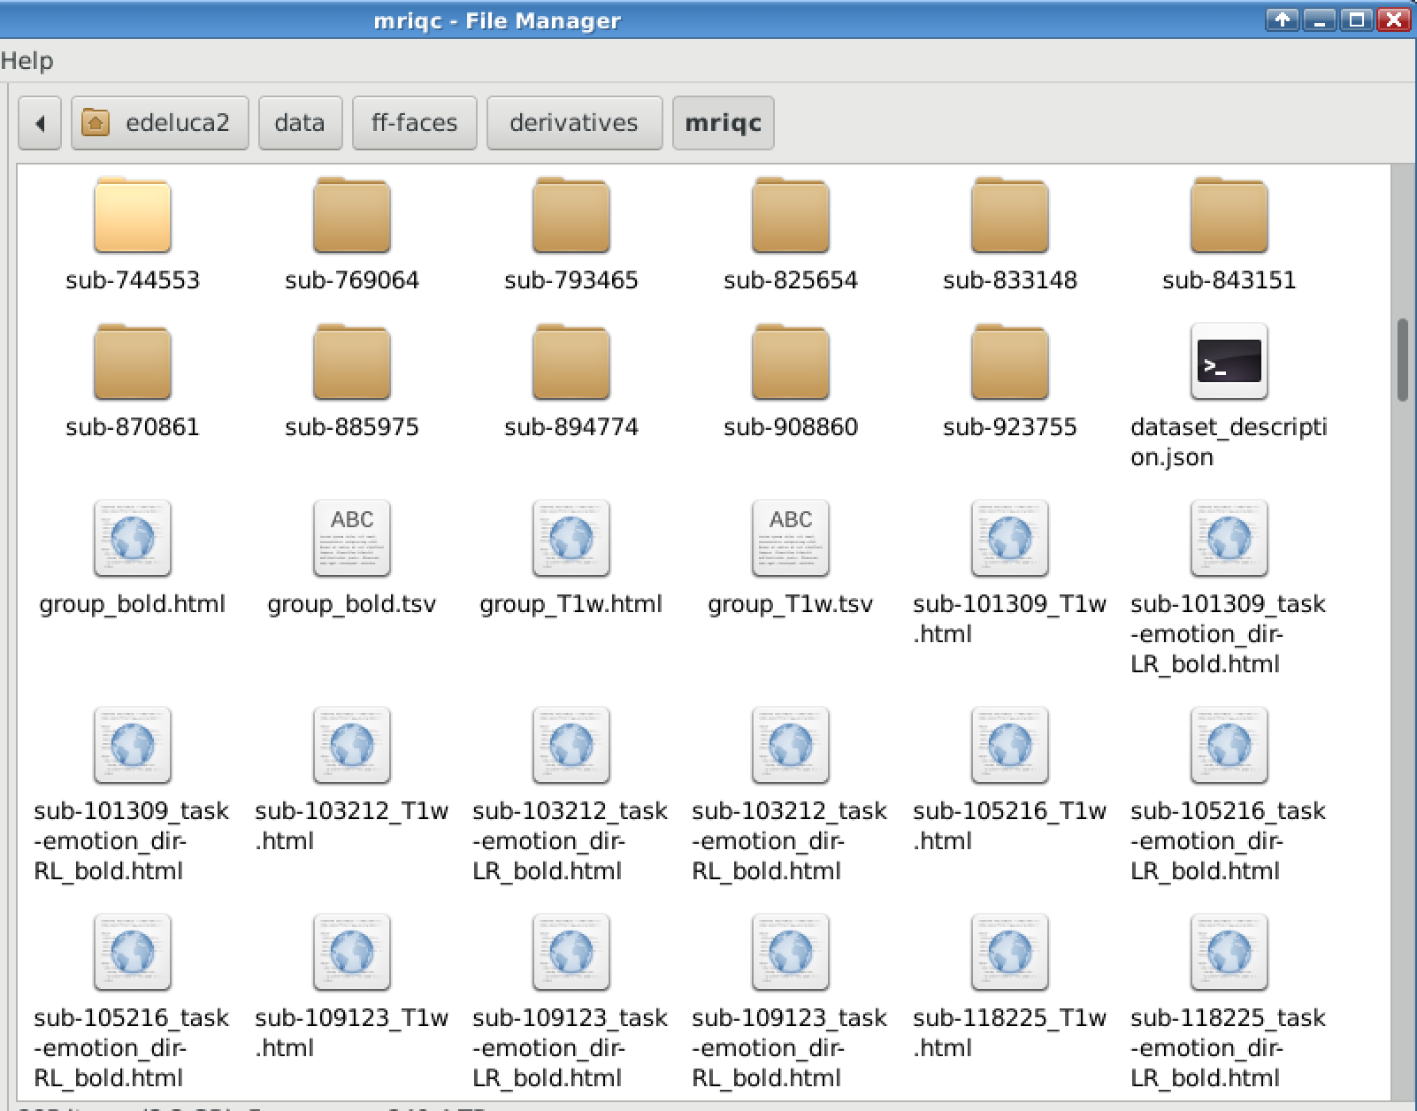
Where to find MRIQC Output Files
After running the Individual Level MRIQC will output:
Subject folders containing .json files
.html files for each type of scan run (T1w, T2w, Bold) for each subject -- located outside of the subject folders
After running the Group Level MRIQC will output
.html and .tsv files for each type of scan
See the tutorial MRIQC PT4: Interpreting Results for more info
These will be located in:
/gpfs/data/<studydir>/derivatives/mriqc

Slide 20
How to Run MRIQC
Locally with docker

Slide 21
Running MRIQC
Will need to put data into BIDS format to run it
See BIDS I & II powerpoints or here for help
Can run MRIQC at the participant level and group level
Running MRIQC at the participant level generates:
A summary .json file for each subject in the bids-root folder
Individual reports with mosaic views of a number of cutting planes and supporting information
Summary section, visual reports, and metadata for T1w & T2w images and BOLD images
Running MRIQC at the group level generates:
Scatter plots for each of the IQMs so that outliers are easily identified
One set for structural IQMs and another for functional

Slide 22
Running MRIQC: Individual pt. 1
Make sure docker is installed, running, and the memory is set to 16 GB
Use mkdir to make a directory titled derivatives in your data folder
Then make subfolder titled mriqc or qa
Open a terminal window
cd to your new mriqc / qa directory
Type the following command:
This will run ALL subjects for ALL sessions in your BIDS directory - at the individual level
docker run -it --rm -v /path/to/bids/directory:/data:ro -v /path/to/qa/output:/out nipreps/mriqc:latest /data /out participant --no-sub

Slide 23
Running MRIQC: Individual pt. 2
If you want to run one subject, a few subjects, or a subject(s) and a particular session, you can do the following:
Type the following command:
These changes indicate that you are now running mriqc for subjects 1001, 1002, and 1003 for only session 01.
docker run -it --rm -v /path/to/bids/directory:/data:ro -v /path/to/qa/output:/out nipreps/mriqc:latest /data /out participant --participant_label 1001 1002 1003 --session-id 01 --no-sub

Slide 24
Running MRIQC: Group
After running MRIQC at the individual level you can now run it at the Group level
Group MRIQC takes around 1 minute to run
docker run -it --rm -v /path/to/bids/directory:/data:ro -v /path/to/qa/output:/out nipreps/mriqc:latest /data /out group --no-sub

Slide 25
How to tell if MRIQC ran successfully
The following output indicates that MRIQC is done running
There may be lag time between the participant finishing and its files being shown in the output folder
The outputs “The use of ‘ ‘template_resolution’ ‘ is deprecated” and “Building bold report: no exclude index was found” indicate that MRIQC is running as it should. The amount of them that show up depends on the number of images you are using

Slide 26
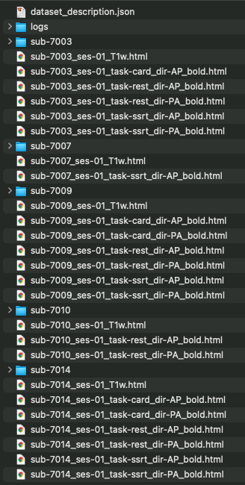
MRIQC Output Files
After running the Individual Level MRIQC will output:
Subject folders containing .json files
.html files for each type of scan run (T1w, T2w, Bold) for each subject -- located outside of the subject folders
After running the Group Level MRIQC will output
.html and .tsv files for each type of scan
These will be located in:
<studydir>/derivatives/mriqc

Slide 27
Helpful Links
https://mriqc.readthedocs.io/en/stable/about.html
https://rpubs.com/sarenseeley/bids-fmriprep-mriqc

Slide 28
References
Esteban, O., Birman, D., Schaer, M., Koyejo, O. O., Poldrack, R. A., & Gorgolewski, K. J. (2017). MRIQC: Advancing the automatic prediction of image quality in MRI from unseen sites. PLOS ONE, 12(9). https://doi.org/10.1371/journal.pone.0184661
Jarrahi, B., & Mackey, S. (2018). Characterizing the effects of MR image quality metrics on intrinsic connectivity brain networks: A multivariate approach. Annual International Conference of the IEEE Engineering in Medicine and Biology Society. IEEE Engineering in Medicine and Biology Society. Annual International Conference, 2018, 1041–1045. https://doi.org/10.1109/EMBC.2018.8512478

