Slide 1
Strategies to Promote Implementation of Standardized Assessments in Stroke Rehabilitation
Lisa A. Juckett, PhD, OTR/L, CHT
Applied LeaRRning Case

Slide 2
Acknowledgements
American Occupational Therapy Foundation
Implementation Research Grant (#AOTFIR21JUCKETT)
Lauren Wengerd, PhD, OTR/L
Meredith Banhos, PT, DPT
Amy Darragh, PhD, OTR/L, FAOTA
The Ohio State University Wexner Medical Center
Occupational therapy department
Physical therapy department
Administrative leadership
Notes:
FIRST

Slide 3
Goals of Applied LeaRRning Case
This case presentation will:
Demonstrate how to identify a problem of interest to occupational therapy practitioners in stroke rehabilitation
Provide tools to elucidate (a) factors influencing the problem and (b) strategies to address these factors

Slide 4
Background
Stroke
Leading cause of long-term disability
80% of stroke survivors have upper extremity impairments
Standardized assessment use is as low as 2.5%
Every 40 sec, an adult in the U.S. has a stroke
Fugl-Meyer Assessment-UE: 5.0%
Action Research Arm Test: 2.5%
Notes:
SOME BACKGROUND
NUMBER OF STROKE SURVIVORS WILL RISE

Slide 5
Notes:
6 months
50 YARDS AWAY
BECAUSE NOW BARRIERS

Slide 6
Implementation STrategies for Outcome Measurement (I-STROM)
Purpose: To increase practitioners’ adoption of the Fugl-Meyer Assessment-UE and the Action Research Arm Test across the stroke care continuum
Occupational therapy practitioners
Acute, inpatient, outpatient @ OSUWMC

Slide 7
Step #1: Conduct a needs assessment
Notes:
THIS IS MORE OF A TRADITION IMPLEMENTATION STUDY DESIGN

Slide 8
Major implementation barriers
Access to knowledge & information
Networks & communication
Implementation culture
Juckett, L. A., Wengerd, L. R., Faieta, J., & Griffin, C. E. (2020). Evidence-based practice implementation in stroke rehabilitation: A scoping review of barriers and facilitators. The American Journal of Occupational Therapy, 74(1), 7401205050p1-7401205050p14. https://doi.org/10.5014/ajot.2020.035485
Notes:
THERE ARE SEVERAL WAYS TO ASSESS IMPLEMENTATION DETERMINANTS
MY COLLEAGUES AND I CONDUCTED

Slide 9
Implementation science influences
Notes:
I FOUND IT INTERESTING
MAKE COMPARISONS

Slide 10
Step #2: Select and tailor implementation strategies
Notes:
THIS IS MORE OF A TRADITION IMPLEMENTATION STUDY DESIGN

Slide 11
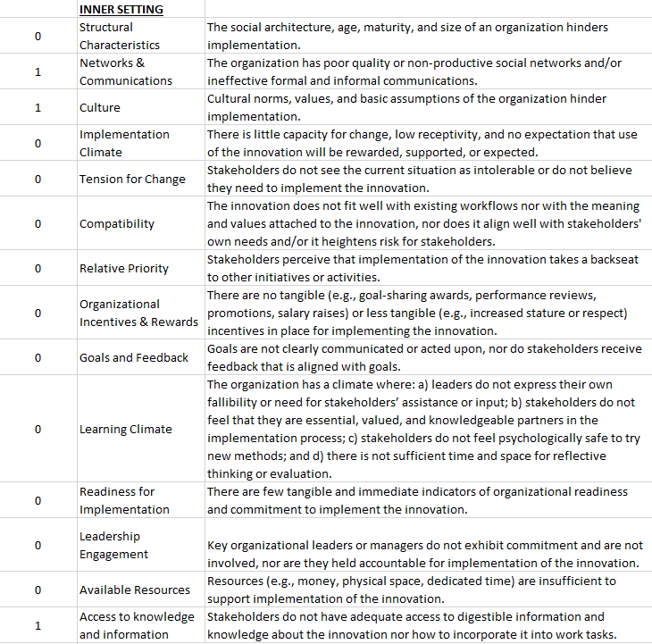
CFIR technical assistance site (https://cfirguide.org)
CFIR-ERIC matching tool
Notes:
IN IMPLEMENTATION RESEARCH, I OFTEN PULL FROM MULTIPLE FRAMEWORKS
CFIR
CFIR TO ERIC MATCHING TOOL
EXPERT INPUT
EXCEL

Slide 12
CFIR-ERIC matching tool: Output

Slide 13
Focus group data + key informant insights
Implementation strategies
Conduct educational meetings
Prepare champions
Create learning collaboratives
Implementation strategies
Develop web-based educational materials
Change physical structure and equipment
Change record systems
Notes:
FROM THERE, WE HAVE STARTED TO COLLECT
UNSURPRISINGLY THERE’S HETEROGENEITY ACROSS SETTINGS

Slide 14
Step #3: Deploy implementation strategies
Notes:
THIS IS MORE OF A TRADITION IMPLEMENTATION STUDY DESIGN

Slide 15
Strategy timeline
Prepare champions: Aug 2021 – Dec 2021
Change record systems: Aug 2021 – present
Develop web-based training materials: Dec 2021 – Mar 2022
Change physical structure and equipment: Mar – Apr 2022
Conduct educational meetings: Mar 2022 – Apr 2022
Create learning collaboratives: In process
American Occupational Therapy Foundation, Implementation Research Grant #AOTFIR21JUCKETT

Slide 16
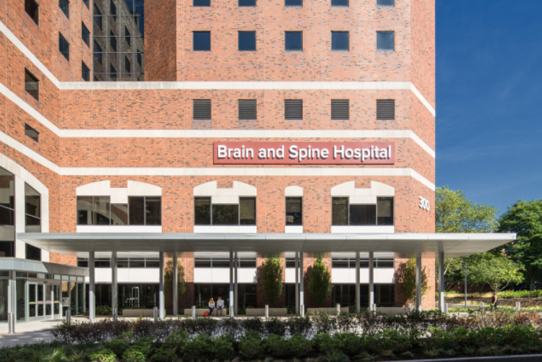
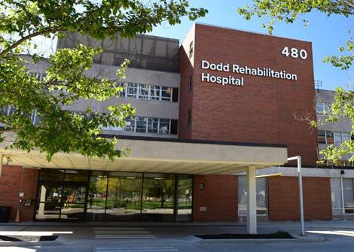
Prepare champions: Aug 2021 – Dec 2021
Acute care
Inpatient
Outpatient

Slide 17
Change record systems: Aug 2021 – present
Notes:
IHIS

Slide 18
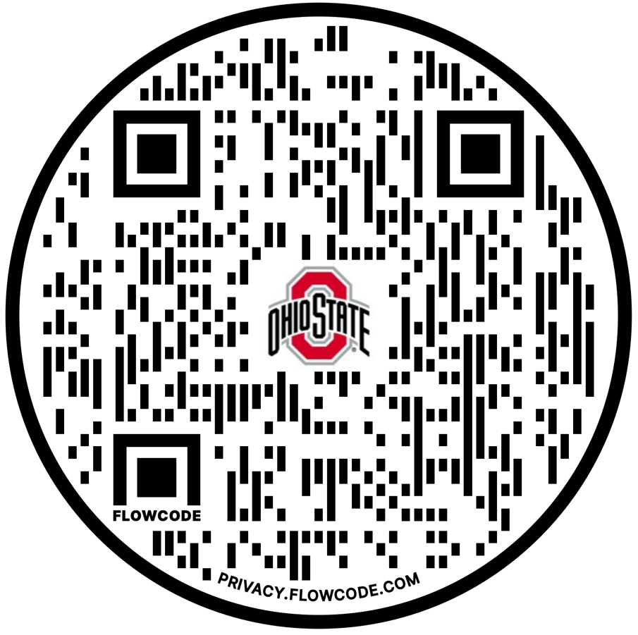
Develop web-based training materials: Dec 2021 – Mar 2022
Fugl-Meyer Assessment
Action Research Arm Test
Notes:
Actual e-manuals not ready for dissemination

Slide 19
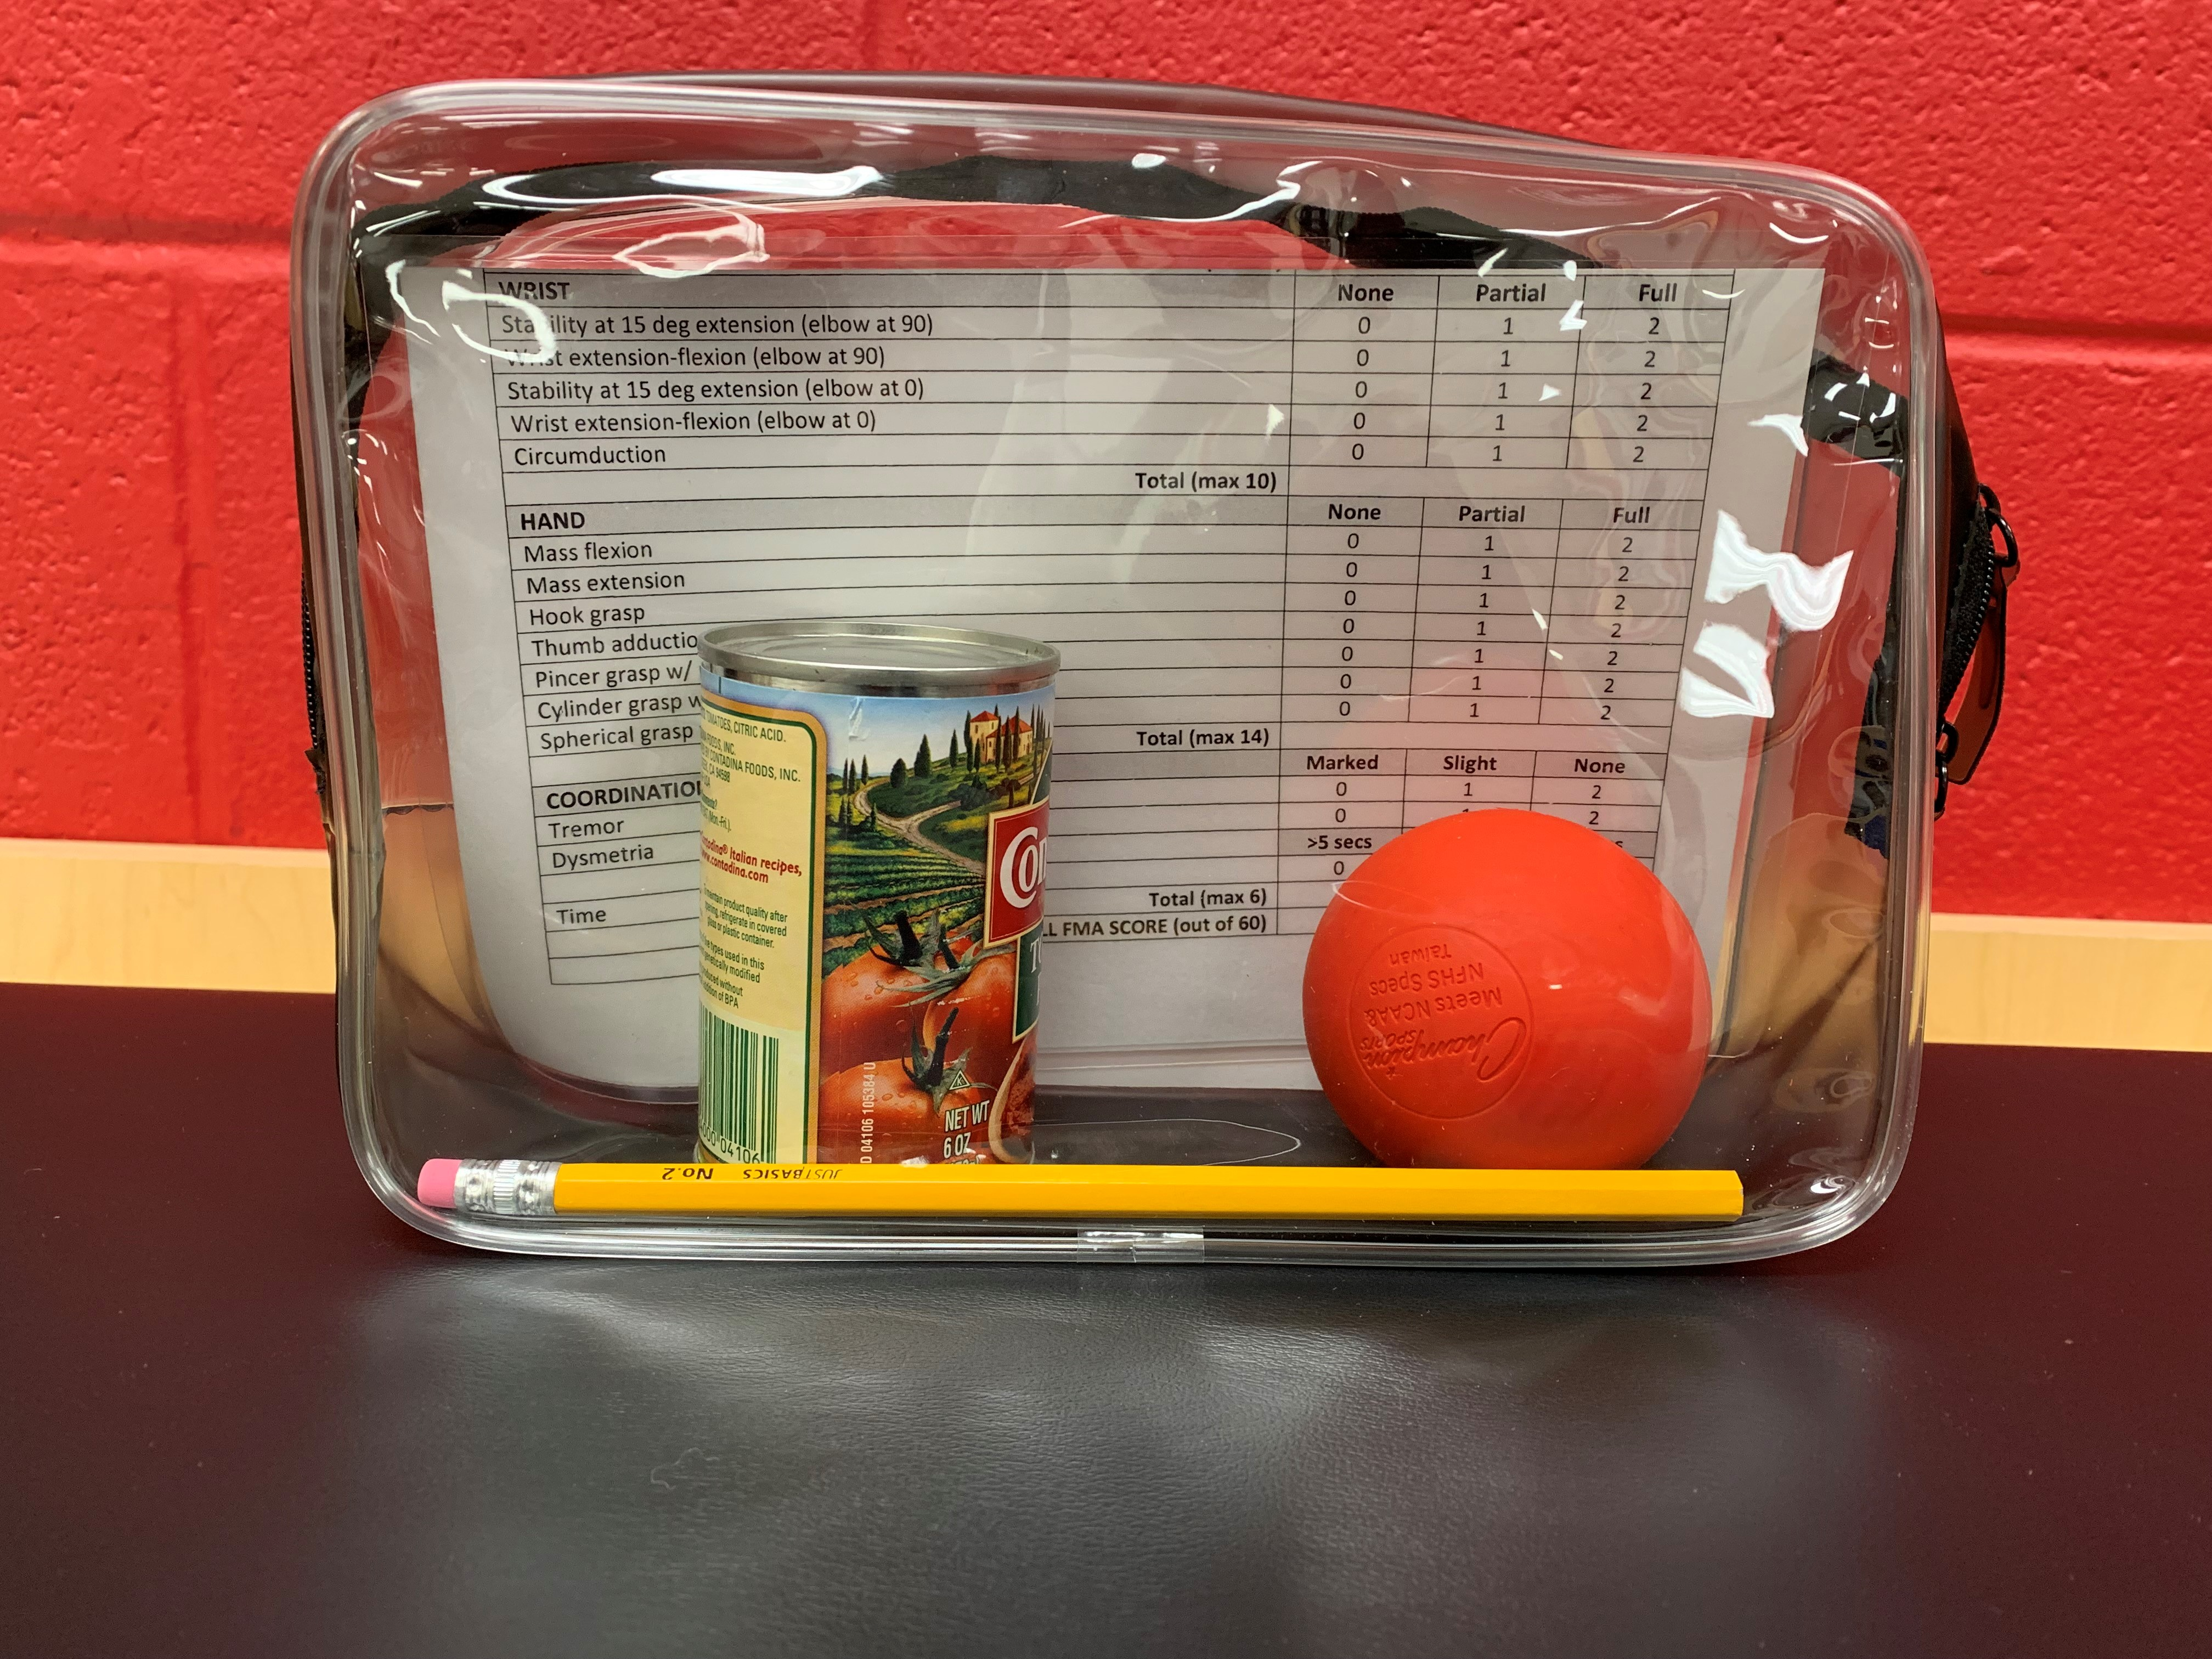
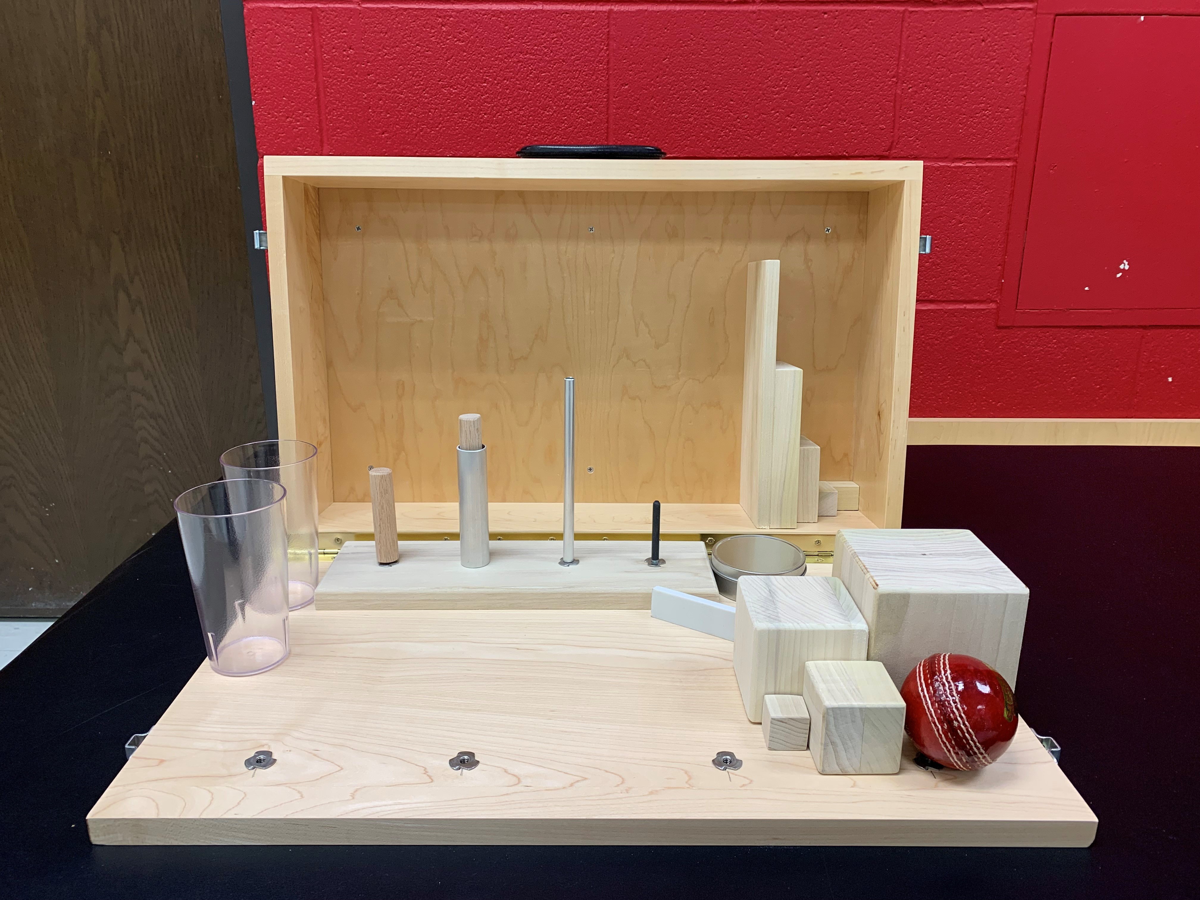
Change physical structure and equipment: Mar – Apr 2022
Acute care: Individual Fugl-Meyer kits
Inpatient: Three Fugl-Meyer kits; one ARAT kit
Outpatient: Individual Fugl-Meyer kits; one ARAT kit (three sites)

Slide 20
Conduct educational meetings: Mar 2022 – Apr 2022
Acute care (n = 8)
Inpatient (n = 10)
Outpatient (n = 8)

Slide 21
Step #4: Evaluate strategies
Notes:
THIS IS MORE OF A TRADITION IMPLEMENTATION STUDY DESIGN

Slide 22
Baseline Fugl-Meyer and ARAT use from July 2020 – June 2021
Fugl-Meyer: 3.5%
ARAT: Not implemented
Goal by August 2023: 85%
Monthly chart audits to monitor changes in assessment use
Continue audits through end of grant period (Aug 2023)
Late spring 2023: Conduct nationwide survey to assess feasibility of deploying I-STROM strategies in other rehabilitation settings

Slide 23
THANK YOU!
Questions: lisa.juckett@osumc.edu
Notes:
Thank you again for tuning in and I look forward to transitioning to our discussion time together.

