Slide 1
LeaRRn Pilot Human Subjects Research Flowchart
Is the study considered Human Subjects Research based on the Decision Tool and this application guide?
YES
Is the study non-exempt?
Check “No” to Human Subjects.
Include an attachment to describe their proposed project and how it meets the criteria for non-Human Subjects Research
Do not complete the PHS Human Subjects and Clinical Trials Information form
NO
YES
Is the study a clinical trial?
Is the answer to all of these questions “Yes”?
1.4.a. Does the study involve human participants? Yes/No
1.4.b. Are the participants prospectively assigned to an intervention? Yes/No
1.4.c. Is the study designed to evaluate the effect of the intervention on the participants? Yes/No
1.4.d. Is the effect that will be evaluated a health-related biomedical or behavioral outcome? Yes/No
The study is exempt.
Identify the exemption number or use the number provided by the Decision Tool
Complete the PHS Human Subjects and Clinical Trials Information form* for this study
Provide separate documents for required attachments, e.g. Inclusion of Women and Minorities, etc. following the Application Instructions
In the Protection of Human Subjects Attachment, provide justification for the exemption with category.
Email information to: learnrehabnetwork@gmail.com
NO
YES
The study meets the definition of a clinical trial.
Complete the PHS Human Subjects and Clinical Trials Information form* for this study and register as a clinical trial with clinicaltrials.gov
Provide separate documents for required attachments, e.g. Inclusion of Women and Minorities, etc. following the Application Instructions
The information will undergo a risk assessment by a NICHD Program Officer (risk level determines reporting frequency)
Follow all NIH clinical trial policies
If the answer to any question was “No,” the study does not meet the definition of a clinical trial.
Complete the PHS Human Subjects and Clinical Trials Information form* for this study
Provide separate documents for required attachments, e.g. Inclusion of Women and Minorities, etc. following the Application Instructions
NO
Underlined text is hyperlinked to source documents.
*Please see the next page for resources on completing the PHS Human Subjects and Clinical Trials Information Form

Slide 2
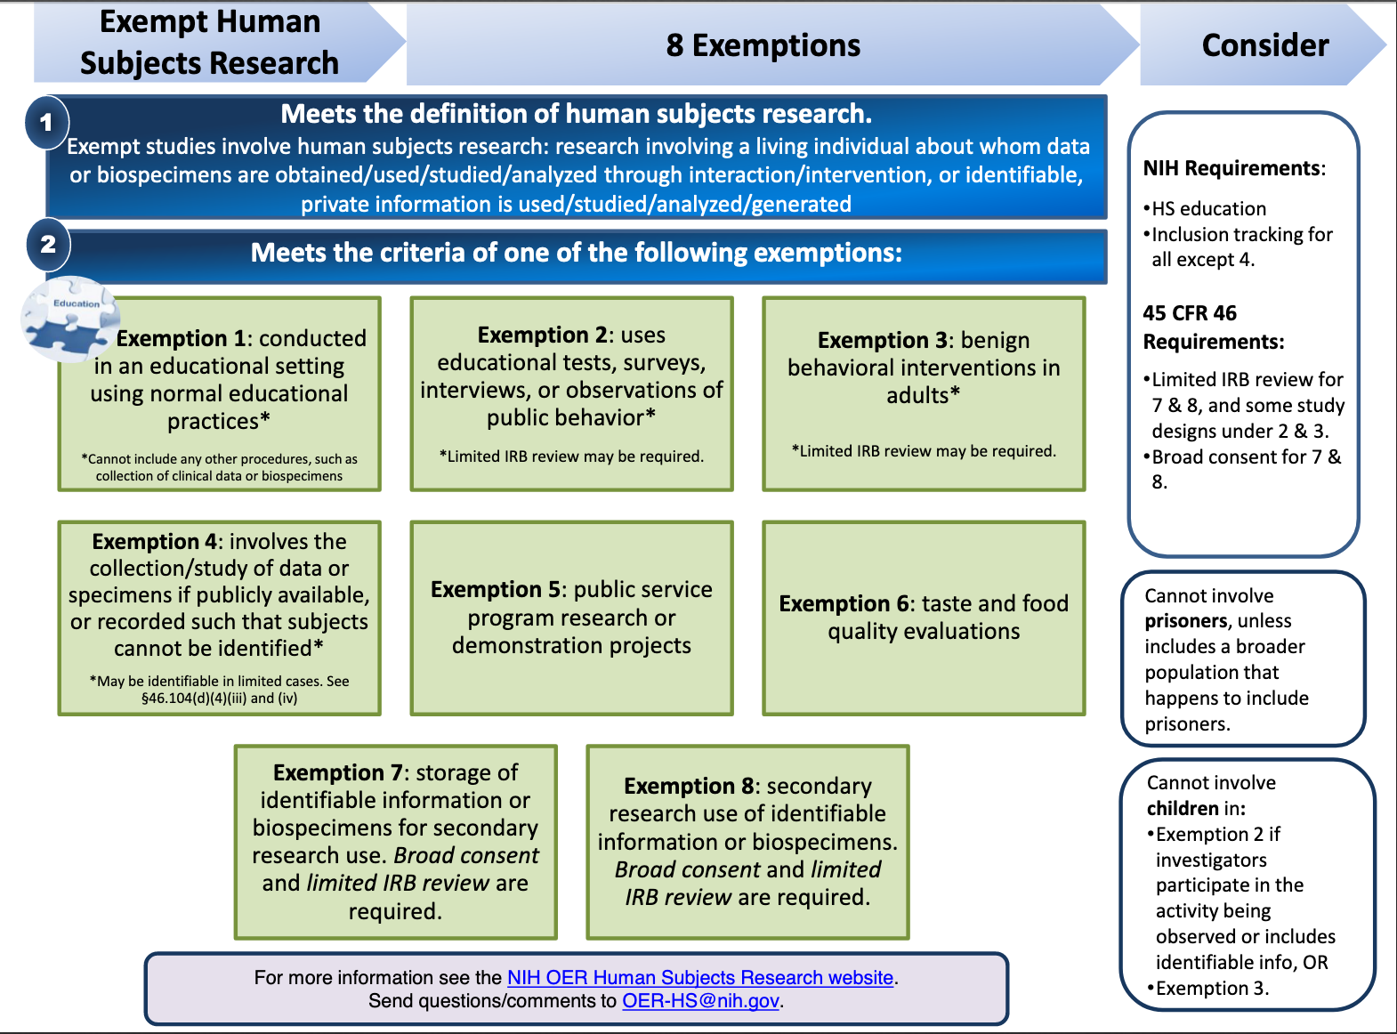
Resources for completing the PHS Human Subjects and Clinical Trials Information form
NIH’s “All About Grants” podcast provides more information about Human Subjects Research and exemptions and can be found here.
If you answered “Yes” to the question “Are Human Subjects Involved?” on the R&R Other Project Information form, you must include at least one human subjects study record using the Study Record: PHS Human Subjects and Clinical Trials Information form.
Provide separate documents for required attachments, e.g. Inclusion of Women and Minorities, etc. following the Application Instructions
How to Complete the Form:
Take a video tour of the form
Use the NIH Annotated Form Sets for quick reference
Follow all Application Instructions carefully

Slide 3
2019 Update on Exemption 4
The regulation states that Exemption #4 can be applied to identifiable data as long as:
"(iii) The research involves only information collection and analysis involving the investigator's use of identifiable health information when that use is regulated under 45 CFR parts 160 and 164, subparts A and E, for the purposes of “health care operations” or “research” as those terms are defined at 45 CFR 164.501 or for “public health activities and purposes” as described under 45 CFR 164.512(b);"
Identifiable data that is not publicly available can be used as long as certain criteria are met.
Basically, research using private identifiable data can be exempt if it is/was collected by a HIPAA covered entity and is not linked to any identifiable person level data that is not HIPAA protected. For example, nursing home EMR data or hospital EMR data can be linked to CMS data under this exemption.

