Slide 1
Associations and Collocations in Corpora
Václav Cvrček, Charles University (vaclav.cvrcek@ff.cuni.cz)
Masako Fidler, Brown University (masako_fidler@brown.edu)
Slovko 2023, October 20
Bratislava
This study was supported by the NPO Systemic Risk Institute (SYRI) number LX22NPO5101, funded by European Union - Next Generation EU (Ministry of Education, Youth and Sports, NPO: EXCELES) and resulted from the implementation of the Czech National Corpus project (LM2023044) funded by the Ministry of Education, Youth and Sports of the Czech Republic within the framework of Large Research, Development and Innovation Infrastructures.
Notes:
Relationship between East West

Slide 2
Our questions and our suspicions
What do we mean by “discourse of X” (discourse of racism, discourse of migration...)?
Frequently used methodology to study “discourse of X”: keywords + collocation analysis
(cf. Partington & Duguid 2013:307, 315; Heritage & Baker 2022: 443; Philip 2011: 26, 64)
Hypothesis: collocations might not provide a complete picture, esp. in contrast to Market Basket Analysis (Cvrček and Fidler 2022).
Notes:
VC

Slide 3
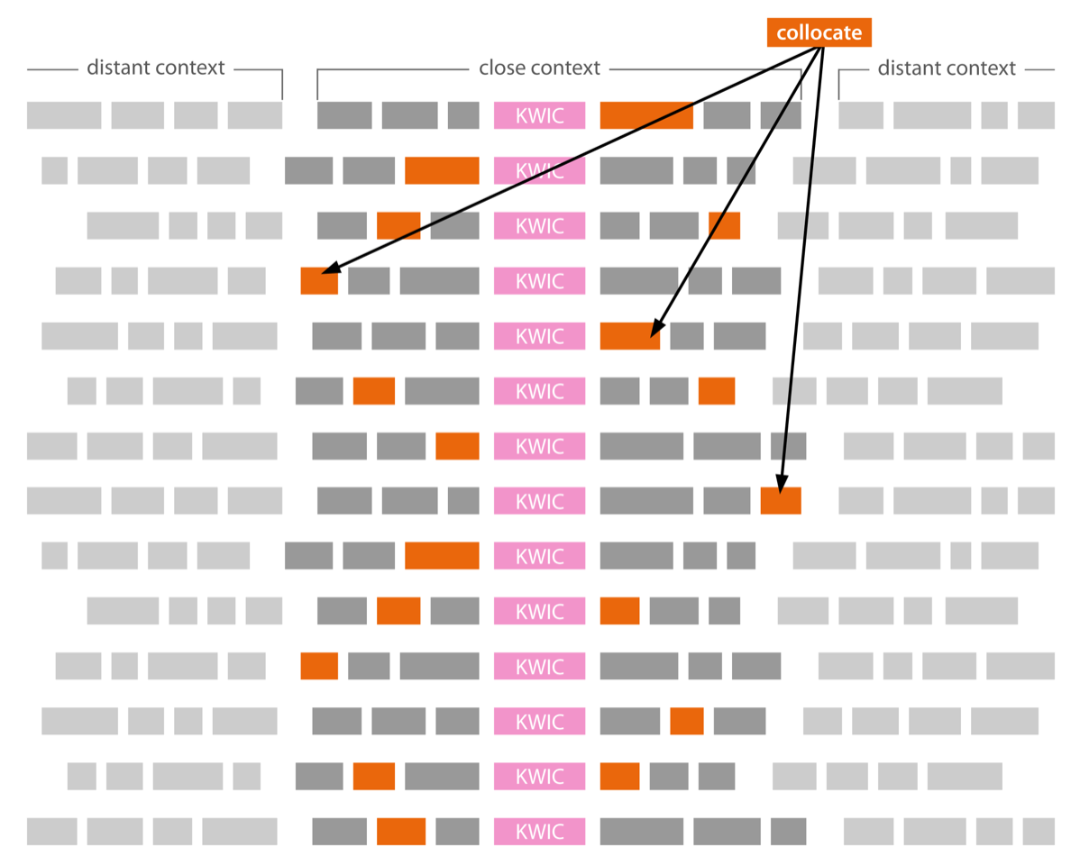
Collocations
Valuable for description of:
meaning and usage (dictionaries)
typical (close) context
...but are they reliable for:
extracting associations of a KW in discourse?
describing discursive frame of a KW?
CA suggests:
the most prototypical use of the seed word (in what sense or syntactic constructions it is likely to be used)

Slide 4
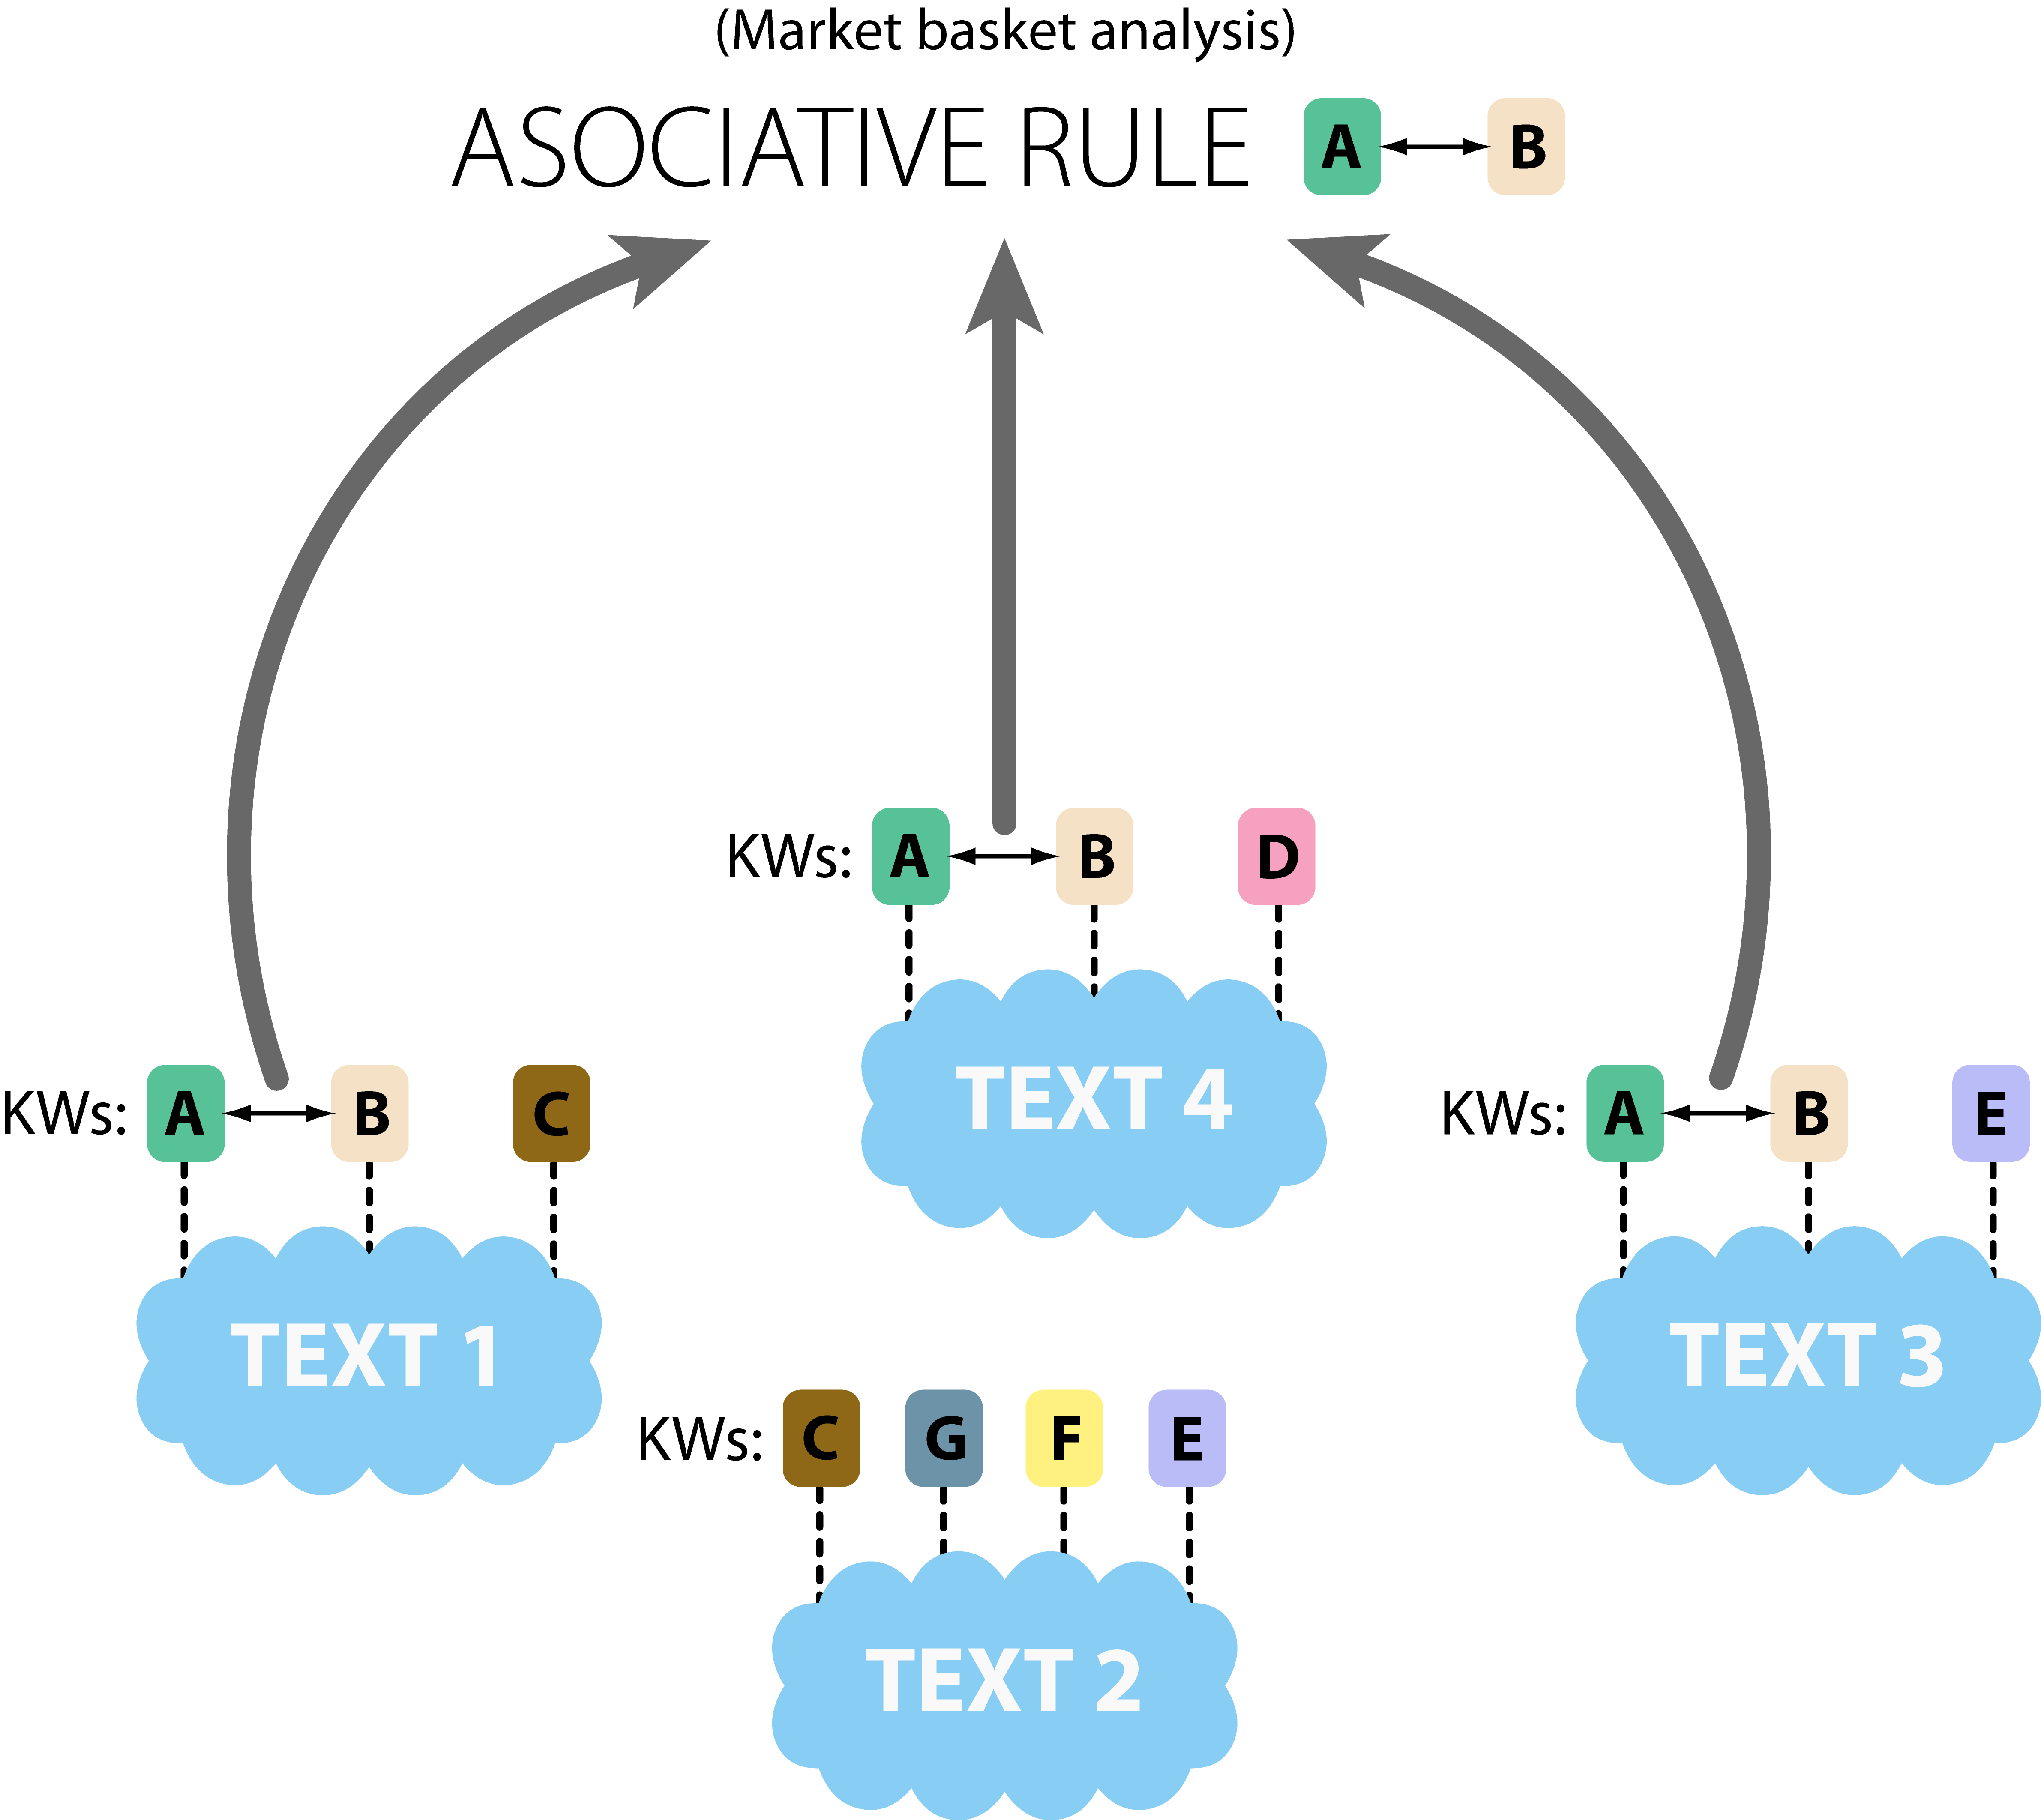
Market basket analysis (MBA)
recurring co-occurrence of KWs
synchronic
Evaluation:
Support – proportion of texts containing A and B; range of uses
Confidence – conditional probability p(A|B); systematic co-occurrence
Lift – strength of association

Slide 5
MBA outputs
A) Associative rule
illegal → migrant
asylum, country → migrant
European, migration → migrant
European, border → migrant
…
B) Associative array (frame)
Migrant: illegal, asylum, country, European, migration, border, … member, law, union, refugee
(Data source: Czech anti-system media 6–9/2020)
Associative arrays suggest:
The set of KWs that are most likely connected to the seed KW in the target corpus

Slide 6
Hypothesis: what we might learn from CA and MBA
CA suggests the prototypical syntactic/semantic properties of a seed word
Semantic connection between a seed word and the immediate context
Syntactic connection where the seed word is most likely its part (this may not be part of the main conceptual network within the entire text)
MBA suggests the prototypical conceptual network within the discourse to which a seed word belongs
MBA helps characterize the frame of the seed
Notes:
VC The notions of where the domain is and how profiling occurs = they predict what collocation and market basket analysis would show us.

Slide 7
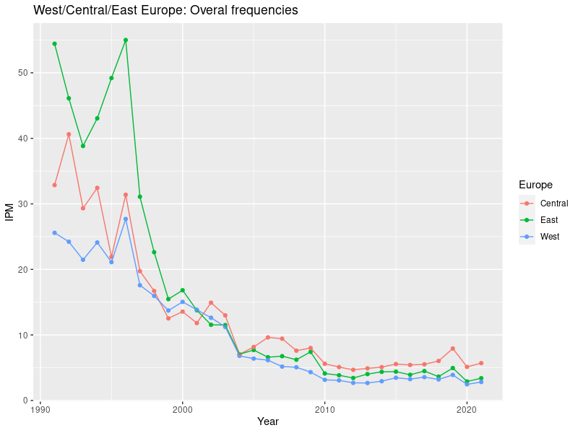
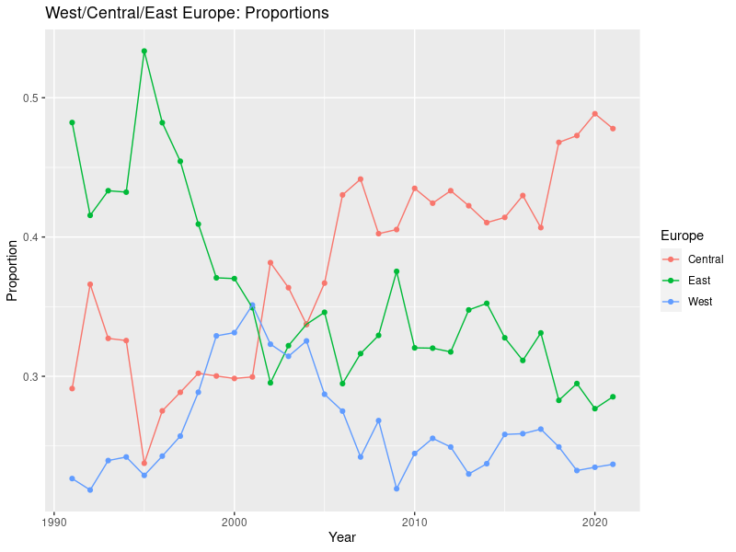
Motivation: West/Central/East Europe?
Normalization per year: each year represented by the same amount of text.
Normalization per lemma: each year is represented by the same number of occurrences of “Europe”.
Source: SYNv11, nationwide newspapers (HN, LN, MfD, Právo)
Notes:
VC
Interpretations:
On the left we see the ipms (instances per million). It shows that the Czech nationwide press tends to speak/write about West/East/Central Europe less than we used to in the 90s.
On the right we can see the changes in proportions of the phrases (West/East/Central Europe), each year is represented by the same number of occurrences.
====>
In the 90s we were more interested in East Europe, currently the most used is Central Europe. At the same time, the central Europeanness might no longer be so associated with Eastern of Western Europe, but as an entity on its own right.

Slide 8
Data
Target corpus: Printed state-wide newspaper articles 1996 vs. 2021 (SYNv11, Křen et al. 2022); approx. 190K or 116K texts/articles
Reference corpus: newspaper articles from 1997 + 2020
Seed KWs: [lemma=”[Vv]ýchod”] and [lemma=“[Zz]ápad”]
Collocations within the span (-3; +3), sorted via LogDice
Prototypical+ CA: top 100 lemmas, min fq. 5 in corpus
Extended CA: more lemmas added to adjust the number of results to match those of MBA (min fq 3)
Associations (MBA support: 0.0001, confidence: 0.2) → associative arrays (AAs)
Notes:
VC
1. úplnou (šedivě) - kde je počet kolokátů podle toho, kolik bylo asociací; limit pro min fq in corpus je zde 3
2. top100 (černě) - kde bereme těch 100 nejvýznamnějších kolokátů podle logDice; u top100 jsem zvýšil limit min fq in corpus na 5
To, co není v top100 je v tabulkách šedivě.
Prototypical+ CA: Lemmas noted in black: min fq. 5 in corpus, 100 lemmas to match the results from MBA
Extended version of CA: Lemmas noted in gray: more lemmas added to adjust the number of results to match those of MBA (min fq 3)
Support of 0.0001 represents minimum of 12 texts in 2021 and 20 texts in 1996.

Slide 9
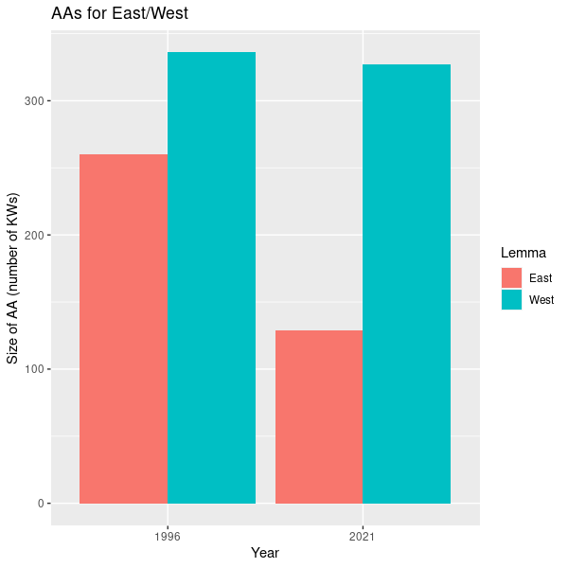
An overview of Associative Arrays in (1996 vs. 2021)
The relative gap between East and West becomes bigger in 2021 than in 1996.
Number of extracted collocations is set to match these numbers (overall as well as within subcategories)

Slide 10
What we looked for: how MBA and CA reflect changing discourse in 1996 and 2021.
the associations/collocates that are unique for the method in each year.
we attempted to group together those associations/collocates that point to a more general rubric (e.g. economy, relation to other countries, weather)
Notes:
VC

Slide 11
Differences in number of associated items
Group | Associations | Collocations
Domestic regions/towns | 21 | 32
Economy and industry | 65 | 54
Function words | 72 | 32
Geographic terms | 27 | 54
Migration | 1 | 11
Modal words | 18 | 0
We (Czechs) vs. they | 32 | 10
Numbers and quantification | 35 | 10
Politics and power | 85 | 29
Proper nouns | 15 | 63
Time related expressions | 44 | 7
Weather | 13 | 38
Total number of associated lemmas: 1210
Lemmas were assigned semantic categories (792):
words of thinking, words of speaking, culture & religion, domestic, economy, evaluation, foreign, function words, geography, journalism, migration, modal words, we vs. they, numbers, politics, proper nouns, Russia, security, sport, time & history, USA, weather
Differences tested by prop.test (test of proportions, chi2) on the level of 0.05 (significant results in red)

Slide 12
MBA vs. CA: West + economic concerns
West | Associations | both | Collocation
1996 | bohatý, drahý, ekonomický, ekonomika, firma, hodnota, hospodářský, chudý, investice, investiční, kapitál, levný, měnový, mzda, obchod, podnikatel, podpora, podporovat, privatizace, průmyslový, technologie, trh | vývoz | dohánění, dohánět, dovážet, export, konjunktura, korporace, poptávka, prosperující, recese, ropa, stagnace, vyvážet
2021 | ekonomika, firma, hodnota, kapitalismus, podpora, podpořit, růst, sektor, technologie, trh | ekonomický, sankce, technologický | bohatý, dohánění, dohánět, dohnat, expanze, konvergence, podporovaný, podporovat, prosperita, průmyslový, rozvojový, supermarket, vyrobený, vývoz
Notes:
MBA
More comprehensive information about the transition economy in 1996
Investment (investice, investiční), support (podpora, podporovat), technology (technologie), business, privatization, the rich and poor, the need for a capital, trade (obchod) wages (mzda) - differences
The much larger number of lemmas in 1996 and 2021 suggest interest and concern about transition economy in the 1990s.
CA, in contrast, indicates fewer aspects of transition economy. Moreover, these lemmas suggest syntactic connections involving the west.
The lemmas are about catching up with the west, stagnation of the west, import-export (dovážet, vyvážet) from and to the west, prosperity (konjuktura) of the west, successful west (properující), corporations from the west.
CA vs. MBA: It is the difference between how we speak/spoke about the West (the former) and what we associate it with (the latter).

Slide 13
MBA vs. CA: East + economic concerns
East | Associations | both | Collocation
1996 | auto, banka, drahý, ekonomika, finance, firma, investice, investiční, kapitál, koncern, koruna, manažer, marka, obchod, podnik, podnikatel, podporovat, prodej, průmyslový, růst, šéf, trh, USD, výrobní, zboží | ekonomický, hospodářský, levný, vývoz | boom, dohánět, expandovat, expanze, export, chudý, konkurence, plynárenský, ropa, rozvoj
2021 | ekonomický |  | dovážet, expanze, levný
Notes:
MUF
MBA
growth, foreign currencies, investments, sale – capturing more aspects of transition economy than CA.
The difference between 1996 and 2021 is more dramatic in MBA than in in CA.
CA
The lemmas suggest syntactic constructions. Boom in the East, the East catching up (with the West), gas and crude oil from the East, development in the East

Slide 14
MBA vs. CA: Russia-related associations/collocations
West | Associations | both | Collocation
1996 | Rus, ruský, svaz, ukrajinský, Zjuganov | Gorbačov, Jelcin, Jelcinův, Lebeď, Moskva, Rusko, sovětský, SSSR, Ukrajina | Dudajev, Groznyj, Primakov
2021 | Putinův, Rus, svaz, ukrajinský | Bělorusko, běloruský, Kreml, Lukašenko, Moskva, Putin, Rusko, ruský, sovětský, Ukrajina | Kyjev, Lavrov, Navalný, protiruský, Stalin
East | Associations | both | Collocation
1996 | Rus, sovětský, SSSR | Moskva, Rusko, ruský, Ukrajina | Primakov
2021 | Putin, Rusko, sovětský, ukrajinský | Donbas, Moskva, ruský, Ukrajina | Kreml, Krym, Kyjev, proruský, separatista, separatistický, Vladivostok
Notes:
CA:
The lemmas suggest lower-level discourse, i.e. news reporting.
(Navalný, Krym, protiruský, proruský, separatista, separatistický, Groznyj) Dudajev – refer to reporting of specific events (poisoning of Navalný, annexation of Crimea, pro-Russian separatists and anti-Russian stances in Ukraine, Chechnya).
Also symptomatic are two names: Primakov and Lavrov. Both are lower-level officials relative to the president. Primakov was foreign minister in 1996 (a lower level official than the leadership – Jelcin) and Lavrov (foreign minister now). Their actions are subordinate to a larger policy laid out by the Kremlin.
Historical accounts on Stalin’s relationship to the West (history) after 1945 (three instances) are also a smaller part of a larger discourse about Russia.
The lemmas also are often part of syntax with the seed words, e.g. Dudajev pohrozil Západu, Dudajev adresoval Západu první hozbu. Dudajev opohrozil Zapadu od Grozného.
Vladivostok – is mainly about sports e.g. Nižnij Novgorod – Čeljabinsk 5 : 2 ( za hosty 2 góly Sedlák ) , Omsk – Jaroslavl 1 : 4 , Minsk – Chabarovsk 2 : 1 , Riga – Soči 2 : 1 , Podolsk – Petrohrad 6 : 5 po náj . Úterý : Kunlun – Vladivostok 3 : 1 , Dynamo Moskva – Spartak Moskva 6 : 3 . Druhá liga , skupina Jih – 4 . kolo : Kobra – Cheb 5 : 2 .
MBA:
The lemmas suggest a higher level discourse framing. References to the USSR and anti-Western politics (svaz, Zjuganov, sovětský, SSSR and Putin) in MBA (consistent in both 1996 and 2021) suggest permeating view of Russia as acting as an empire still like the USSR in relation to West-East
Pozn. pro nás: Zjuganov he attacked the infiltration of Western ideals into Russian society and portrayed Russia as a great nation that had been dismantled from within by traitors in cahoots with Western capitalists, who sought the dissolution of Soviet power to exploit Russia's boundless resources. (Wikipedia)

Slide 15
MBA vs. CA: weather
West | Associations | both | Collocation
1996 | jasno, mlha, teplota | oblačno, polojasno, přeháňka, studený, vzduch, zataženo | fronta, frontální, chladný, oblačnost, slunce, srážkový, tlak, vlhký, vydatný
2021 | jaro | slunce, studený, tlak | bouřka, fronta, oblačnost, povodeň, vedro, vichřice
East | Associations | both | Collocation
1996 |  |  | frontální, oblačno, oblačnost, polojasno, přeháňka, slunce, studený, teplý, tlakový, vát, vzduch
2021 |  |  | déšť, slunce, studený
Notes:
MUF
1996 was unusually warm year. According to global weather.
Vydatný déšť, vydatné srážky, vydatný liják
(výběžek vyššího) tlaku vzduchu
CA:
Syntax a local level discourse – CA
Part of a short note within a text that covers miscellaneous events, e.g. politics, others.
MBA:
2021 Arab Spring tenth anniversary (2011)
Prague spring concert series
They can occur in a much developed article
Collocation is based on only freq.

Slide 16
Observations
Broader topics | MBA Associations Network of concepts | Collocates Primarily syntactic constraints
Economy | Concerns about transformation in 1996, vs. 2021 (cf. numbers of associations in MBA, showing a denser conceptual network) | Less concerns about economy
Russia | Framing: a consistent narrative of Russia as the former USSR in the East-West relations | Indicate local events with respect to Russia (e.g. Chechnya, East Ukraine, Navalny) in relation to East and West
Weather |  | Much more results than MBA Reflects syntactic constructions (weather and its locations)
 | East-West as geopolitical concepts that frame texts together | East West as geographic locations
Notes:
MUF
Expanze
Geographic location

Slide 17
Conclusions and where to go from here
Collocation analysis and MBA show different scopes of discourse.
Collocates are likely to be motivated by immediate syntactic constructions. CA points to specific situations, but it does not seem to provide a larger conceptual framing than MBA.
MBA results tend to point to the type of text where the seed word is likely to occur.
MBA shows a wider discursive context (framing) in which a word is embedded
Notes:
MUF, VC the cognitive linguistic notions of domain and profile, applied to smaller or larger-discourse areas, predict the type of information that the two analyses provide.
These notions are important in thinking about what it means to study DISCOURSE OF SOMETHING.
On the wish list
Comparison to British broad sheets if possible (suspected: a different conceptualization of West and East from the Czech press )

Slide 18
References
Cvrček, V. and M. Fidler. 2022. No keyword is an island. Corpora. 17(2). 259–290
Partington, A., A. Duguid and C. Tayler. 2013. Patterns and Meaning in Discourse: Theory and Practice in Corpus-Assisted Discourse Studies (CADS). Studies in Corpus Linguistics. John Benjamins.
Heritage, F. and P. Baker 2022. Crime or culture? Representation of Chemsex in the British Press and Magazines Aimed at GBTQ+Men. Critical Discourse Studies 19(4): 435-453. https://doi.org/10.1080/17405904.2021.1910052.
Philip, G. 2011. Colouring Meaning: Collocation and Connotation in Figurative Language. Amserdam/Philadelphia: John Benjamins.

